Slide 1


Solo Power: One-Person libraries and Continuing Professional Development
Special Library Day, Slovenia, 28th May 2026

Slide 2

Talking points
Hello from a one-person librarian!
Research
OPLs and CPD in Ireland
Some ideas for you
HOPE!

Slide 3
A quick hello…
…from a solo librarian and researcher

Slide 4
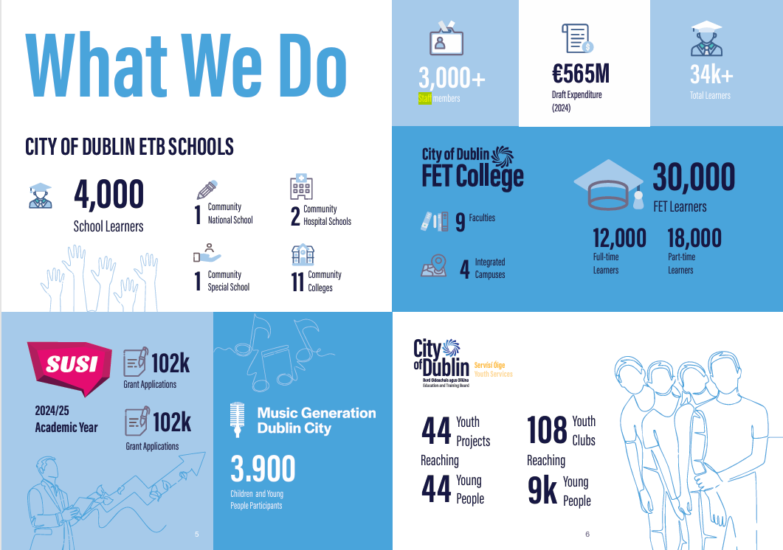
City of Dublin ETB
City of Dublin ETB is the state education and training authority for Dublin city with over 3,000 staff who provide education and training opportunities for over 34,000 people.

Slide 5
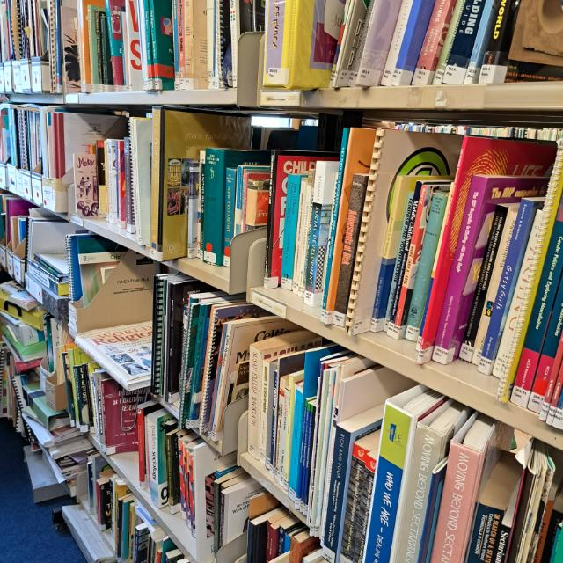
The Curriculum Development Unit library
Special library serving staff (teachers, school managers, administrative staff) working in City of Dublin Education and Training Board: primary and post-primary schools, adult education, youth work, prison education and further education colleges.
Information and research services
Document supply
Social media, Moodle, website

Slide 6
Frustration
…led to research!

Slide 7

Continuing Professional Development (CPD)
PhD research on solo librarians and their perceptions of CPD.
One-person librarians (OPLs) have been rarely studied, yet one in three librarians in the world is a OPL (Siess, 2003)
Continuing professional development (CPD) is central to our role as information providers
Little research into CPD for OPLs, none on their own perceptions of this concept

Slide 8
Research project
Phenomenography: Qualitative in nature, looks at variation within perception of a phenomenon
30 OPLs across Ireland took part in semi-structured interviews (maximum variation sampling)
Research questions:
                What are their conceptions of CPD?
            How do OPLs in Ireland experience different methods of CPD?

Slide 9

Results!

Slide 10

Categories of Description Conceptions of CPD as experienced by OPLs
Category 1: Upskilling for the sake of the organisation/library service (service orientation)
Category 2: Developing as a professional librarian (LIS profession orientation)
Category 3: Helping you to do all the jobs an OPL does (OPL orientation)
Category 4: When you have learned something and you want to do things in a better way when you come back (personal orientation)
Category 5: Your development as a human being (lifelong learning orientation)

Slide 11

Reported CPD activities
Some of these might work for you, too!

Slide 12
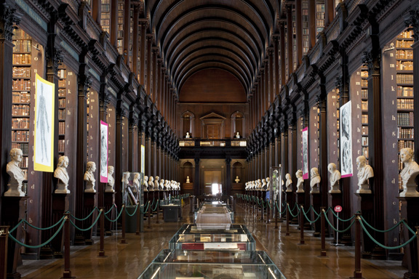
Category 1
Category 1: Service orientation
Both formal and informal; formal strong Formal: Training courses (both in the organisation and outside), seminars, academic degrees; being involved in work committees Informal: Internet (email lists, online tutorials, free resources); on the job

Slide 13
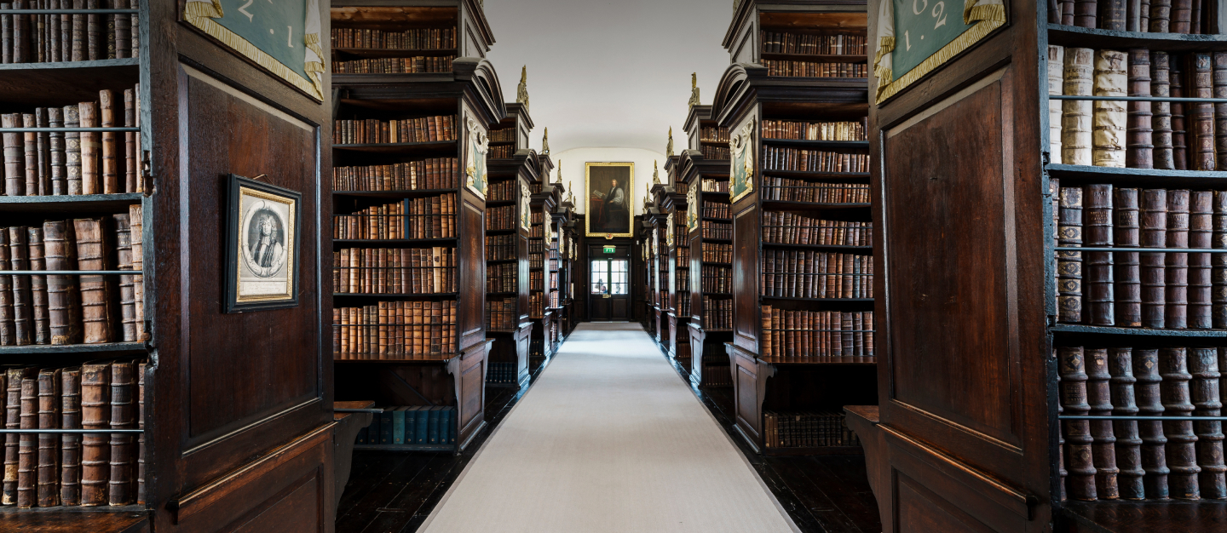
Category 2
Category 2: LIS Profession orientation
Formal and informal; often informal more important, but accreditation or formal structure strong Formal: Courses, conferences, seminars; training courses as part of a conference; case studies Informal: hands-on, people showing you things; email lists, help forums, web seminars, online learning, correspondence courses, email, phone; reading, especially professional literature; informal networking evening

Slide 14
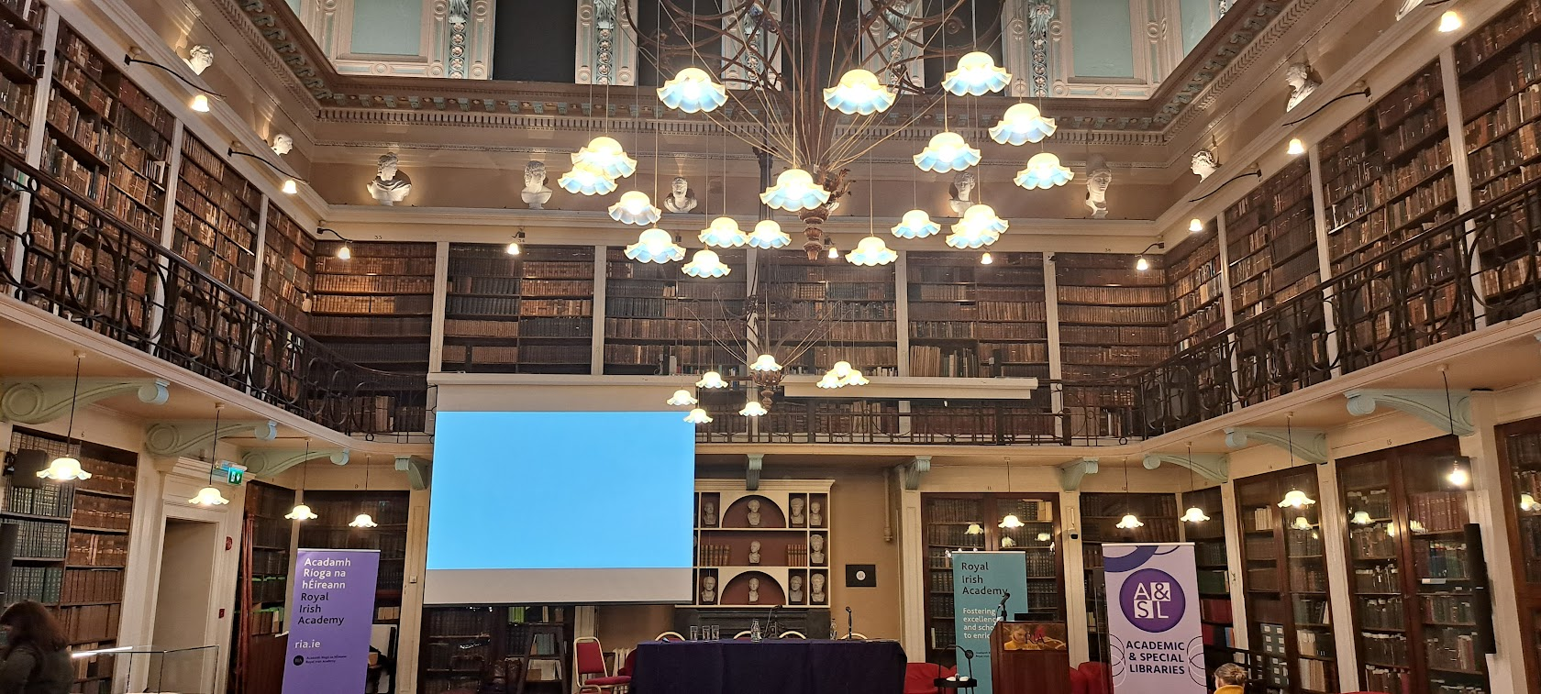
Category 3
Category 3: OPL orientation
Much more emphasis on informal Internet (Web, email, email lists, online tutorials), database providers, phone; reading journal articles; on the job activities

Slide 15
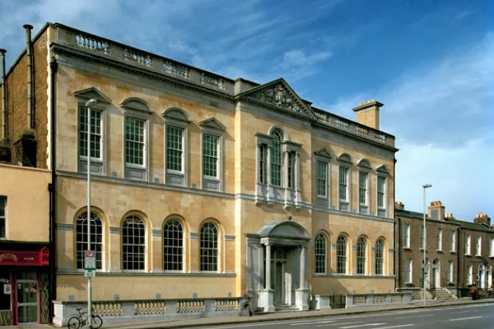
Category 4
Category 4: Personal orientation
Both formal and informal Formal: Short seminars, training courses, refresher courses Informal: Internet (email lists, newsgroups, restricted groups); hands-on, people show you how to do things (shadowing people); Newsletters from vendors; journals

Slide 16
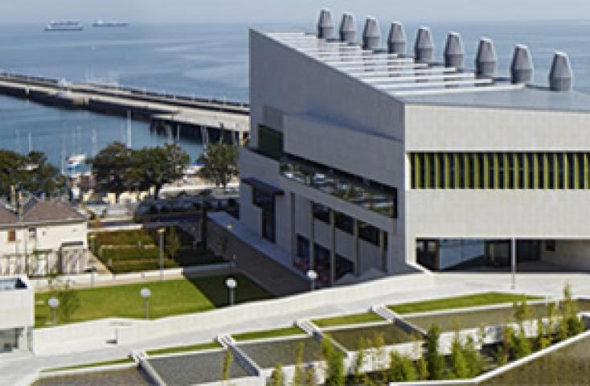
Category 5
Category 5: Lifelong learning orientation
Both formal and informal, very strong on both Every opportunity to learn!

Slide 17
What is happening now for solo librarians in Ireland?

Slide 18
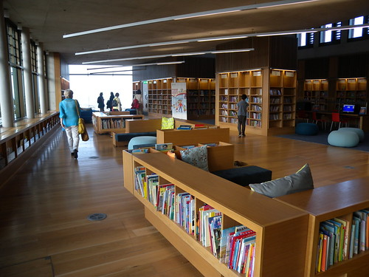
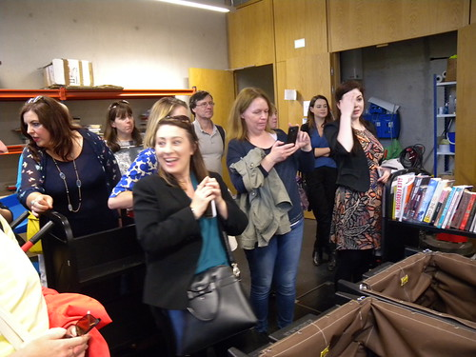
Professional Association (LAI)
The Academic and Special Libraries Section of the Library Association of Ireland (LAI) now runs informal networking evenings:
Visit to a library/new service to be followed by a trip to a nearby pub.
Mainly in Dublin, but also in Cork and Dublin

Slide 19
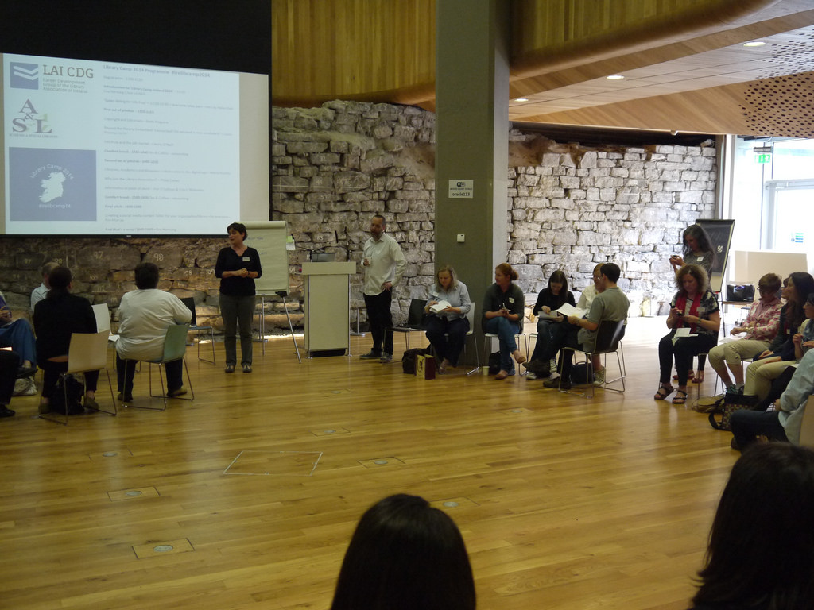
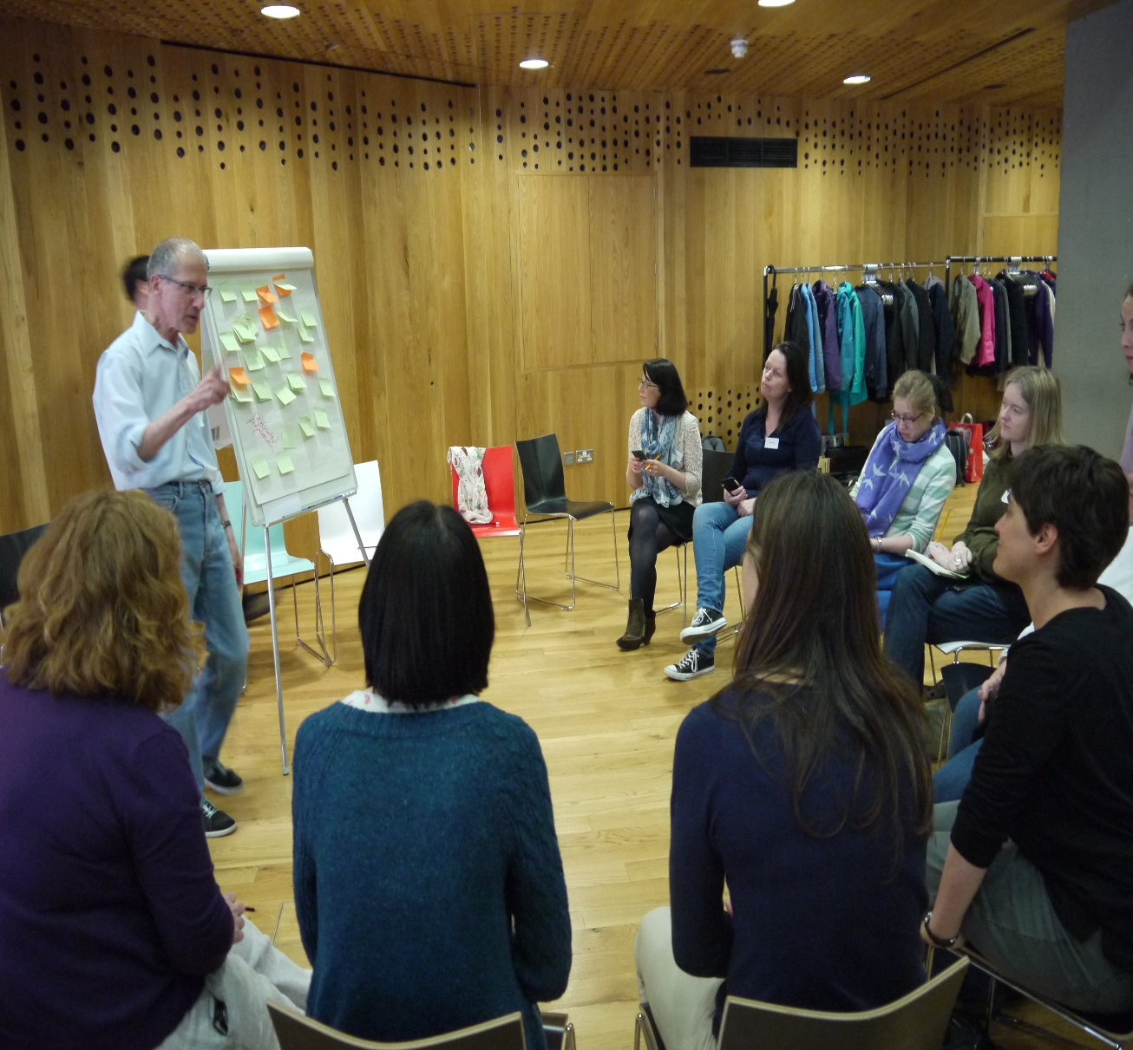
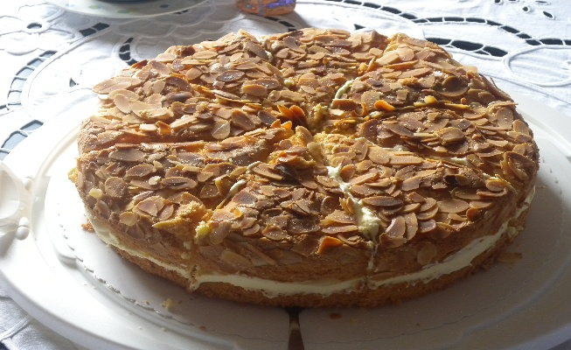
Other
activities
A group of librarians organised
LibCamps on a Saturday (2013, 2015, 2016):
“Unconference” = not-a-conference
People pitch ideas or talk about projects
Very informal with lots of interactions
Feedback from the audience
Cake!

Slide 20

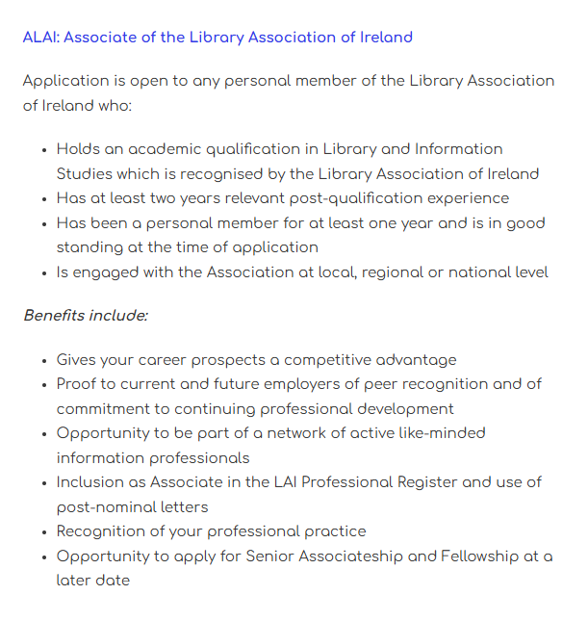
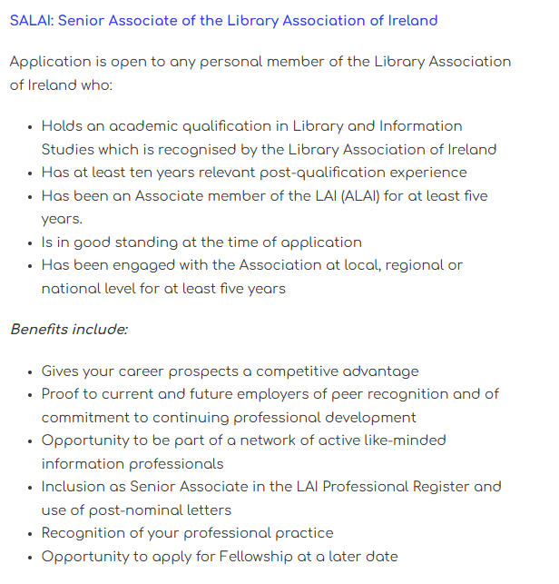
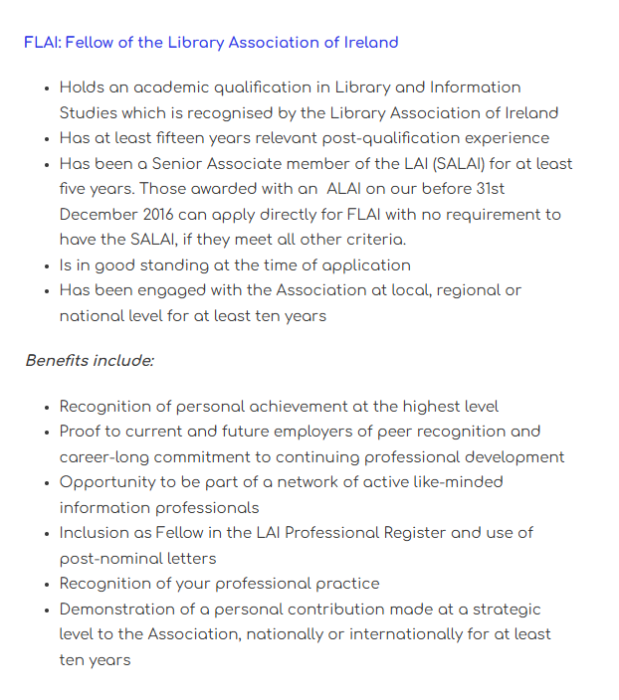
CPD Framework and recognition
The LAI runs a professional registration scheme:
Associateship
Senior Associateship
Fellowship
Shows active commitment to CPD and the profession
Recognises professional practice
Offers peer recognition
Competitive advantage when applying for jobs
Mentors are available.

Slide 21

New OPL group
In late 2025, a group of solo librarians working in health libraries formed an informal network.
They advertised this at a conference.
We hope to expand it Ireland-wide and to other types of settings.

Slide 22
HOPE!

Slide 23
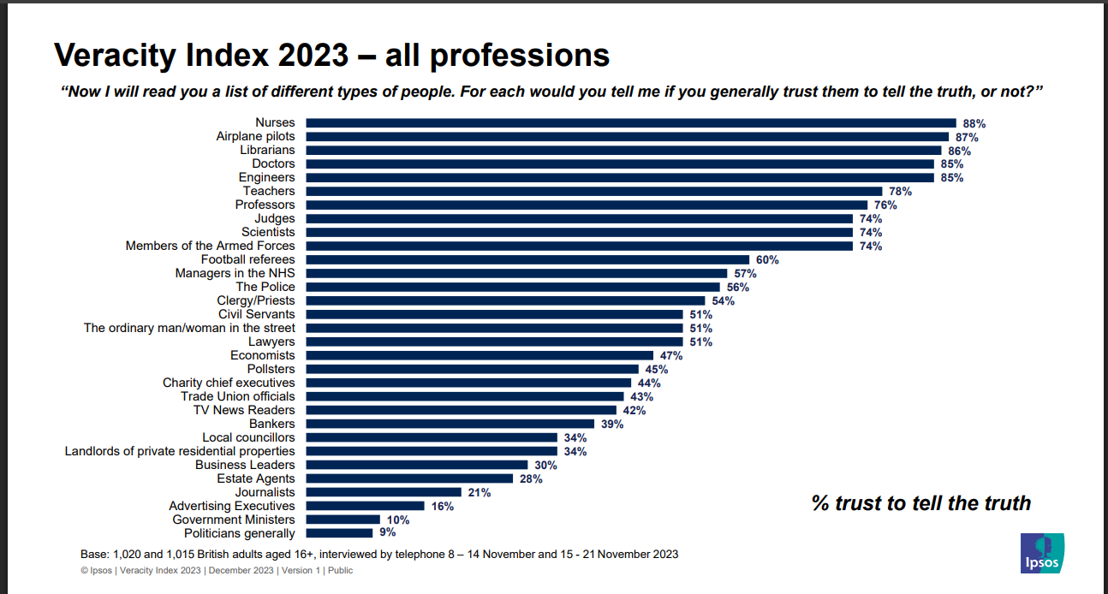
People trust us!

Slide 24
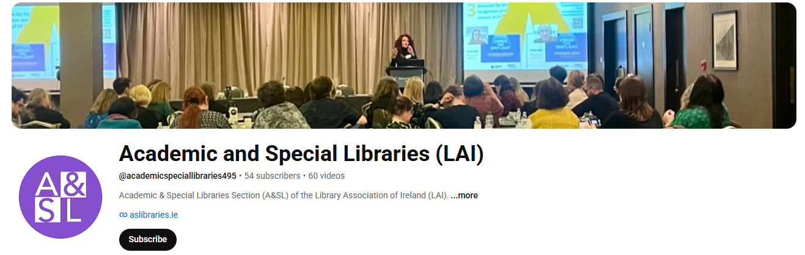

What you can do
Network! Locally, nationally, internationally
Host or join local meetups
Sign up to email lists: Google Groups "Solo Librarians“ (you need a Gmail account)
Join free webinars: https://www.ifla.org/events/ and https://eblida.org/events/?_sft_category=webinars
Explore free microcredentials
Use YouTube and LinkedIN

Slide 25
Free Resources

Slide 26

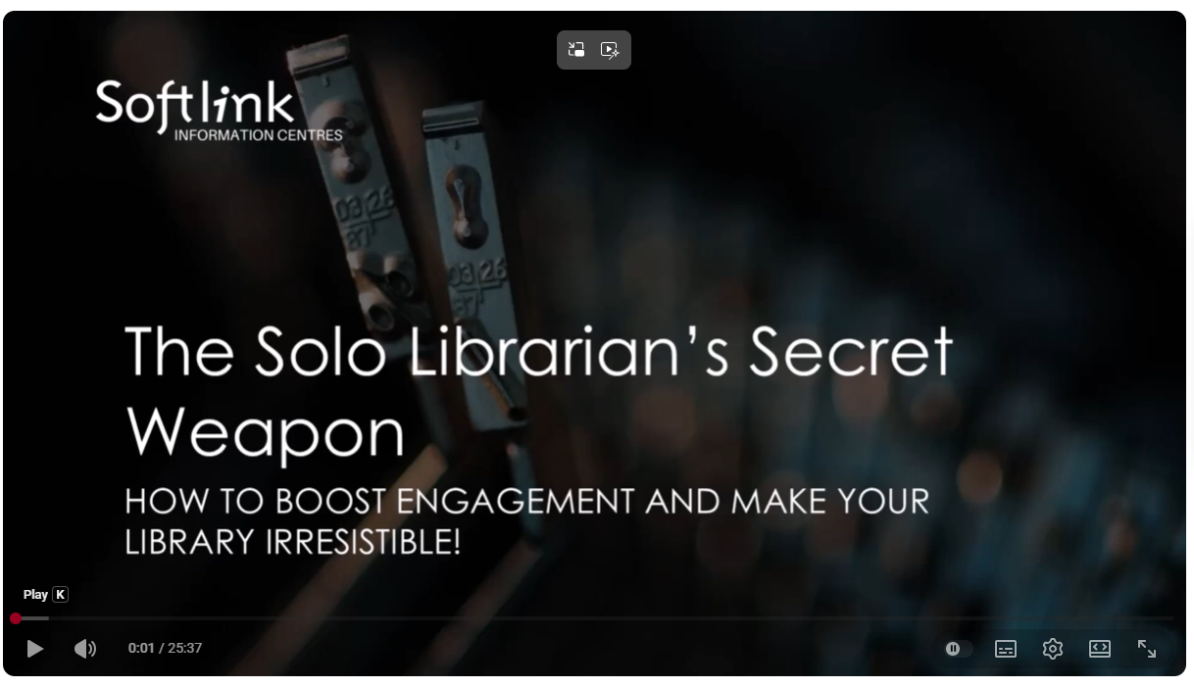
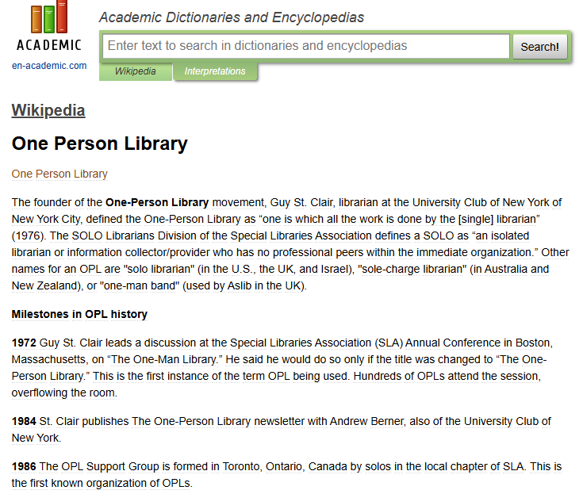
A video, a timeline…

Slide 27


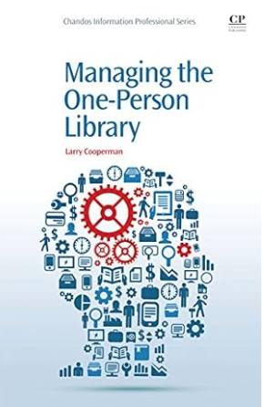

And some books
2024
2014
2011

Slide 28
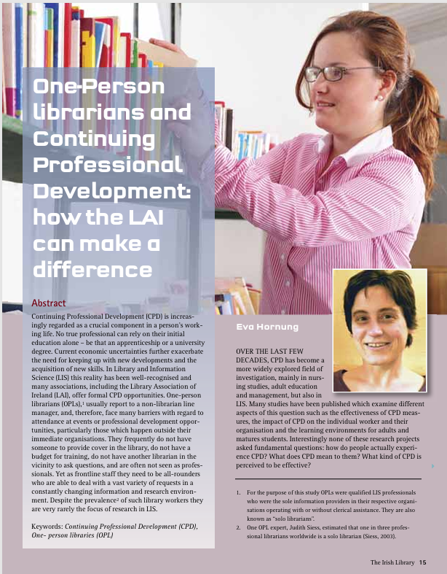
Reference

Slide 29


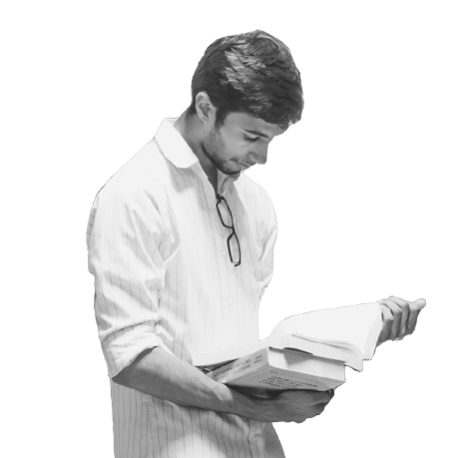



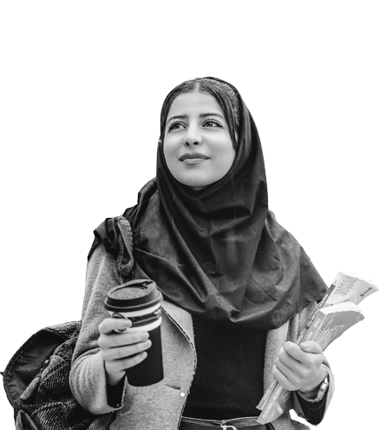


Thank you!
eva.hornung@cdu.cdetb.ie
https://www.linkedin.com/in/evahornung/

