Slide 1


Norwegian national library strategies
2015-2025
Arne Gundersen
Background, completion, and results

Slide 2
Content
National library policy in Norway - background
Library strategies 1 and 2 - completion
Evaluation and future

Slide 3
Timeline
Library Reform 2014 (2006)
White Paper on public libraries (2009)
New mandate for National Library (2010)
Amended Library Act (2014)
Library Strategy 2015-2018
Library Strategy 2020-2023
Expanded Library Strategy 2024-2025
Evaluation (2026)

Slide 4
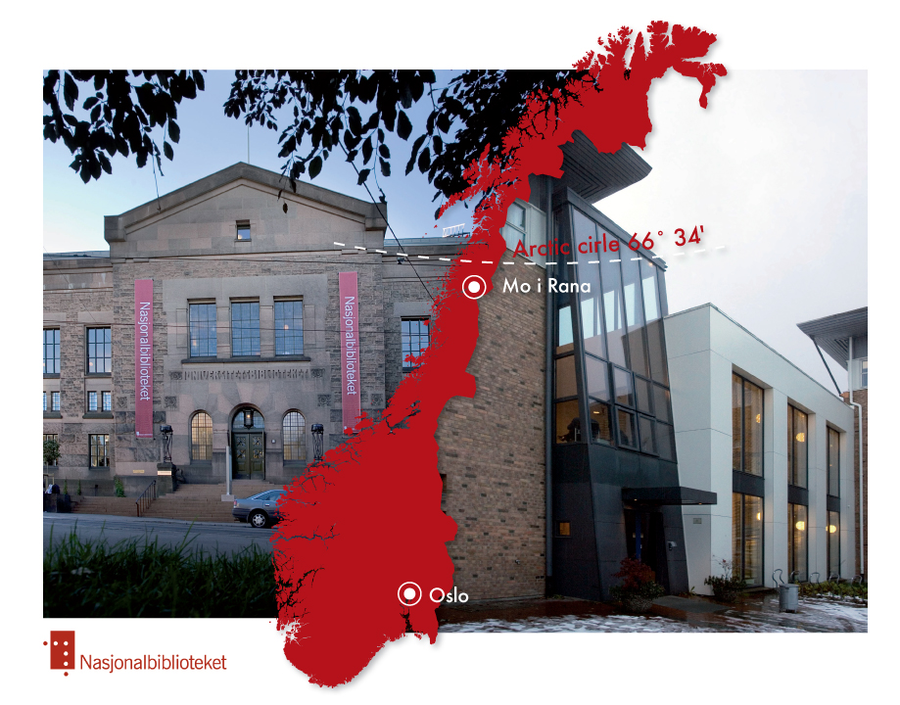
National Library of Norway
630 employees
492 full-time equivalents
NOK 850 M annual budget (2025)
Mo i Rana: Stacks, deposit library and digitisation
Oslo: Services for the public
1000 km from the stacks to
the reading room
www.nb.no

Slide 5
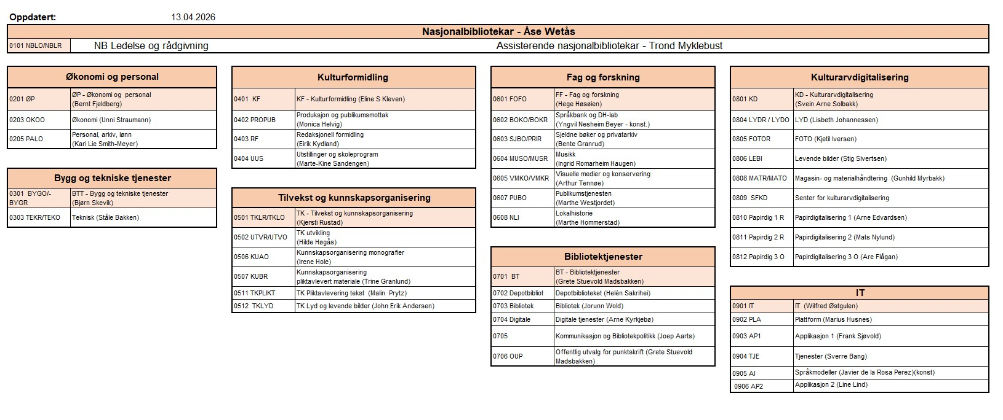
Organization chart

Slide 6
Communcation and
Library Policy Section –main tasks
Administration
National library development
Library Act
Prison libraries
State purchasing scheme for literature (Arts Council)
Library statistics
Development
Project funding
User surveys, analyses
National library card
National library search
Cooperation, guidance,
training
Courses and conferences
National library strategy
Training bank
Advisory council of library heads
International contact

Slide 7
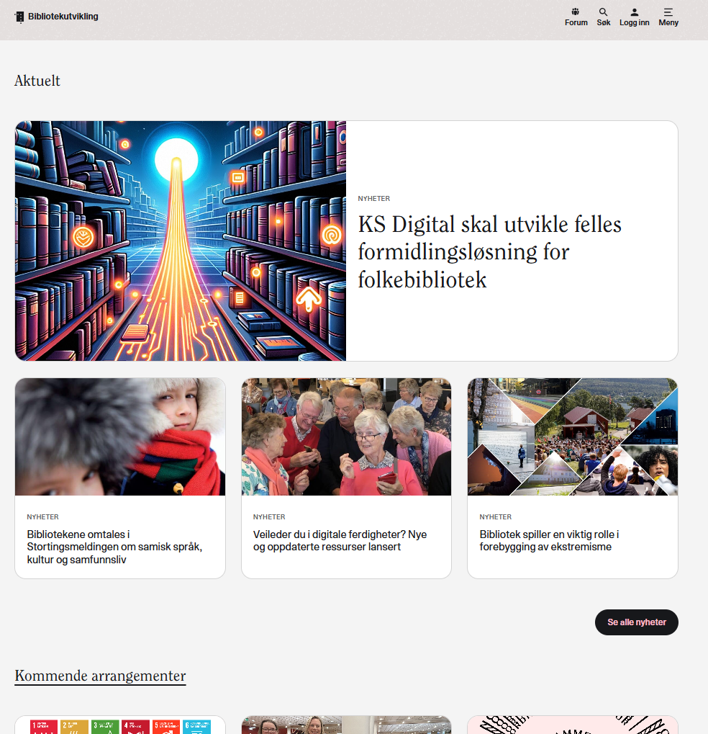
Web site – Bibliotekutvikling.no
news for libraries
calendar
project bank
training bank
library statistics
newsletter

Slide 8
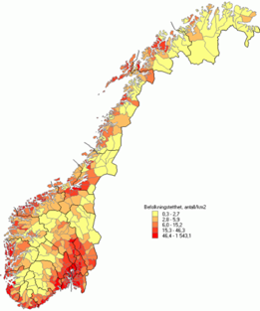
The landscape of public libraries in Norway
5,6 mill. inhabitants in Norway
357 municipalities – 619 public libraries
Public Libraries founded on the Public Library Act
Owned and financed by the municipalities
74 % of the municipalities have a qualified chief librarian
1 828 full-time equivalents
12 county libraries with responsibility for regional library development

Slide 9
Timeline
Library Reform 2014 (2006)
White Paper on public libraries (2009)
New mandate for National Library (2010)
Amended Library Act (2014)
Library Strategy 2015-2018
Library Strategy 2020-2023
Expanded Library Strategy 2024-2025
Evaluation (2026)

Slide 10
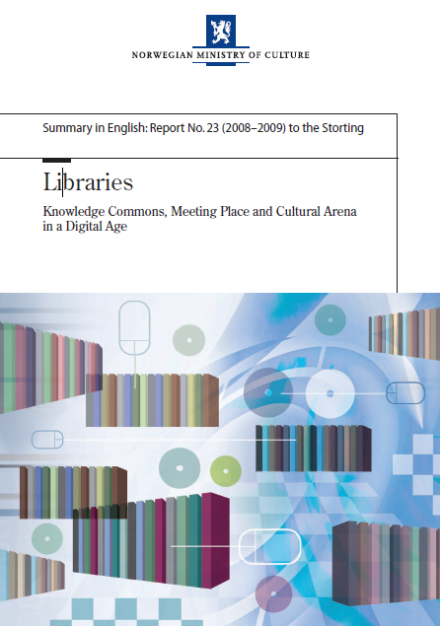

National library policy - background

Slide 11

Libraries - Knowledge Commons, Meeting Place and Cultural Arena in a Digital Age – White Paper (2009)
”Libraries are meeting places and arenas that can help to attain the overriding objectives of the Government’s cultural and knowledge policy.”
Notes:
11

Slide 12
Libraries - Knowledge Commons, Meeting Place and Cultural Arena in a Digital Age – White Paper (2009)
“The Ministry of Culture and Church Affairs …will consider whether….it might be a solution to transfer library tasks from ABM Development (State Agency for Archives, Libraries and Museums) to the National Library.”
Notes:
12

Slide 13
Timeline
Library Reform 2014 (2006)
White Paper on public libraries (2009)
New mandate for National Library (2010)
Amended Library Act (2014)
Library Strategy 2015-2018
Library Strategy 2020-2023
Expanded Library Strategy 2024-2025
Evaluation (2026)

Slide 14
National library mandate
«Drawing on our own experience and the evolution of our own services, Nasjonalbiblioteket has a particular responsibility to develop and strengthen the role of libraries across the country as active and relevant institutions within Norwegian society.»
«As the national development agency for the library sector, Nasjonalbiblioteket helps to shape and implement central government policy for public and specialist libraries. Nasjonalbiblioteket is a national centre of expertise and a central resource for other institutions in the library and cultural sector.»

Slide 15
Timeline
Library Reform 2014 (2006)
White Paper on public libraries (2009)
New mandate for National Library (2010)
Amended Library Act (2014)
Library Strategy 2015-2018
Library Strategy 2020-2023
Expanded Library Strategy 2024-2025
Evaluation (2026)

Slide 16
Public Library Act -
Statutory objectives (§1) as of 1 Jan 2014
The task of public libraries is to promote the spread of information, education and other cultural activities through active dissemination and by making books and other media available for the free use of all the inhabitants of Norway.
Public libraries are to be an independent meeting place and arena for public discussions and debates.
The individual library shall place emphasis on quality, versatility and topical relevance in its services for children and adults.
The library’s contents and services are to be made known.
The public libraries are part of a national library system.
http://www.nb.no/content/download/8330/82005/file/4297-EN-%20nasjonalbiblioteket.pdf

Slide 17
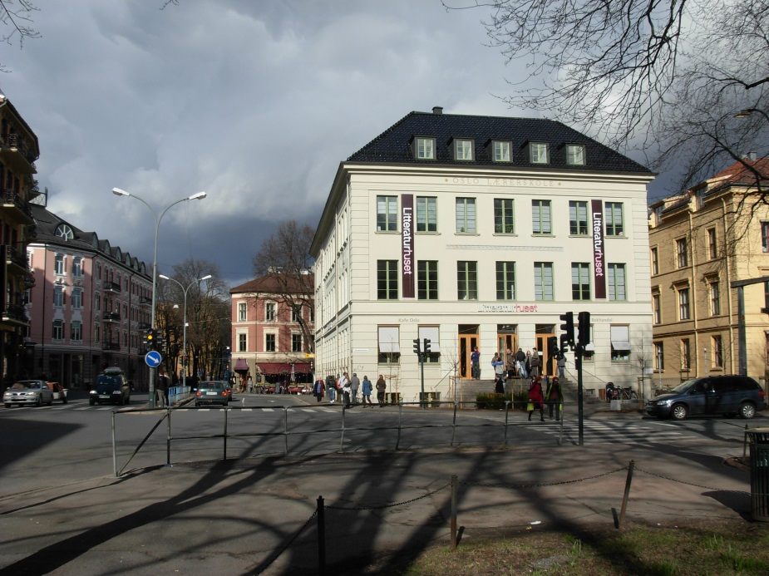
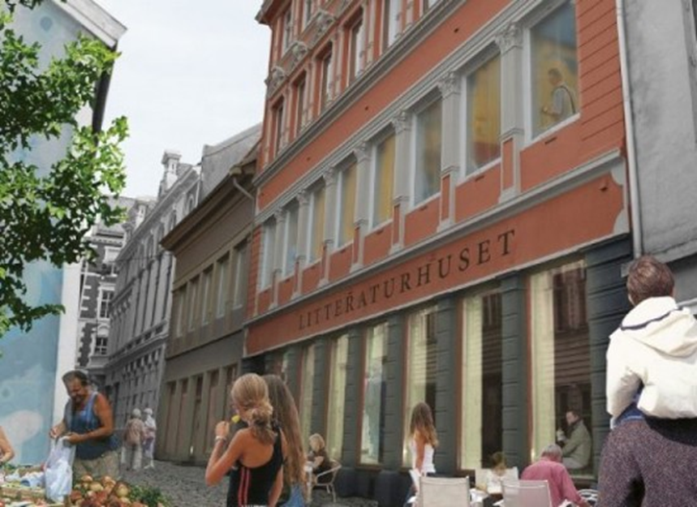
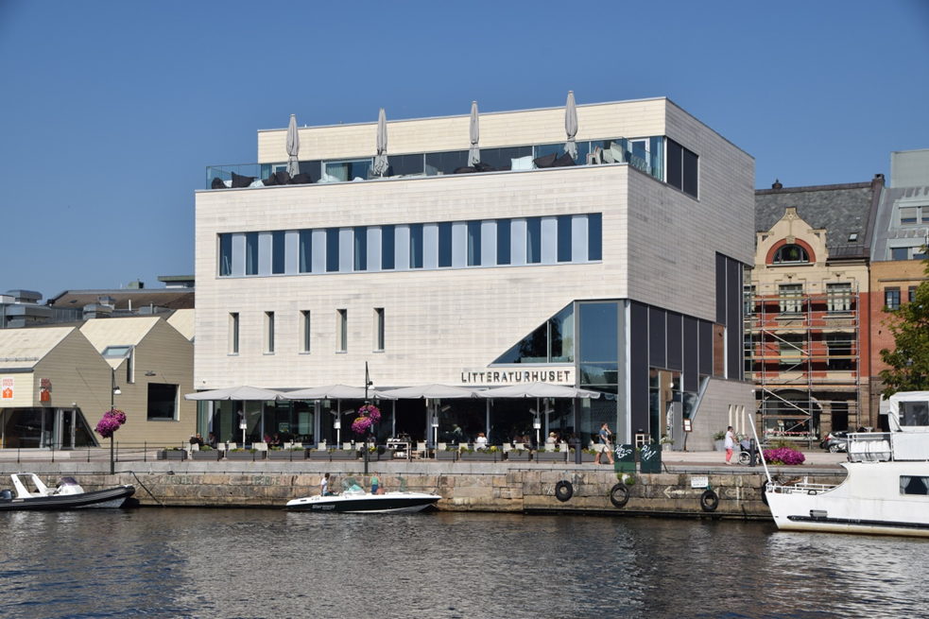
Norwegian houses of literature …
Bergen
Oslo
Fredrikstad

Slide 18
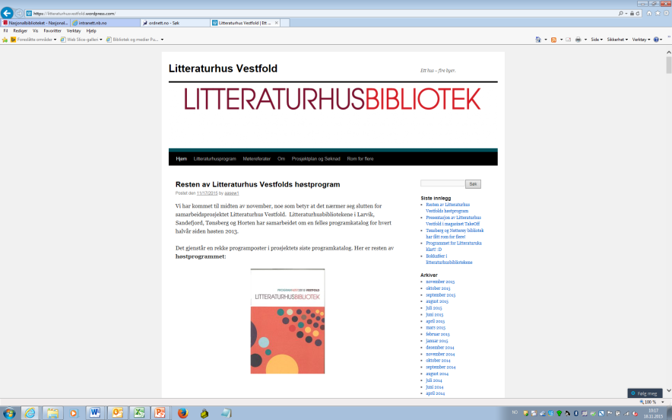
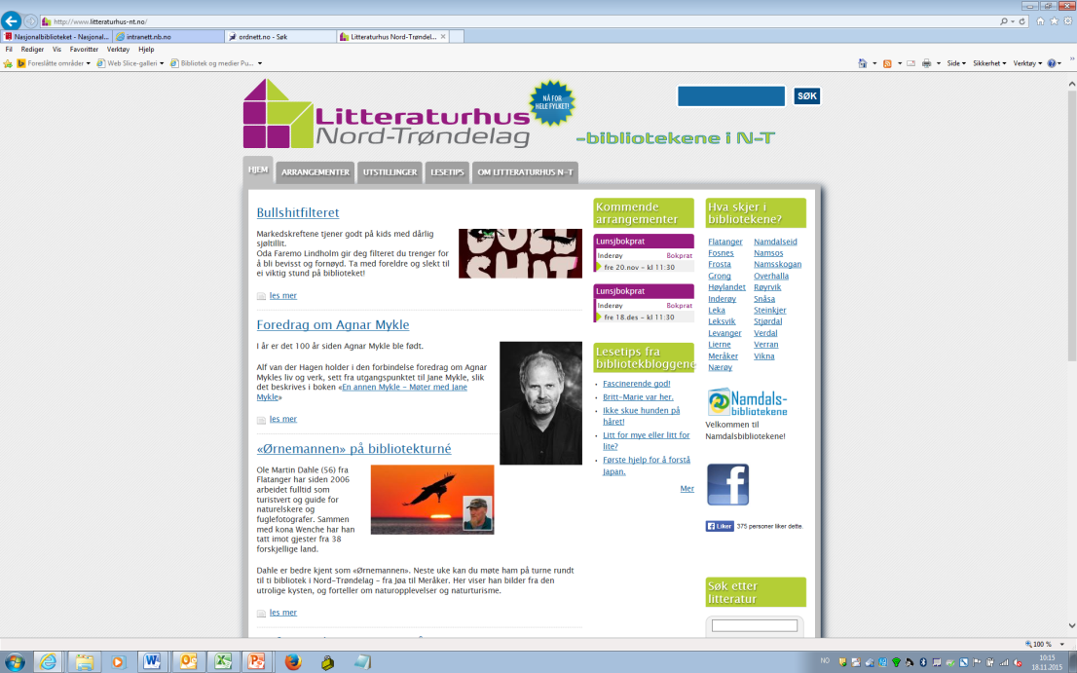
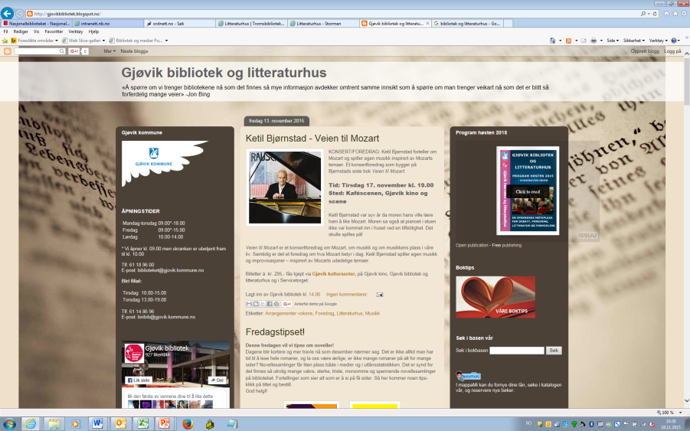
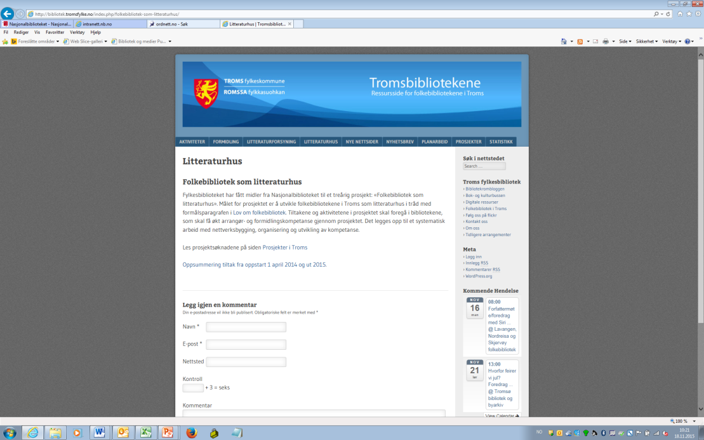
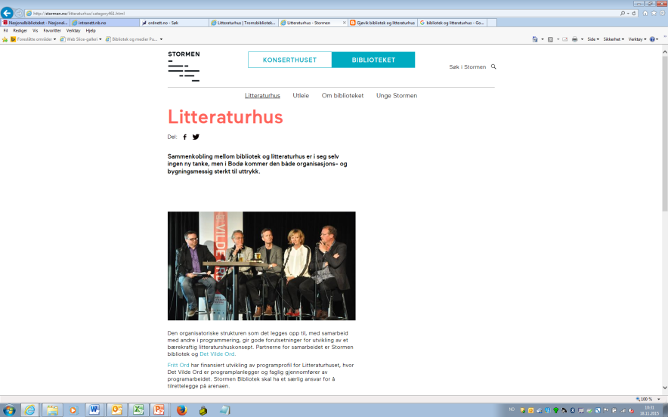

Slide 19
Challenges 2013/2014
“There are two particular challenges in relation to the development of modern public libraries. One is to find their role in the digital society when new services are increasingly available directly online. The other is to develop services in response to the challenge of establishing literature houses in many municipalities.”
Letter from the National Library to the Ministry, Dec 2013

Slide 20


Strategy process launched
Submission of proposals from the National Library and Arts Council Norway for the development of public libraries (Feb 2014)
Innovation meeting arranged by the Ministry (May 2014)
Working group and reference group set up (Autumn 2014)
Reports (spring/summer 2015)

Slide 21

Survey of library use 2015
Four out of ten people visited a public library last year, compared with about five in ten in 2005
The reduction is particularly significant for the 16-24 age group
Two thirds of children and young people used libraries in the last 12 months
The number using the libraries’ online services has increased
There is a marked decrease in the traditional use of libraries for all groups. Furthermore, there is a growing tendency in the use of libraries for other activities
https://www.ssb.no/en/kultur-og-fritid/artikler-og-publikasjoner/undersokelse-om-bibliotekbruk-2015

Slide 22
Timeline
Library Reform 2014 (2006)
White Paper on public libraries (2009)
New mandate for National Library (2010)
Amended Library Act (2014)
Library Strategy 2015-2018
Library Strategy 2020-2023
Expanded Library Strategy 2024-2025
Evaluation (2026)

Slide 23

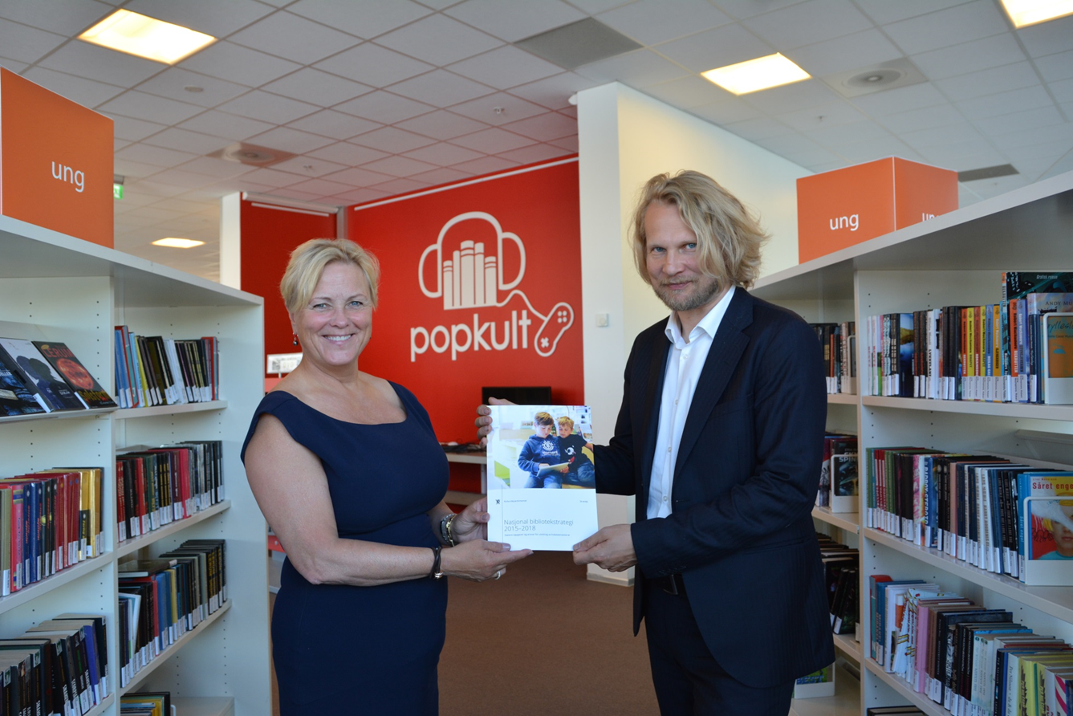
Drammen library, August 2015
Photo: Wenche Nybø, Ministry of Culture

Slide 24
New funding scheme
Before 2015: Project and development funds for public and specialist libraries were allocated directly from the ordinary state budget
2015 and since: The framework for these funds has been determined through the distribution of the gaming surplus from Norsk Tipping (the cultural share of the gaming funds), and it is the National Library that manages and announces this money for development measures in the sector

Slide 25

Four main areas – 23 actions
The National Library of Norway’s role as a developer
Library development with project and development funding
Digital content
Joint infrastructure

Slide 26
1. The National Library of Norway’s role as a developer
The National Library of Norway will be more active in development work by initiating, coordinating and setting in motion development projects.
The National Library of Norway will strengthen its function as a competence and resource centre
The National Library of Norway will develop a project database providing access to reports and contact information on development projects
Public library statistics will be further developed to highlight digital services and the public libraries as arenas for learning and debate

Slide 27
2. Library development with project and development funding
A new model for allocating project and development funding during the strategy period
A four-year investment to develop libraries as houses of literature and debate
  Support for arranging events in the library
  Support for minor adaptations of the library’s physical space
Greater investment in new methods of dissemination, digital services development and free development measures in project and development funding
Development of the library as a learning arena in joint projects spanning school libraries, public libraries and special libraries
The programme Digidel 2017 will strengthen the libraries’ advisory services for basic digital skills

Slide 28
3. Digital content
The National Library of Norway will ensure greater access to digital content resources in the libraries
The National Library will further develop digital services that make digital material accessible and will work actively to disseminate these services
The National Library will recommend a model for the purchase and lending of e-books in dialogue with the Norwegian Publishers Association and other relevant actors
The National Library will further develop digital dissemination of Norwegian literature, based on its own collections and if appropriate, in collaboration with other actors in the field of literature
Arts Council Norway will revise all its literature funding schemes in order to make them future-oriented and to give e-books a permanent place
The Norwegian Film Institute will launch new solutions for streaming of short films and documentaries for the libraries in the course of autumn 2015
The Norwegian Film Institute will ensure access to computer games and their dissemination in the library through procurement schemes

Slide 29
4. Joint infrastructure
The National Library of Norway will provide free access to appropriate high-quality bibliographic data for all libraries
Biblioteksøk (Library Search) will be developed as a national service with functionality for both libraries and borrowers
The storage capacity of the Legal Deposit Library will be increased
The Multilingual Library will be transferred to the National Library of Norway with effect from 1 January 2017
The National Library of Norway will establish a digital meeting place and resource bank for the development and sharing of digital services
The Norwegian WebDewey will be launched in autumn 2015, facilitating free use of Norwegian public libraries and school libraries
The National Library of Norway takes responsibility for the further development of the scheme for a national library card that is valid in the whole of Norway

Slide 30
Main message of the strategy
If the National Library can take more responsibility for infrastructure, the public libraries can spend more of their time and resources on their primary functions.

Slide 31
A new model for allocating project and development funding 2015-2018
Total funds: Approx. 50 mill NOK (5 mill. Euro) annually
Development of joint infrastructure measures under the auspices of the National Library of Norway, available for all libraries (1/3)
Development of public libraries as arenas for debate and learning, meeting places and dissemination institutions (1/3)
Free, innovative project and development initiatives (1/3)

Slide 32
Arena development - results
57 million NOK for arena development funds over three years
77 percent of municipalities chose to apply during the three-year period
97 percent received support
33 million NOK (59 percent) was distributed to upgrade physical facilities and event equipment
24 million NOK (41 percent) was distributed to events in libraries

Slide 33
Evaluation Library Strategy
2015-2018
The evaluation was based on three surveys:
a survey of a representative sample of the Norwegian population
a questionnaire survey of all the country's county and public libraries
in-depth interviews with 10 people from the library sector

Slide 34
Evaluation Library Strategy
2015-2018
The National Library's role as a developer is central to the strategy, with keywords such as development projects, competence centers, project base, and visibility of digital services.
In this area, a great deal has been done within project development with arena and development funds. The funds are the point at which all parties believe the strategy has been most successful.
Much has been done in the area of ​​shared infrastructure, but there is more to be gained from the library search and free metadata services.
Overall, the overall goals of the strategy have been achieved.
The most important thing in this respect is to continue the work to achieve effect and resource utilization of the funds that have been invested.
There is a significantly positive attitude towards libraries as providers in the population, this is a resource that must be managed well in the years ahead.

Slide 35
State Budget 2019:
New library strategy
“The Ministry will initiate work on a new national library strategy 2020–2023. There is a need to continue and further develop the measures that were implemented with the current library strategy. The theme will be the state's responsibility and tasks for the development of the public library sector…”
Working group with representatives from Ministry of Culture and the National Library. The Ministry of Education and Research will contribute
Reference group with stakeholders

Slide 36
Timeline
Library Reform 2014 (2006)
White Paper on public libraries (2009)
New mandate for National Library (2010)
Amended Library Act (2014)
Library Strategy 2015-2018
Library Strategy 2020-2023
Expanded Library Strategy 2024-2025
Evaluation (2026)

Slide 37
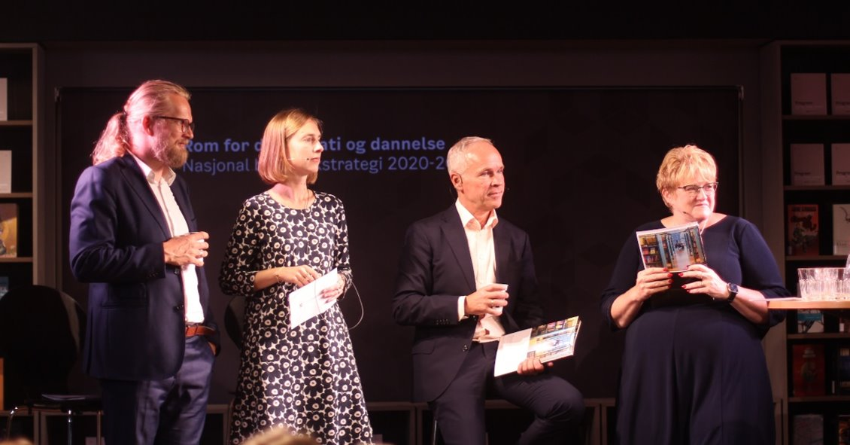
Furuset Library, Oslo – September 2019
Two ministries, three ministers and a national librarian

Slide 38
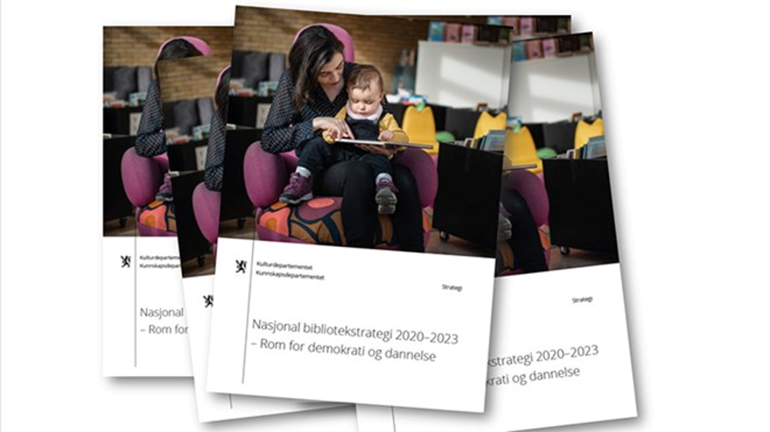
National Library Strategy 2020-2023
Message from the Ministers
The Ministry of Culture and the Ministry of Education are joining forces on a joint initiative to strengthen Norwegian libraries. The strategy emphasizes the important role of libraries as an arena for knowledge, education and critical thinking.
The government is presenting specific measures along three main lines that together will contribute to achieving the goal: Libraries are houses of democracy. From the National Library to public libraries, school libraries and specialist and research libraries.
The National Library's responsibility for shared services, as part of the national infrastructure, is further strengthened. The goal is to free up resources in the libraries so that these can be used for public-oriented work.

Slide 39
Three lines – 25 actions
Dissemination
Cooperation and development
Infrastructure

Slide 40
1. Dissemination
Each year, the National Library will announce funding for active dissemination, enabling public libraries and county libraries throughout Norway to draw up effective measures to boost reading and increase the borrowing of physical and digital material from the collections
The National Library will initiate projects related to outreach library activities with a view to attracting new user groups/readers, including in schools
The National Library will support measures that develop methods for digital dissemination
The National Library will create a website for disseminating the National Library’s collections to lower secondary school pupils
The National Library will develop web pages for its map centre, which will also consist of content that schools can use for teaching
The National Library will disseminate its own events through a streaming service, and will also stream events held by other libraries following an editorial assessment

Slide 41
2. Cooperation and development
The National Library will announce project and development funding to stimulate:
  New areas of cooperation
  More cooperation between public libraries and libraries in higher education in relation to dissemination
  Trials of different models of operation and cooperation in libraries and library services, with a special focus on new counties and merged municipalities
  New forms of cooperation between school libraries and public libraries
The Norwegian Directorate for Education and Training is announcing grants for school libraries, and is extending the focus on this priority area by two years – from 2021 to 2023.
The grants/project funding from the Norwegian Directorate for Education and Training and the National Library will be viewed in conjunction with each other.
Funds are being set aside for the maintenance, updating and operation of Språkløyper (the National Strategy for Language, Reading and Writing) for a limited period of time
The responsibility for collecting statistics on school libraries will be transferred from the National Library to the Norwegian Directorate for Education and Training.
The National Library will initiate an evaluation of the impact of development funding on libraries in higher education.

Slide 42
3. Infrastructure (1/2)
Throughout the strategy period, the National Library will endeavour to increase the scope of digital material that the libraries can access
The National Library will negotiate with Kopinor to secure an extension of the Bokhylla agreement
The Norwegian Film Institute will evaluate and further develop the procurement schemes for computer games
The National Library will raise awareness in school libraries of the Multilingual Library’s general services
The National Library will offer documented machine-readable access to its open access digital collection
Arts Council Norway will establish a pilot project for school libraries in its procurement schemes

Slide 43
3. Infrastructure (2/2)
The National Library will join forces with UNIT and the higher education institutions to secure access to the large printed collections of foreign journals found in Norwegian higher education ibraries
The National Library will join forces with UNIT and the higher education institutions to ensure the preservation of and access to documents and metadata in UNIT’s national open research archive
The National Library will join forces with UNIT to establish a national vault of metadata, which will constitute the only authorized source of metadata for Norwegian libraries and enable the reuse of metadata both between the libraries and between the libraries and other parties
The National Library will join forces with UNIT to ensure that the common register of authority records is implemented in the various library systems in Norway, and is expanded to include more types of authority records
The National Library will continue to develop the national library card
In cooperation with the county authorities, the National Library will hold seminars and conferences that provide knowledge and training in the use of national library services
The National Library will strengthen the bibliotekutvikling.no website as a professional resource for library staff

Slide 44
Adjusted model for project and development funding 2020-2023
Total funds: Approx. 55 mill NOK (5,5 mill. Euro) annually
Development of joint infrastructure measures under the auspices of the National Library of Norway, available for all libraries (slight increase)
Funding for active dissemination, enabling public libraries and county libraries throughout Norway to draw up effective measures to boost reading and increase the borrowing of physical and digital material from the collections (new)
Free, innovative project and development initiatives (slight decrease)

Slide 45

2020: COVID strikes!
As part of the package of measures to ensure the population's access to library services when libraries are closed, the government has allocated NOK 20 million for the purchase of e-books for public libraries.
The funds will be distributed to the county libraries (consortia) according to population.
The individual counties decide which books to purchase and how the funds are distributed between ordinary e-books and digital audio books.
The government has also allocated NOK 5 million for digital dissemination in public libraries

Slide 46
Timeline
Library Reform 2014 (2006)
White Paper on public libraries (2009)
New mandate for National Library (2010)
Amended Library Act (2014)
Library Strategy 2015-2018
Library Strategy 2020-2023
Expanded Library Strategy 2024-2025
Evaluation (2026)

Slide 47

Expanded national strategy for libraries – through 2025
Due to the pandemic, the libraries did not start dissemination activities as planned in the library strategy.
Already in 2020, the strategy period was extended to 2024. In December 2022, the National Library was commissioned to propose a revision of the library strategy.
The assignment involved reviewing existing measures to update them if necessary, and proposing new measures.
The expanded national library strategy is based on proposals from the National Library, which in turn is based on input from external stakeholders and discussions with the National Library’s advisory council.
The expanded strategy cannot be read without the original strategy and is a continuation of this. Some measures are new, some have been changed and some continue as they are.

Slide 48
Expanded national strategy for libraries – through 2025 – three main areas
Dissemination will be continued and strengthened
Cooperation and development will be focused on larger and fewer individual projects
Infrastructure will be continued and strengthened.

Slide 49
Expanded national strategy for libraries – through 2025 – 20 actions
4 actions new
6 actions updated
10 actions continuing
The Ministry of Education and Research will see its actions in the strategy in the context of a new reading promoting strategy

Slide 50
1.
1. Dissemination
The National Library will each year announce funding for active dissemination, so that the public libraries and county libraries can create good measures to promote reading enjoyment and literature dissemination in libraries across the country (updated)
The National Library will develop an online resource for upper secondary schools linked to the National Library’s collection and dissemination of Norwegian cultural history (updated)
The National Library will make its own events accessible digitally and facilitate competence sharing with other libraries in the area of digital dissemination (updated)
The National Library shall make the services offered by libraries visible to individuals with disabilities that make it difficult for them to read visual text or normal books, such that the libraries actively disseminate this to users entitled to adapted library services (new)

Slide 51
1.
2. Cooperation and development
The National Library will announce project and development funding (updated)
The National Library will partner with relevant players to follow up on applicable measures in the upcoming strategy for reading enjoyment (new)

Slide 52
1.
3. Infrastructure
The National Library will establish an infrastructure that facilitates a transition to central production and sharing of metadata for Norwegian libraries (updated)
The National Library will, in partnership with Sikt – Norwegian Agency for Shared Services in Education and Research develop the Norwegian Authority File (updated)
The National Library will, in close consultation with the library sector, contribute to establishing a shared national digital infrastructure in Norwegian public libraries (new)
The National Library will, in close consultation with the library sector, investigate various models for organising and funding digital infrastructure for public libraries for the period after 2025 (new)

Slide 53
Active dissemination - results
Main objective throughout the strategy period: Library staff to practice dissemination activities and promotion of library content
53 million NOK for active dissemination over four years
89 percent of municipalities chose to apply during the four-year period
Typical areas: Cooperation with schools and kindergartens, Gaming, Digital services, Outdoor activities, Pop-up libraries, Inclusion, Shared reading, Cooperation with health institutions, Sustainability activities, Services for elderly, youth, children, students
The 12 county libraries received funds to coordinate project activites for libraries (10-20) in their counties
The 12 county recieved funds for a common four-year skills development project for library staff

Slide 54
Infrastructure – results
Bibliotek.no
Bibliotek.no consists of several functions that should work together as one comprehensive solution
Project funded by the National Library (2 x 10 mill. NOK)
Project owned by KS Digital who develops and delivers services and solutions for municipalities and counties
Functions
Website and app
Publishing for reuse in different channels
Sharing between libraries
Newsletter
Info screens
My page
Universal design
Integrations with other systems
Lysark
Lysark

Slide 55
Timeline
Library Reform 2014 (2006)
White Paper on public libraries (2009)
New mandate for National Library (2010)
Amended Library Act (2014)
Library Strategy 2015-2018
Library Strategy 2020-2023
Expanded Library Strategy 2024-2025
Evaluation (2026)

Slide 56
National Library Strategy - knowledge, influence and relevance

Slide 57
Knowledge of the national strategy
To what extent do you have knowledge about…
157

Slide 58
The importance of the strategy
How important or unimportant do you think it has been to have a national library strategy for the years 2020-2025?
157

Slide 59
The relevance of the strategy
To what extent do you think the National Library Strategy 2020-2025 has addressed the needs of public libraries?
157

Slide 60
Insights from qualitative interviews:
The strategy provides direction and a basis for working according to plan
Unifying, provides a common language and argumentation
Contributes to ensuring a more equal core offering of library services
"It provides a consistent line. We align ourselves with national guidelines and adapt it to regional and local needs. It is well-connected, not least in terms of education, for both politicians and employees, and is a great way to work" (county library manager).

Slide 61
The strategy’s impact on priorities and work
To what extent has the National Library Strategy guided the work and priorities at your library in the period 2020-2025?
157

Slide 62
The strategy’s impact on priorities and work
65 %
have used the strategy in their own plans
Has the National Library Strategy been used in the development of local and/or regional plans?
157

Slide 63
The strategy as a tool for visibility and impact
To what extent do you agree or disagree with the following statements? The National Library Strategy 2020-2025 has...
157

Slide 64
The National Library's role as a development actor
To what extent do you agree or disagree with the following statements about the National Library as a development actor for public libraries during the strategy period?
157

Slide 65
To sum up what libraries report
The strategy has
influenced local priorities
shaped local plans
strengthened library visibility
improved cooperation
reinforced the National Library's development role

Slide 66
Opinion of the population
How important or unimportant do you think it is that there is a public library in your municipality?
1008

Slide 67
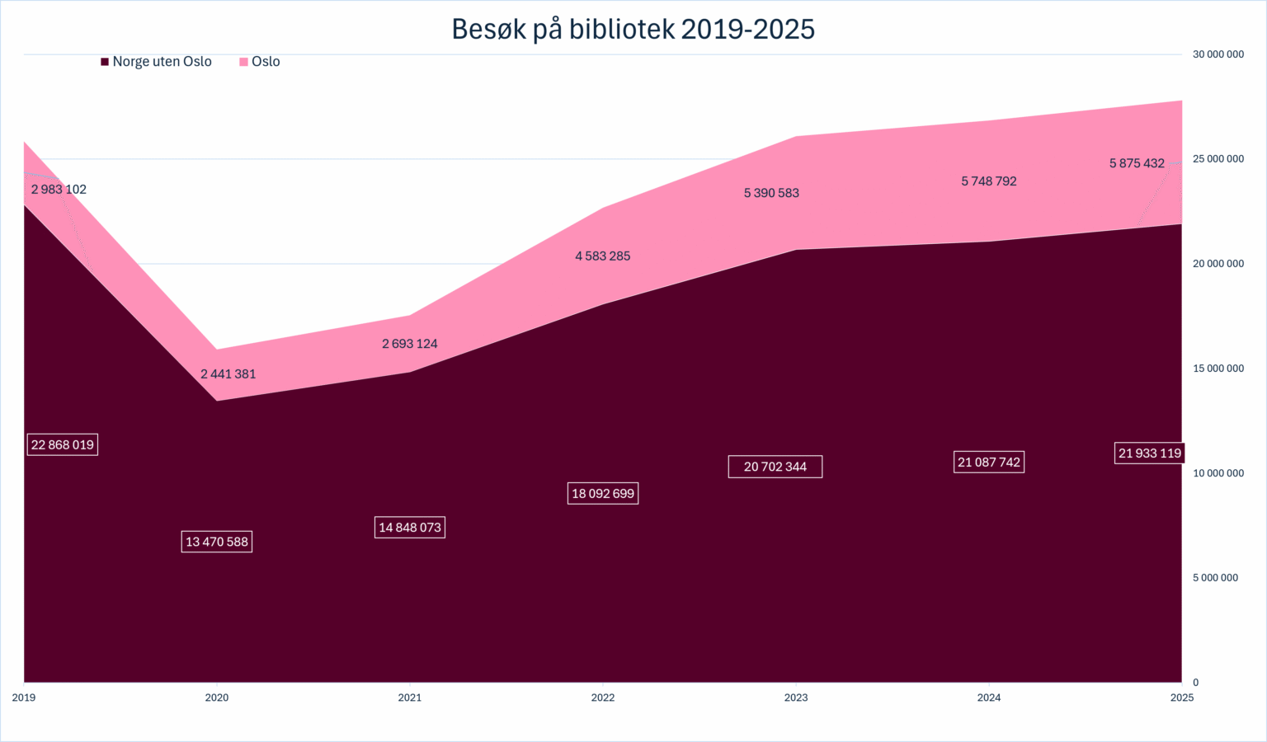
Library visits 2019-2025

Slide 68
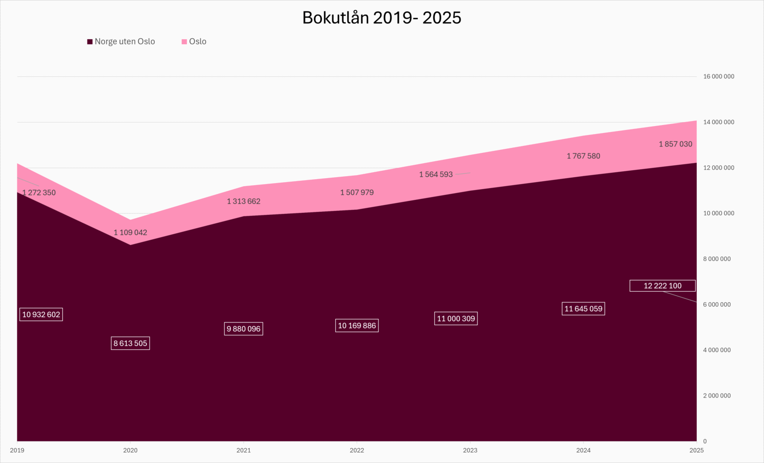
Library loans 2019-2025

Slide 69
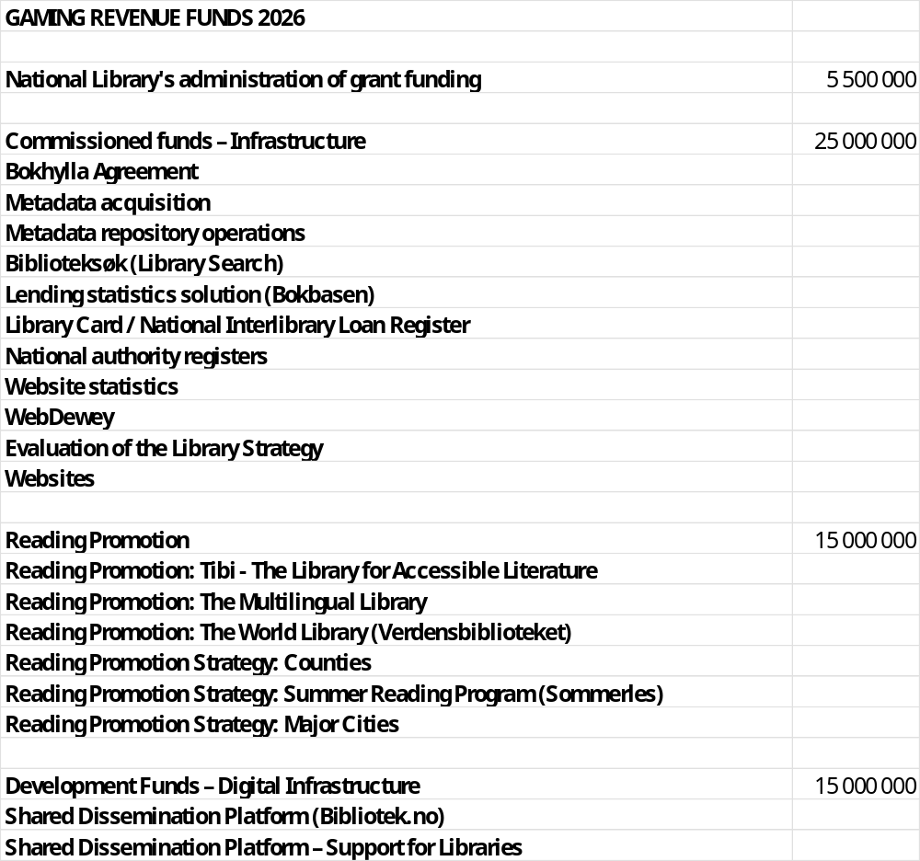
Gaming revenue funds
2026

Slide 70
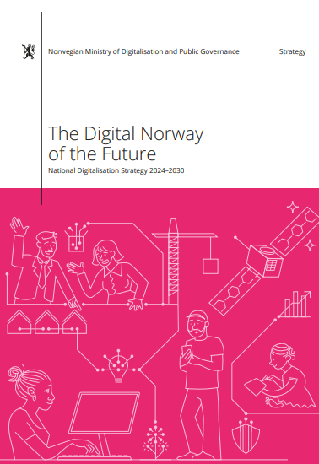
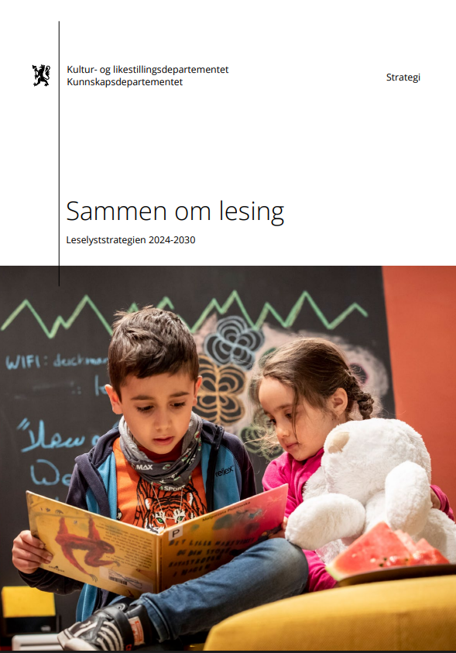
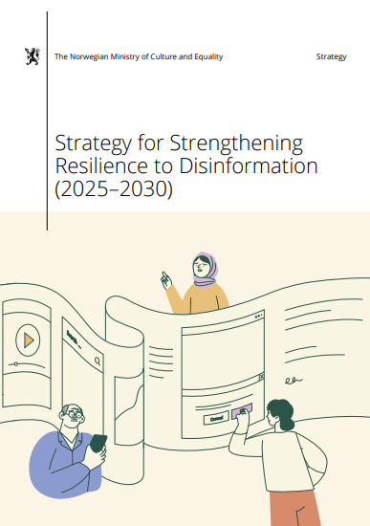
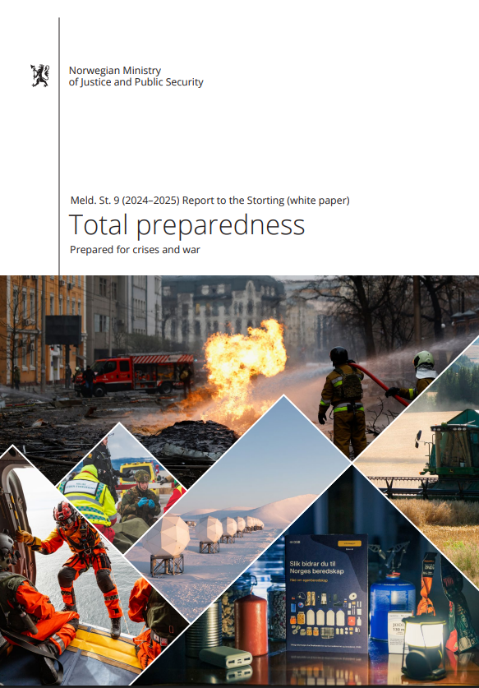


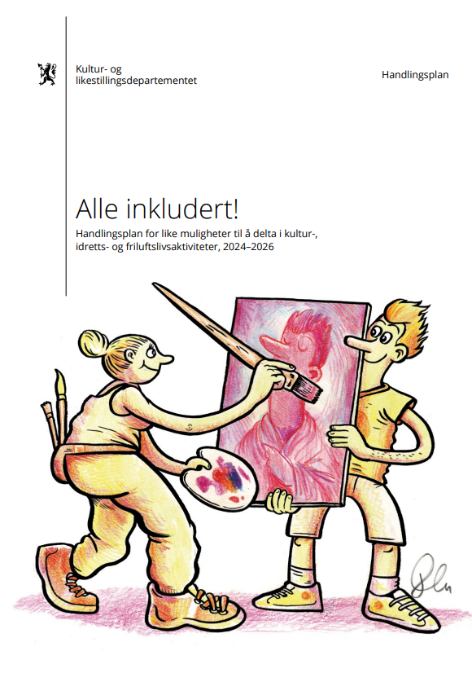

Current challenges: a variety of political documents
Work in progress in the Ministry of Culture for
Reading promotion strategy for adults
Strategy for cultural arenas

Slide 71

New professional council appointed
The Professional Council will supplement the expertise in the National Library with user perspectives and perspectives from the library field. The purpose is to ensure a broad and sound decision-making basis for the management of the National Library.
The Professional Council shall be an advisory body and contribute to the National Library maintaining a good, regular and coordinated dialogue with the libraries and to good contact between user organizations and the National Library.
The Professional Council consists of 15 permanent members appointed by the National Librarian.
The Council is appointed for four years.
First meeting October 2026.

Slide 72
Some final observations
Our experience demonstrates the importance of a clear national strategy
The combination of national infrastructure and local innovation has proven effective
The role of the National Library has been to create conditions that allow local libraries to focus on people, communities, learning, reading, and democracy

Slide 73
Thank you for your attention!
Arne Gundersen, Senior Adviser
National Library
PB 2674 Solli, N-0203 Oslo, Norway
Arne.Gundersen@nb.no
Tel. 47 9743 7692
www.bibliotekutvikling.no

