Slide 1
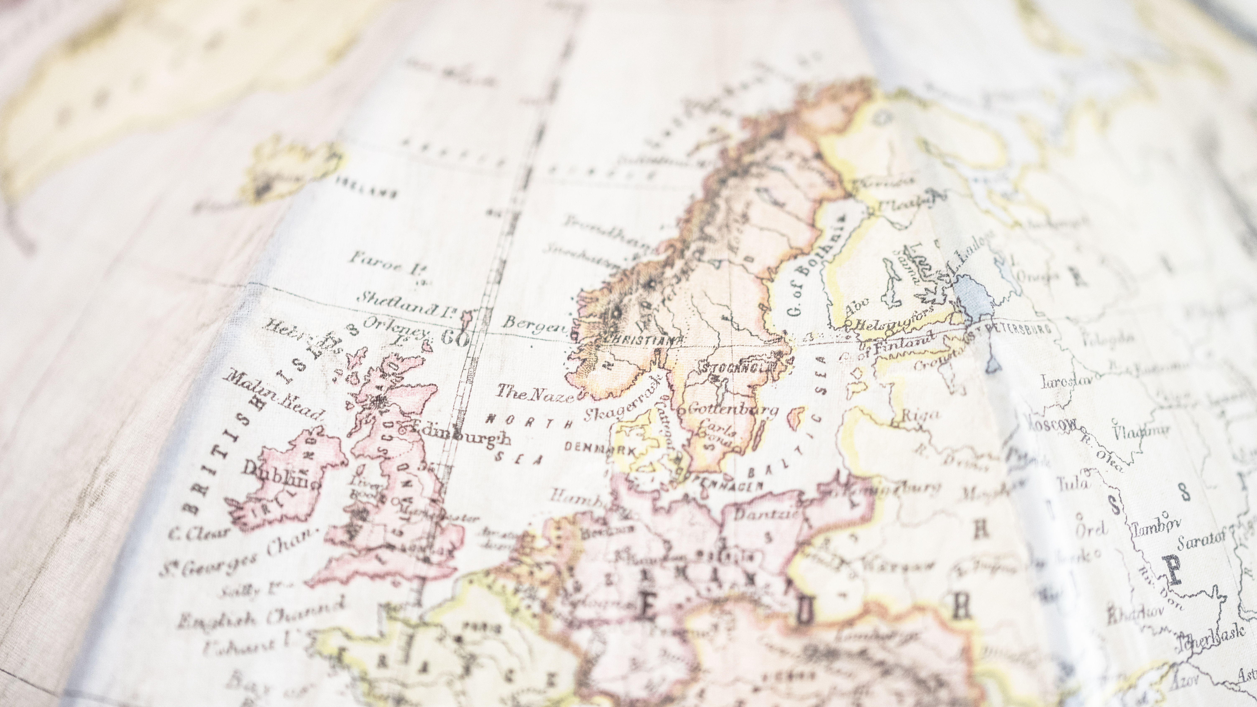

The OMC report – a perspective from Norway
Arne Gundersen

Slide 2
Content
My interest in the OMC group process
Why is the OMC report important in Norway
How can the OMC report be used at national and local levels
  The Belgian 3-step approach
  The Path for Growth
  Best practices
  European funding streams for public libraries

Slide 3
My interest in the OMC group process
Member of the board of NAPLE (National Authorities for Public Libraries in Europe)
  NAPLE is a network for all European countries, no only EU
  A report on European public library policy is important to NAPLE, so board members should engage
Member of the IFLA European Regional Division Committee (EURDC)
  EURDC should promote European library initiatives to the global library community
  EURDC recently presented the OMC report at IFLA’s World Library and Information Congress

Slide 4
OMC group – timeline for Norwegian involvement
April 2023
Plan for an OMC group launched at EBLIDA conference in Luxemburg
October 2023
Mandate decided for OMC group
February – June 2024
OMC group meetings without outside EU countries
November 2024
Third OMC group meeting (Norway observer)
December 2024
Consultation meeting between OMC group co-chair and outside EU countries
2025
Content deliveries from all countries to the OMC report (statistics, fact sheets, best practices)
March 2026
Presentation of draft report by OMC group co-chair at Norwegian library conference
July 2026
OMC report published

Slide 5
Why is the OMC report important in Norway?
The recommendations for library development are relevant to all countries, not only EU
Even though some recommendations are for EU level, there are still three other levels – national, regional, local
Norway is part of the European library community
  Norway can learn from Europe
  Europe can learn from Norway
Libraries in Norway can use the report in their practical work

Slide 6
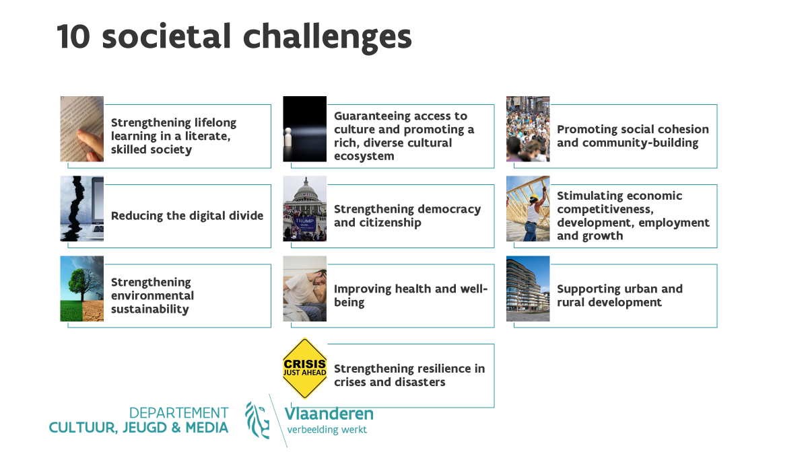
National level –
The Belgian 3-step approach
Methodology based on the 10 societal challenges
of the OMC-report

Slide 7
National level –
The Belgian 3-step approach
Sum up for every societal challenge what public libraries are doing in your country. Divide this in the different levels of government
Decide what societal challenges should be the priorities for the future
Take the selected societal challenges and think about what to work on using the six domains from the OMC-report
  Legislation and strategies
  Multilevel responsibility – who does what?
  Data collection
  Professional workforce
  Sustainable and inclusive public spaces
  Digital maturity and innovation

Slide 8
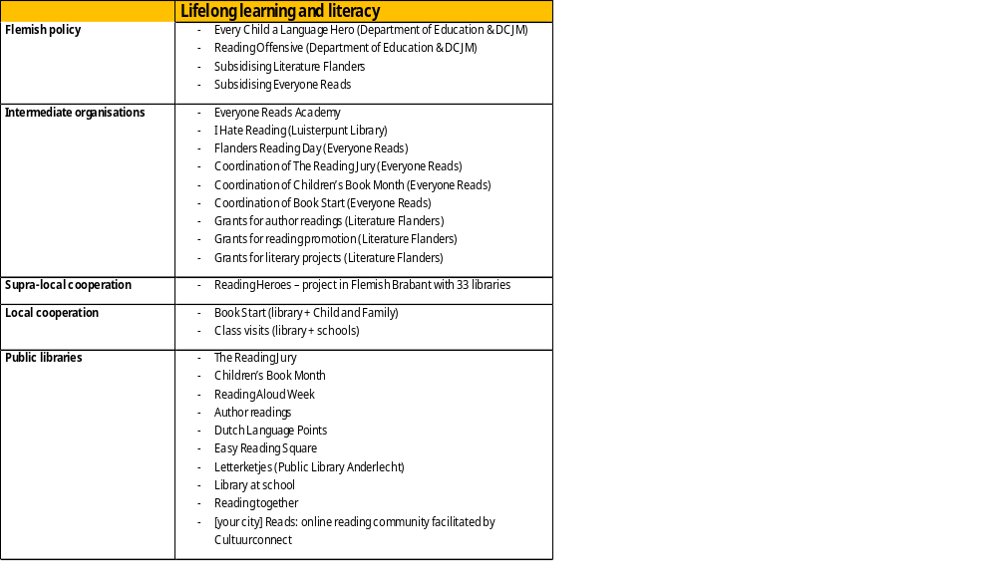
Step 1:
«Sum up for every societal challenge what public libraries are doing in your country. Divide this in the different levels of government”
Example societal challenge 1: Strengthening lifefelong learning in a literate and skilled society

Slide 9
Step 3:
“Take the selected challenges and think about what to work on using the six domains from the OMC-report.”
 | Lifelong learning and literacy
Legal and strategic framework
Agreements and responsibilities between policy levels
Data-based decisions
Professional staff
Sustainable and inclusive public places
Digital maturity and innovation
Example societal challenge 1: Strengthening lifefelong learning in a literate and skilled society

Slide 10
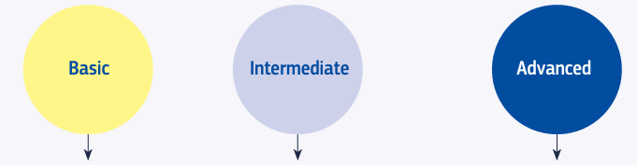
Local level – A path for growth –Developing the multiple roles
A self-assessment tool
European public libraries operate in very different environments: Urban/rural, well funded/resource-constrained, digitally advanced/digitally underserved
There is no single blueprint for success - instead, a flexible development model is needed
The Path for growth framework identifies three stages of development
  Basic level
  Intermediate level
  Advanced level
The framework offers structured recommendations for library development, guiding libraries on how they can expand their impact and adopt new roles
Individual libraries will not achieve the same stage across all roles, due to differences in resources, political support and local needs
Nevertheless, the three-stage model is a flexible planning and evaluation tool, adaptable to different contexts

Slide 11
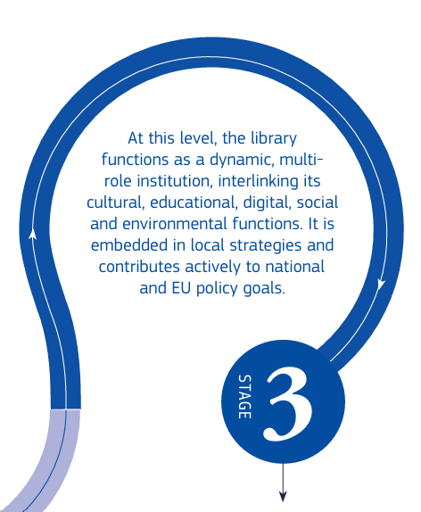
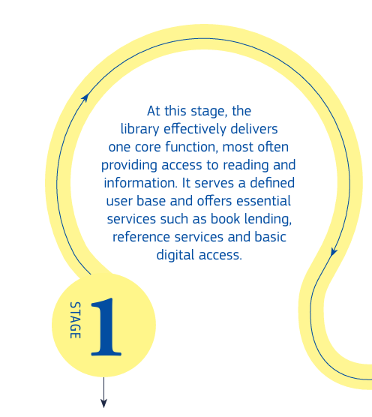
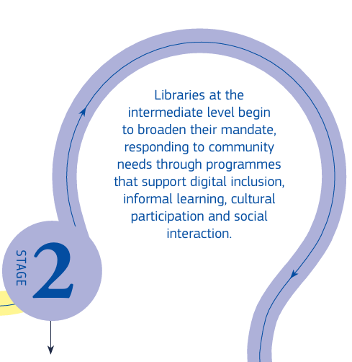

Slide 12
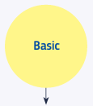
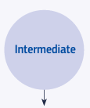
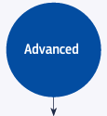
The three levels - characteristics
Basic level:
  Insufficient to address complex societal challenges
  Provides the infrastructure and community trust necessary to expand roles in the future
Intermediate level
  Shift from service provision towards community development
  Enables libraries to engage more effectively in local partnerships and contribute actively to societal development.
Advanced level
  Catalysts for societal transformation and resilience
  Strategic collaboration with partners at the local, national and European levels
  Implement projects aligned with broader policy goals and use evidence-based approaches to service development and advocacy.

Slide 13
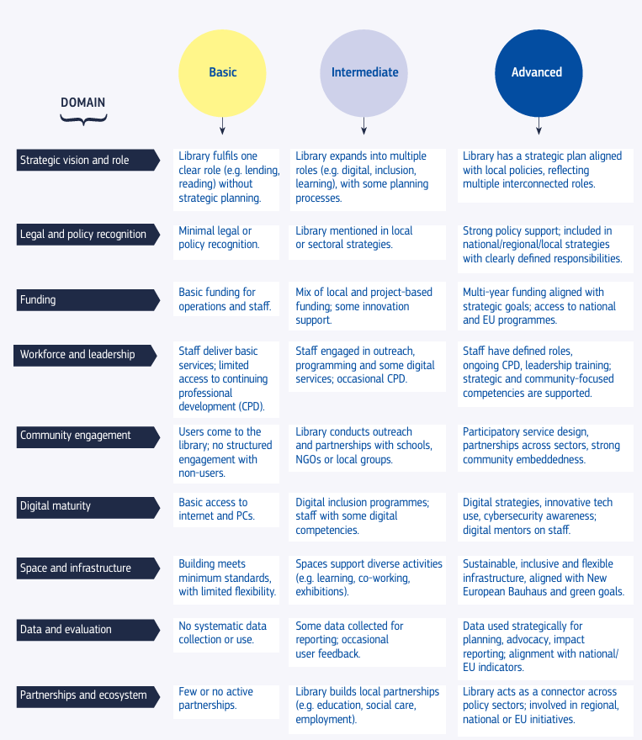
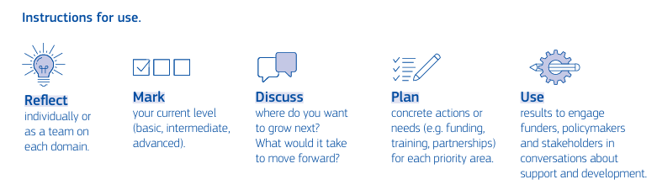

Slide 14
OMC group ambitions
- With adequate support from stakeholders and funders, the OMC Group recommends setting a target for libraries to achieve at least intermediate level by 2030 in relation to a majority of the 10 identified societal challenges.

Slide 15
OMC group recommendation
The OMC Group recommends the creation of a library development toolbox to support strategic planning and strengthen the enabling conditions for libraries
This toolbox should include, at a minimum:
  strategic dialogue questions
  a policy and investment checklist for local authorities
As the first, concrete step for this toolbox, the annex includes a self-assessment matrix
This allows libraries to assess their current position along the developmental path across key strategic domains
The matrix serves as a practical starting point to stimulate internal reflection, collective discussion and strategic planning.
It helps libraries identify strengths and gaps, forming the foundation for more targeted development and future engagement

Slide 16
Best practice examples
Societal challenge | Examples
1 Enhancing lifelong learning in a literate and skilled society | 11
2 Ensuring access to culture and promoting a rich, diverse cultural ecosystem | 6
3 Fostering social cohesion and building communities | 13
4 Narrowing the digital divide | 10
5 Strengthening the resilience and the functioning of democracy | 8
6 Stimulating economic competitiveness, development, employment and growth | 7
7 Contributing to environmental sustainability | 10
8 Improving health and well-being | 12
9 Supporting urban and rural development | 5
10 Building resilience for crises and disasters | 4

Slide 17
European funding streams for public libraries
EU PROGRAMMES | Examples
Creative Europe programme | 3
Erasmus+ programme | 4
Horizon Europe programme | 2
EU structural funds | 7
‣ European Regional Development Fund
‣ European Social Fund Plus
Asylum, Migration and Integration Fund | 2
CERV | 1
The rural development programmes | 1
OTHER EUROPEAN PROGRAMMES
The Europe Challenge (European Cultural Foundation)
EEA and Norway Grants

Slide 18
EEA and Norway grants - example
The European Economic Area (EEA) and Norway grants are financial mechanisms established by Iceland, Liechtenstein and Norway to
  contribute to reducing social and economic disparities in Europe
  strengthen bilateral relations with 15 EU countries in central and southern Europe
The funding is organised into multi-year periods. The current period is from 2021 to 2031, with significant financial resources allocated to various programmes
Implementation of the grants involves various stakeholders, including national and local authorities, NGOs, research institutions and private sector entities from both the donor and beneficiary countries
Projects are typically co-funded and require collaboration between entities from the donor countries and the recipient nations.

Slide 19
EEA and Norway grants – priority sectors
Innovation, research, education and competitiveness
Social inclusion, youth employment and poverty reduction
Environment, energy, climate change and a low-carbon economy
Culture, civil society, good governance and fundamental rights

Slide 20
EEA and Norway grants –
Beneficiary countries
15 Member States
Bulgaria, Czechia, Estonia, Greece, Croatia, Cyprus, Latvia, Lithuania, Hungary, Malta, Poland, Portugal, Romania, Slovenia and Slovakia

Slide 21
Libraries for local communities - project funded by EEA grants
National libraries of Poland (main partner), Iceland and Norway
3-year project
2 mill. euro
16 selected public libraries from Poland
A number of public libraries from Iceland and Norway
Conferences, work-shops, events and activities in Polish libraries, exchange of practice and experience

Slide 22
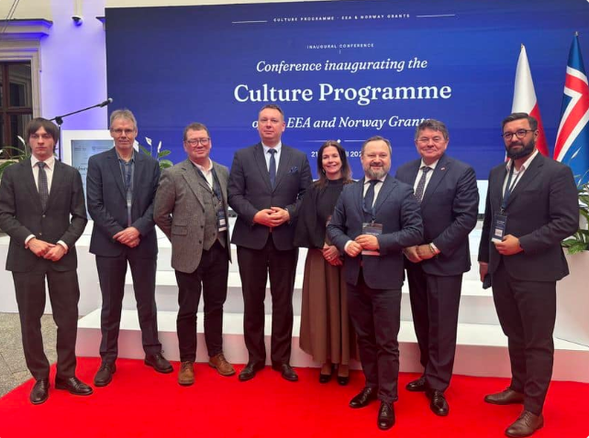
«Over €106 million for culture in Poland. The fourth edition of the 'Culture' programme was officially launched in Warsaw»
https://eeagrants.org/en/poland/programmes/culture/news/new-chapter-culture

Slide 23
Conclusion
The OMC report is the most important European policy document on public libraries for a long time
It is relevant far beyond the European Union
The report is practical for all libraries
Achieving the ambitions of the report will require cooperation. Libraries, governments, policymakers, funders, and international partners must work together

Slide 24
Thank you for your attention!
Arne Gundersen, Senior Adviser
National Library
PB 2674 Solli, N-0203 Oslo, Norway
Arne.Gundersen@nb.no
Tel. 47 9743 7692
www.bibliotekutvikling.no

