Slide 1



Sustainability in the Austrian Library Landscape
Ursula Liebmann – Austrian Library Association

Slide 2
Austrian Library Landscape
Agenda
BVÖ (ALA) – Offers & Support
Sustainability in Austrian Libraries
Examples
Perspectives

Slide 3
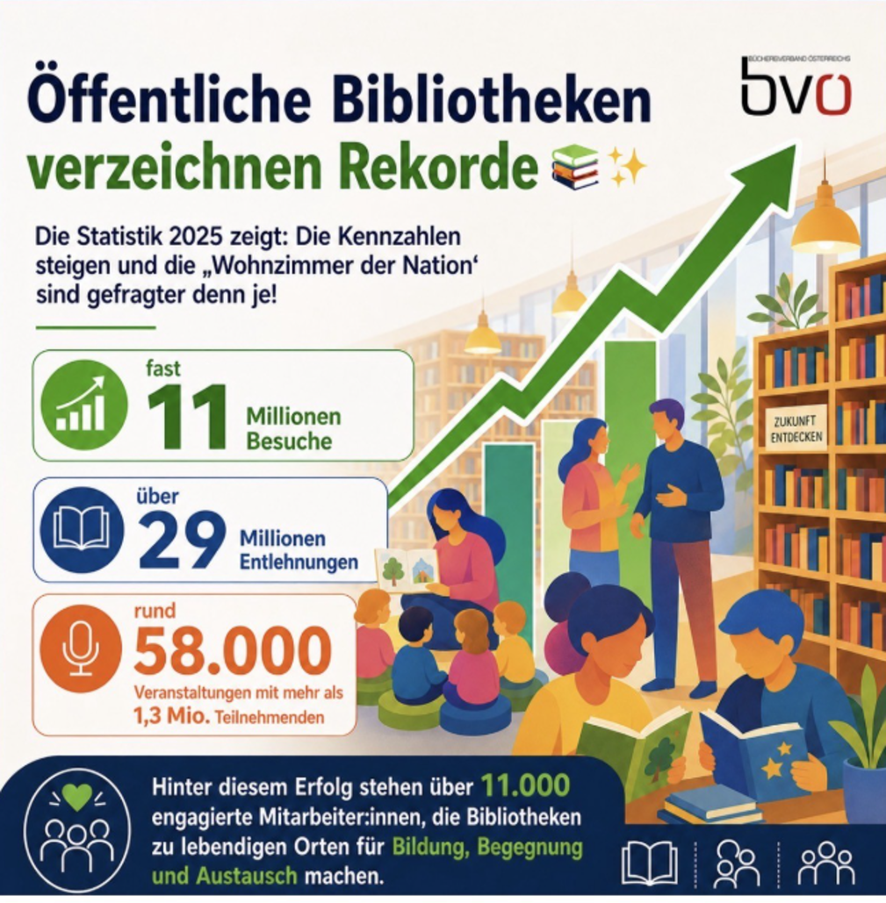
Austrian Library Landscape
Facts & Figures
9,2 mio residents
1.340 public libraries
11.300 librarians
84% volunteers (10.000)
700 community based
200 church based
340 cooperative
92,2 Mio. total expenses
9 states →
9 different infrastructures
No library act
Austrian Library Development Plan
Austria - IFLA - Library Map of the World

Slide 4

BVÖ (ALA) – Offers & Support
Library Funding
(Further)Education for employed and volunteer librarians
Digital Support (Websites, OPAC, library-platform Bibmail, statistics)
Publications: journal, newsletter, news, manuals, ...
Projects for reading motivation and other library topics
Erasmus+ Consortium
Advocacy, Lobbying & Public Relation
Büchereiverband Österreichs | BVÖ - Büchereiverband Österreichs
Schwarz: #000000
Weiß: #FFFFFF
Rot: #bb0007

Slide 5
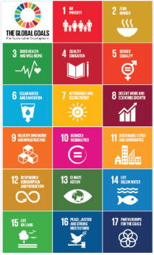
Sustainability in Austrian Libraries
Libraries:
various factors
(room, finance, support organization, team, interests, participation & cooperation.
9 states within Austria:
9 different service-centers or specialized offices:
various topics
various fundings
BVÖ (ALA)
project funding, connection inter-/national, information, cooperations, projects, materials
Picture: UN

Slide 6
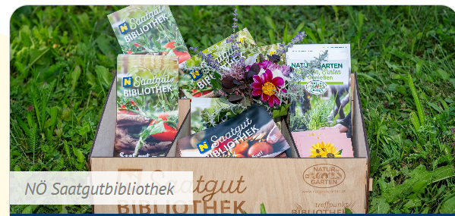
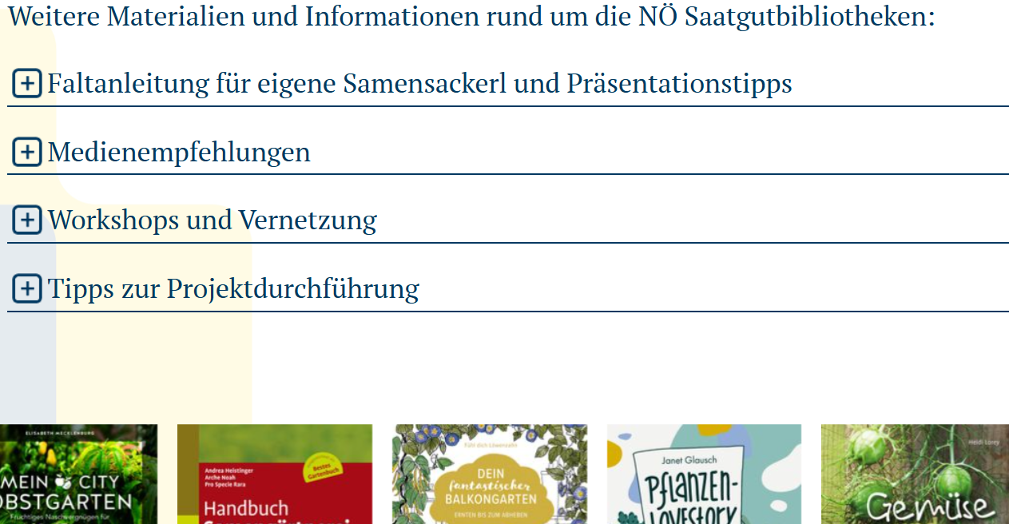

Example : Seed – library in Lower Austria
Treffpunkt Bibliothek – Meeting Point Library
Servicecenter of Lower Austria
NÖ Saatgutbibliotheken - Treffpunkt Bibliothek - Treffpunkt Bibliothek
Boxes and seed-bags
Manual, free-cards, posters, workshops
Cooperation with Nature in Garden
Around 100 active seed-libraries

Slide 7

Project ideas for Seed Libraries
Seed Exchange Day
Planting event in front of the library, f.i. with schoolchildren
Plant Exchange Market
Designing your own outdoor spaces with plants that can be used for seed collection
Lectures and workshops on seed collection and gardening
Making “seed bombs”
Hands-on activities (planting tomatoes, sowing seeds together, making seed pouches, harvesting together)
Readings, exhibitions, action days, harvest festivals, film screenings
Kickoff event for your Seed Library
All pictures: website

Slide 8
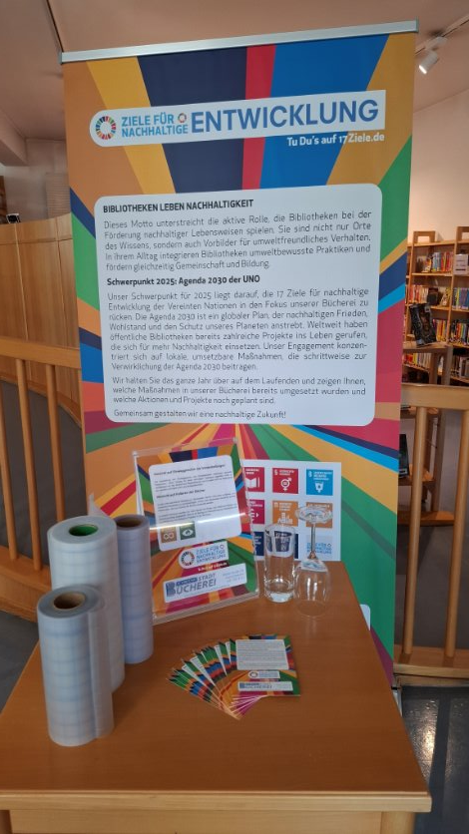
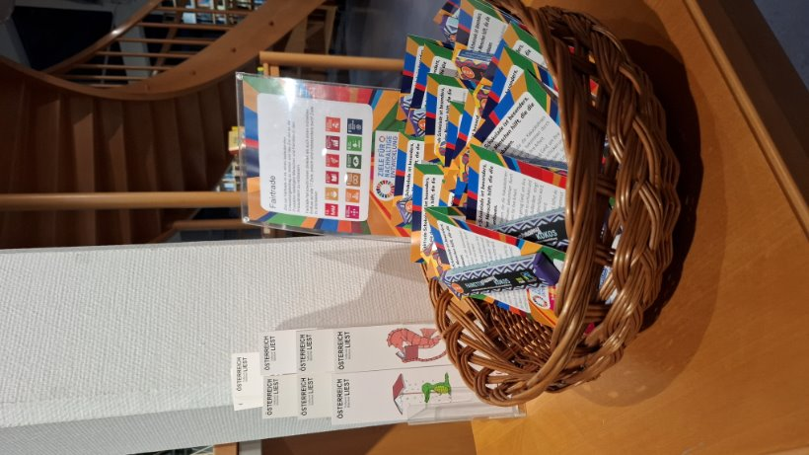

City Library Schwechat
Goals:
Raising Awareness of the 17 SDGs​​
Motivating visitors to take action themselves
Implementations:
CD, roll-up banner, promotional table in the entrance area
Eyeglass-Drive (Collecting for )
Regular visits to the Seniors Center
Readings & Workshops concerning this topic for all generations
Waste Management Association Information Booth
No plastic wrap and no single-use tableware
Open Games Cabinet
Reading Garden
Fair Trade Chocolate during the Austria Reads-Week
          Stadtbücherei Schwechat
          23.000 residents/pictures:Teleu

Slide 9
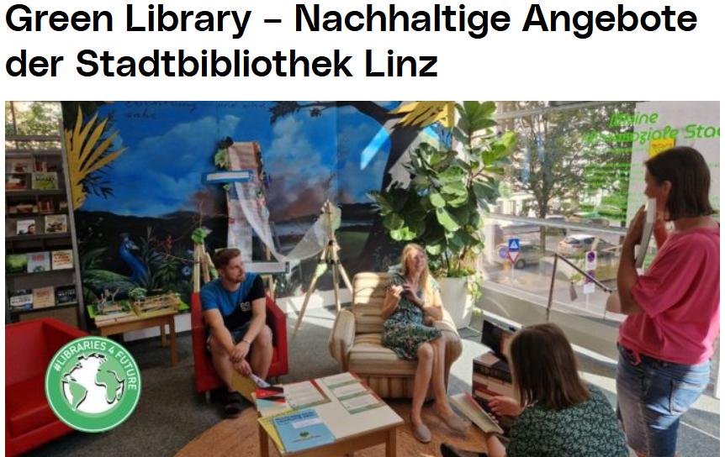
City Library Linz Stadtbibliothek Linz | Wissensturm Linz
What the Library offers for sustainability:
Food Sharing Stations – Combat Food Waste
Repaircafe – monthly
Library of things
Cargo Bike Rental: Linz-bicycle
Recycling & collecting boxes for:
CDs, DVDs, Mobiles, batteries, ...
Climate-corner:
Non-book-section with climate relevant media
215.000 residents/ picture: website

Slide 10
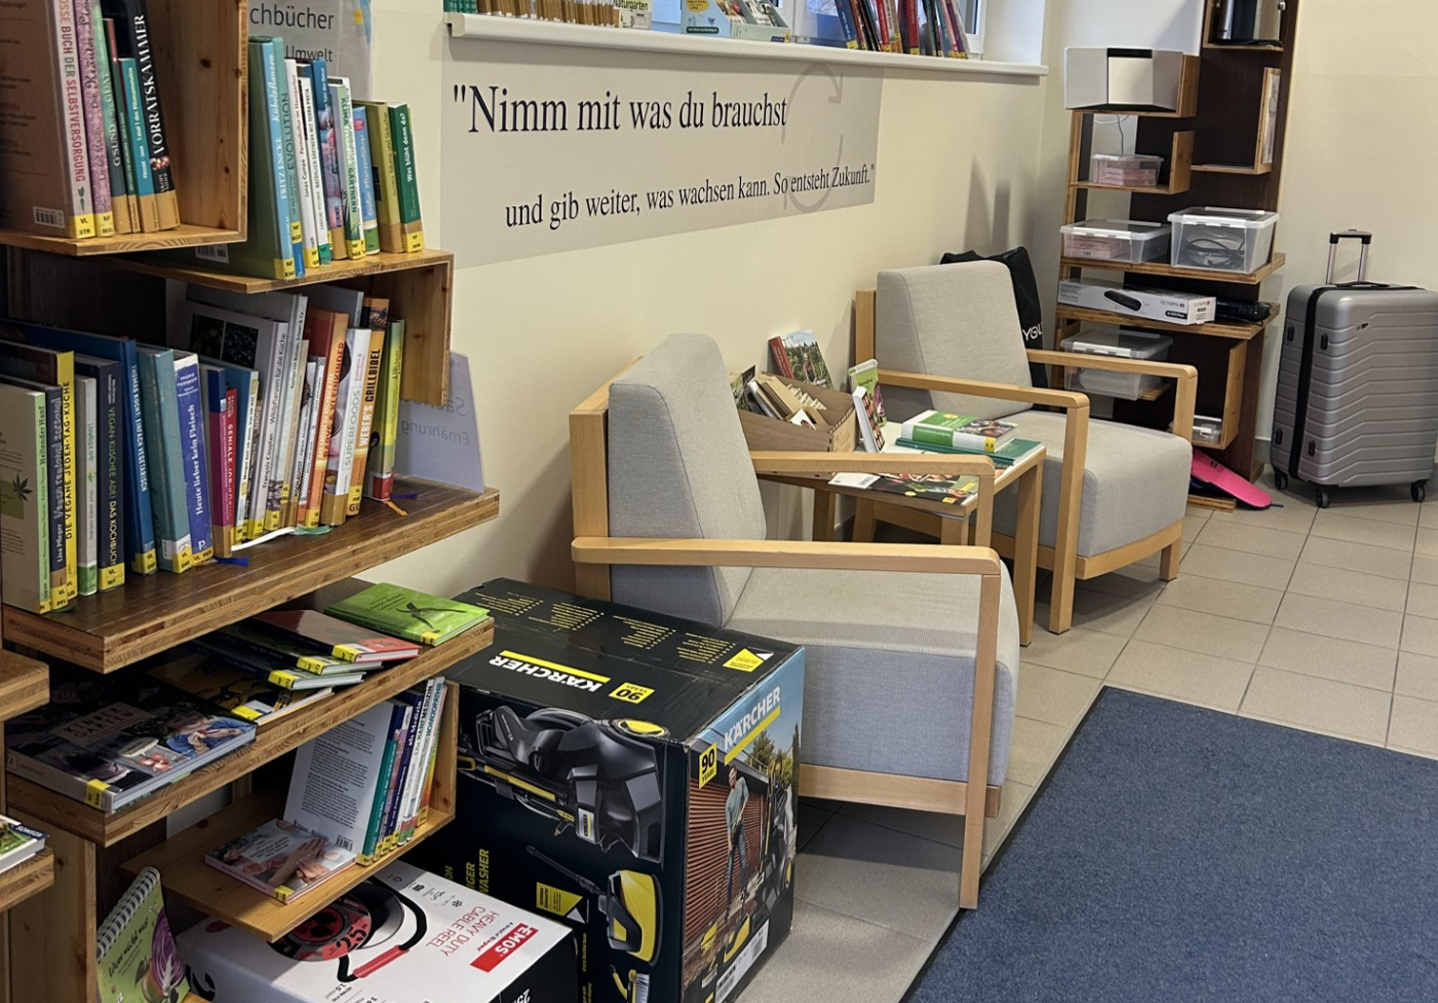
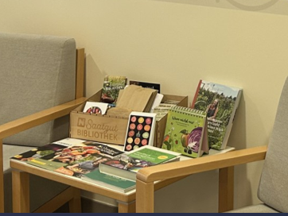
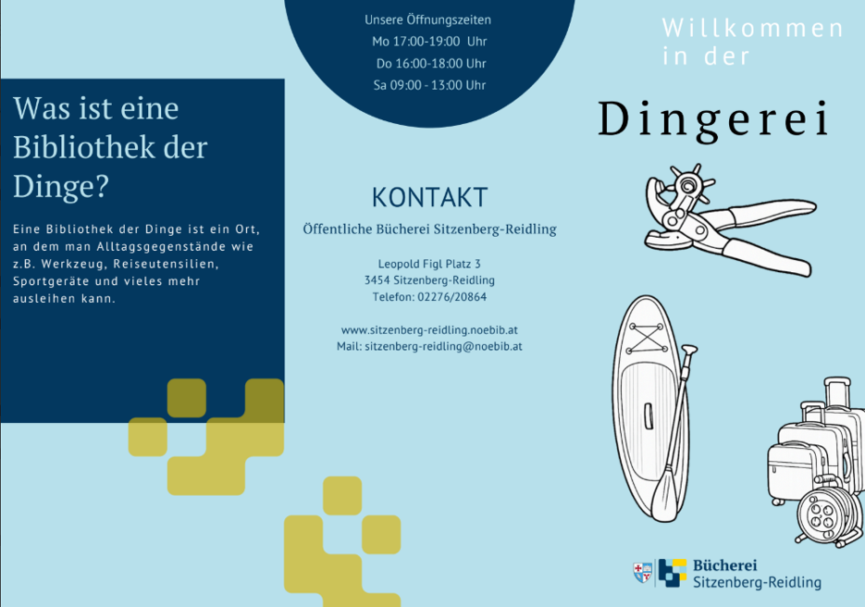
Cooperative Library Sitzenberg-Reidling
2.450 residents
Cooperative Library – 150m2
Team: 12 volunteers
Around 45 events a year
Öffentliche Bücherei Sitzenberg-Reidling
Library of Things & Seed Library Library
Pictures: U. Liebmann

Slide 11
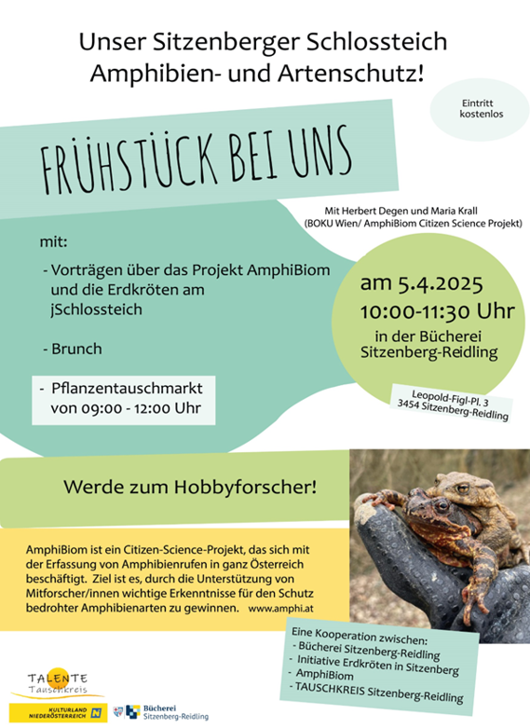
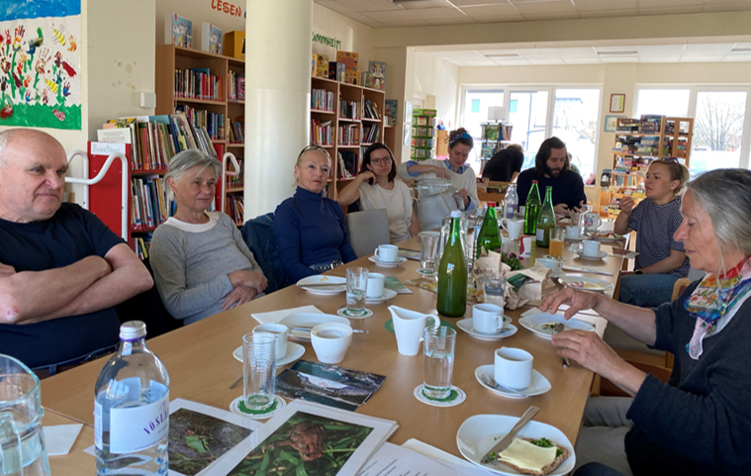
Cooperative library -Sitzenberg-Reidling
Citizen Science (Austria is researching & OeAD)

Slide 12
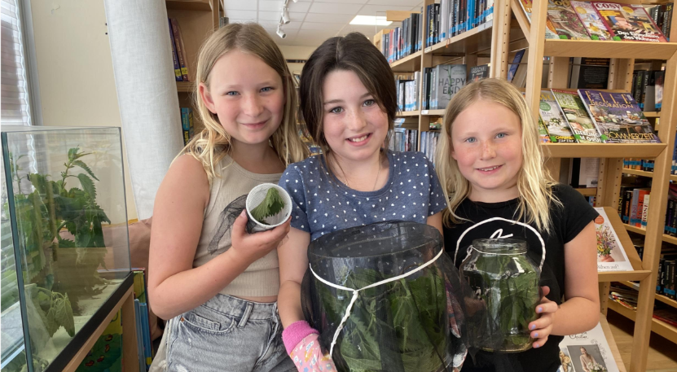
Library Schwertberg Bibliothek Schwertberg
The Schwertberg Librarys Butterfly Project
Since 2018, our butterfly project has made it possible to experience the transformation from caterpillar to butterfly up close. Numerous families and children have already enthusiastically participated, caring for and feeding the little creatures at home and witnessing the great miracle of hatching. For many families, this became an exciting adventure: collecting stinging nettles, observing, waiting, and finally rejoicing at the sight of the first butterfly in their own living room. The feedback continues to be overwhelming: children and adults alike are fascinated, school classes have used the project for lessons, and many families have reported that since then, no walk goes by without them taking a look at stinging nettles. To complement this, the library offers not only relevant literature but also workshops for aspiring butterfly breeders, and since 2024, an insect research station equipped with a microscope. (picture: website)
Winner of the Citizen Science Award 2026!

Slide 13
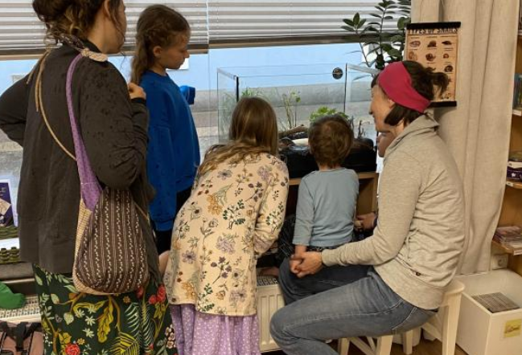
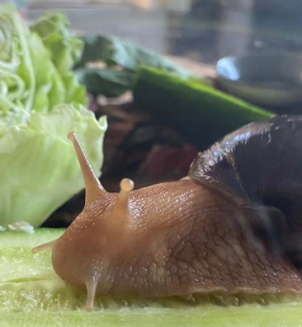
Library Schwertberg
The African agate snail is not only fascinating to watch, but it is also used as a therapeutic snail for children.
Additionally:
Dandelion puffs “make a wish- jars” – all over the year
Bio-Diversity project
MINT-(STEM)- Suitcase for a lot of workshops
Handmade Craftwork out of old books
Citizen Science
Library Drivers Licence for children
And many more projects often in cooperation/participation with the residents of Schwertberg and the surrounding regions
5.500 residents/Pictures: website

Slide 14
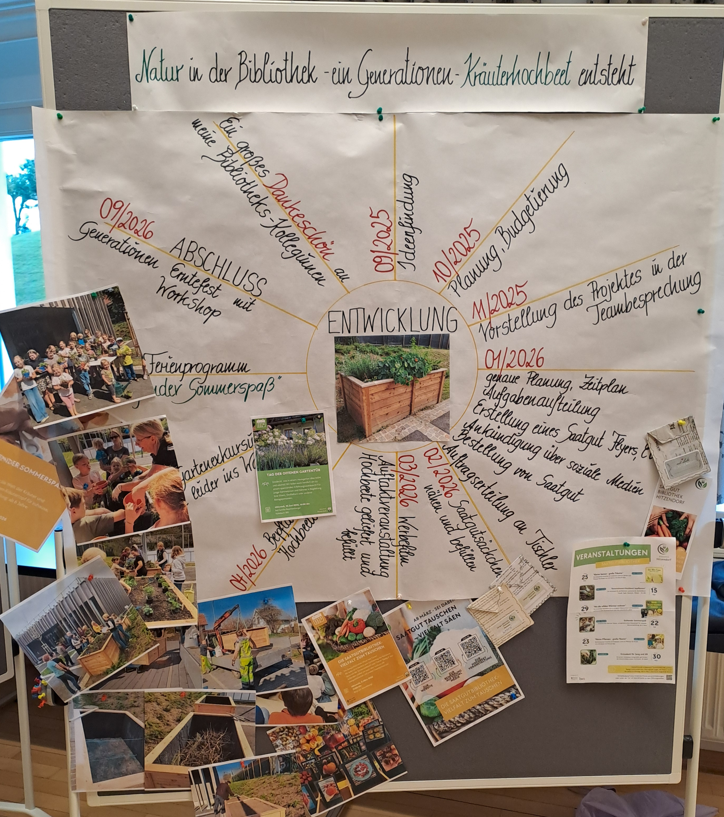
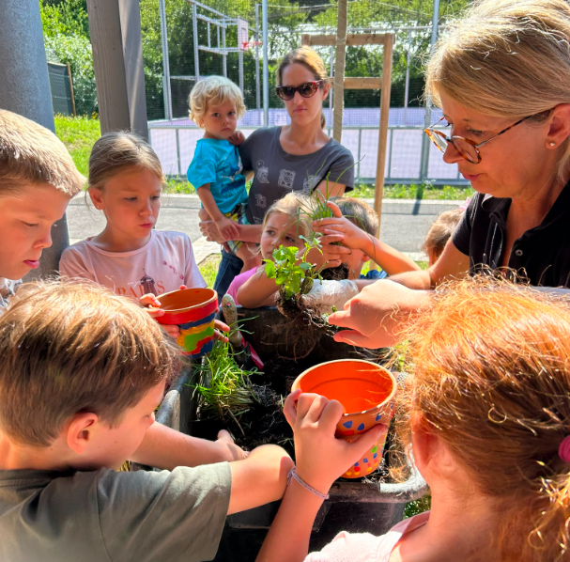
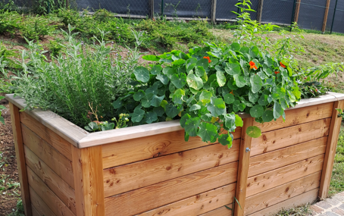
Library Hitzendorf Bibliothek Hitzendorf
Project: Generation-Raised bed
Building and planting
Workshops
Cooking
Look over fences
Story Cafes
Seed Library
Thanksgiving Celebration
7.400 residents/Pictures: Rauchenberger

Slide 15
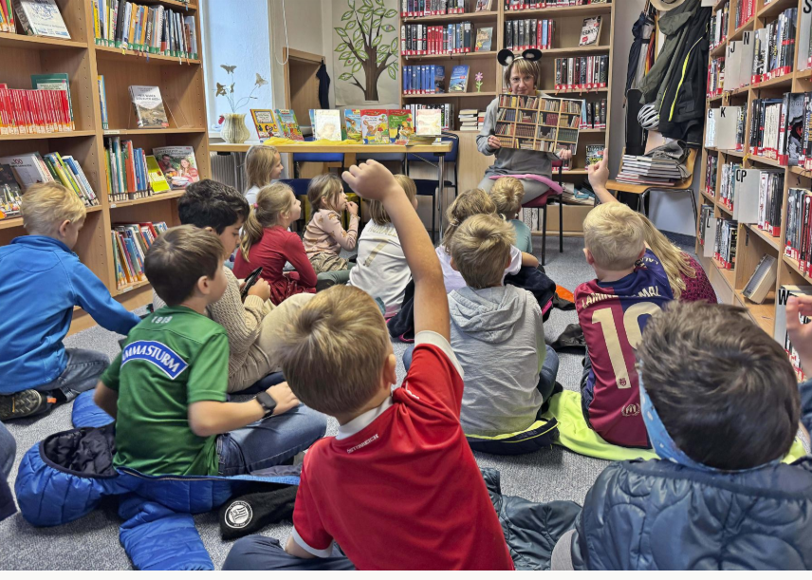
Kraubath - Library of the year 2026
Bücherei - Marktgemeinde Kraubath - 1.350 residents
Jury Statement
“The Kraubath Library was established in 1999 as part of an ecological land development program. As a “Green Library,” the library actively promotes Education for Sustainable Development (ESD) and embodies the goals of the UN Sustainable Development Goals (SDGs) in its daily work and in its outreach to visitors. Through networking and smart collaboration with many local organizations, the 10 volunteers have managed, to create a vibrant gathering place that is also highly regarded by the local community.
The librarys mission statement includes this beautiful line:
“We believe in the transformative power of reading and education, and that even a small library can make a big difference for the common good, for the community, and for the future.”
Submission for the Green Library Award picture: website

Slide 16

Useful informations for Green Libraries
IFLA ENSULIB
PL 2030
VÖB (AAL)
Environment, Sustainability and Libraries Section
IFLA Guidelines for Green Libraries – IFLA
Public Libraries 2030 | Connect. Innovate. Advocate.
Association of Austrian Librarians
Commission for Sustainability
Kommission für Nachhaltigkeit - Vereinigung Österreichischer Bibliothekarinnen und Bibliothekare

Slide 17

Libraries are key players in promoting
the Agenda 2030, the global plan for
peace, democracy, humanity
and environmental protection.

Slide 18
For working together
…let´s keep in touch!
liebmann@bvoe.at

