Slide 1
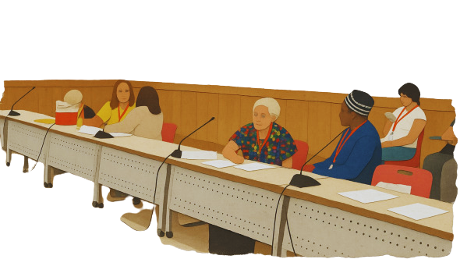

CAMILLA NOTARBARTOLO
MILAN PUBLIC LIBRARY SYSTEM
IFLA CPDWL SECTION 2023-2027
16 OCTOBER 2026
Professional coaching in theory and practice
Training workshop for professional coaches
How can coaching help library professionals unlock their own potential — and strengthen our organisations?

Slide 2

Why Professional Coaching Matters
Trend Report 2024 (updated in 2025)
Skills Agenda for the Trend Report 2025
Weak Signals Report 2026
Rapidly changing information environment:
  adaptability and resilience
  futures-oriented thinking
  leadership capabilities
Practical, partnership and personal development skills as essential for building a resilient and future-ready library workforce
Need for AI literacy, new leadership models, community-led design, climate engagement, trust in information ecosystems, and human-centred technology

Slide 3
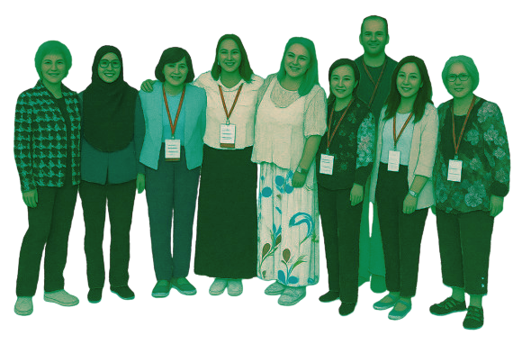
The IFLA CPDWL Coaching Initiative
  A joint initiative of the CPDWL (Continuing Professional Development and Workplace Learning) and the M&M (Management & Marketing) Section
  Developed with the support of IFLA Headquarters, the Professional Council and Professional Division C

Slide 4

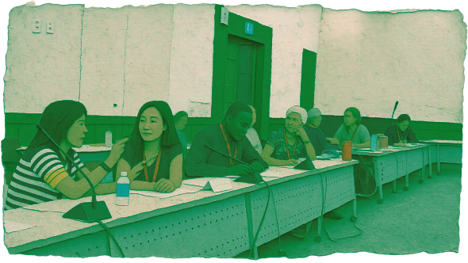
Two complementary formats
Online coaching
  virtual coaching session
  in different languages to support as many professionals as we can
  ongoing follow-up interactions between coaches and coachees
  at least a month of continuous engagement after the initial session
  Topics:
    Career development
    Leadership, Management, Staff Training
    Needs emerging from the IFLA Reports
In-person coaching
  at the WLIC – World Library and Information Congress
  in different languages to support as many professionals as we can
  single one-to-one coaching interaction of approx. 15-30 minutes
  Topics:
    individual’s career and professional development
    involvement in IFLA as an opportunity for professional development.

Slide 5

Dialogue as theoretical starting point
Dialogue is one of the most powerful tools for human-to-human relationships — irrespective of the title on the business card.
Dialogue can help us: • inform • get to know • acknowledge • give feedback • follow up • develop • empower
Different conversational tools can serve different purposes: • instruction • advice • tutoring • mentoring • pepping • coaching
The key question is: what does this person need from me right now?

Slide 6

What is coaching
  an approach → given the right support and tools, people can take responsibility for their actions
  a method → a coach supports people in achieving personal and professional goals
  a leadership style → unleashing motivation and potential
  a communication style → inspiring reflection, willingness and action

Slide 7

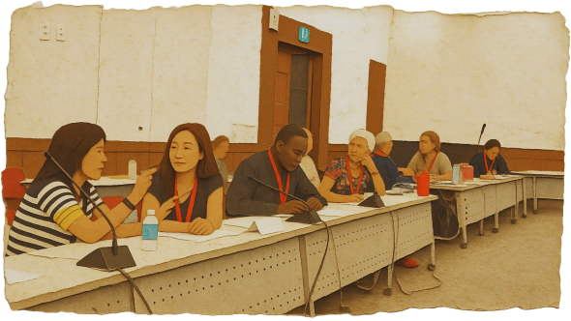
Coaching approach vs. Coaching
COACHING APPROACH
  A communication style and attitude
  Can be used in everyday conversations between people, irrespective of their role
COACHING
  A professional, structured dialogue between a coach and a coachee
  Usually based on a clear purpose and a formal agreement

Slide 8
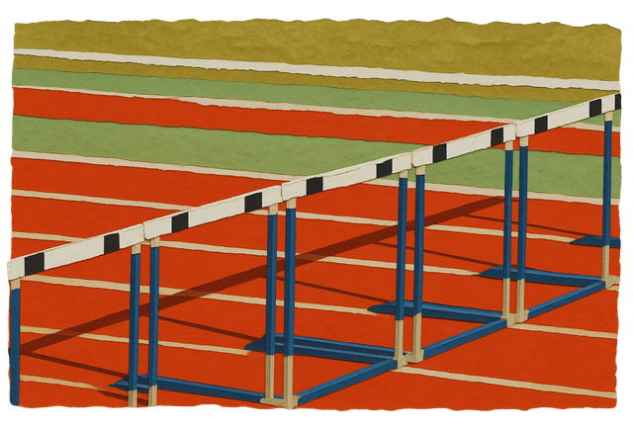



What does a Coach do
Moves people from where they are to where they want to be
Asks questions that inspire reflection and empower people
Helps people identify and overcome internal obstacles
Supports a mental state that liberates their natural capacity to develop and improve
Core idea: people are capable of learning, making choices and taking responsibility.

Slide 9
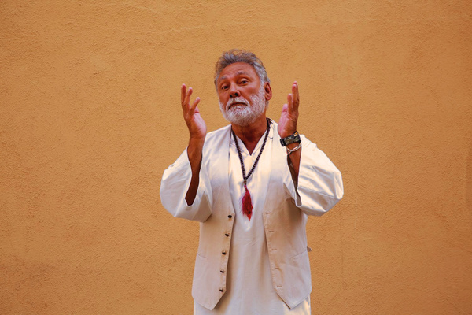
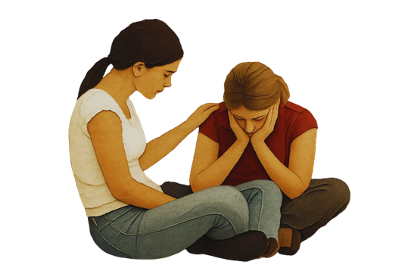
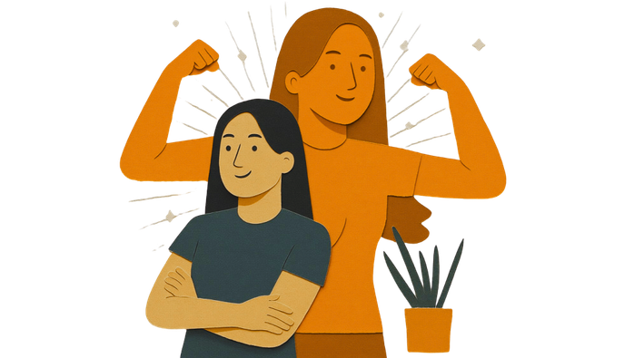

Coaching is NOT…
Pepping (boost someone to enhance his/her enthusiasm)
Cheering and praising
Having all the answers for someone else (making people do what you want)
Giving advice
Coaching is about creating the conditions for people to find and act on their own answers.

Slide 10

Essential Coaching Tools
ACTIVE LISTENING
  Internal listening → listening mainly through our own experience and thoughts
  Focused listening → attention is fully on the other person
  Global listening → adding what we hear, observe and sense
→ Avoid the SHIFT RESPONSE: moving the focus back to ourselves
→ Use a SUPPORT RESPONSE: help the other person go deeper
THESE ARE NOT ONLY COACHING TECHNIQUES: THEY ARE EVERYDAY PROFESSIONAL CAPABILITIES.

Slide 11

Essential Coaching Tools
POWERFUL QUESTIONS
  Good coaching questions are:
    open, simple, short
    one at a time
    probing, challenging
    timely
  They invite clarification, exploration and learning
  They create new perspectives
  They inspire willingness and action
A useful rule: ask less — and listen more.
THESE ARE NOT ONLY COACHING TECHNIQUES: THEY ARE EVERYDAY PROFESSIONAL CAPABILITIES.

Slide 12
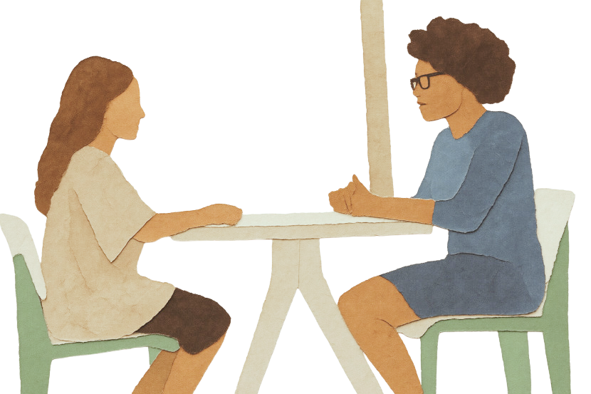
Essential Coaching Tools
CONSTRUCTIVE FEEDBACK
Effective feedback supports learning and development when it is:
  Relevant
  Understandable
  Respectful
  Specific and concrete
  Actionable
  Focused on behaviour, not on the person
When giving feedback: be direct, timely, honest, concrete, empowering and respectful.
THESE ARE NOT ONLY COACHING TECHNIQUES: THEY ARE EVERYDAY PROFESSIONAL CAPABILITIES.

Slide 13

Growth mindset
The mindset for giving and receiving feedback:
  abilities can be developed
  skills can be trained and improved
  failure is part of learning
Everyone needs to feel significant, competent and respected.
When people feel psychologically supported, empowerment, commitment and engagement can grow.
Feedback is a gift — it works best when it is given with good intentions and received with openness.

Slide 14
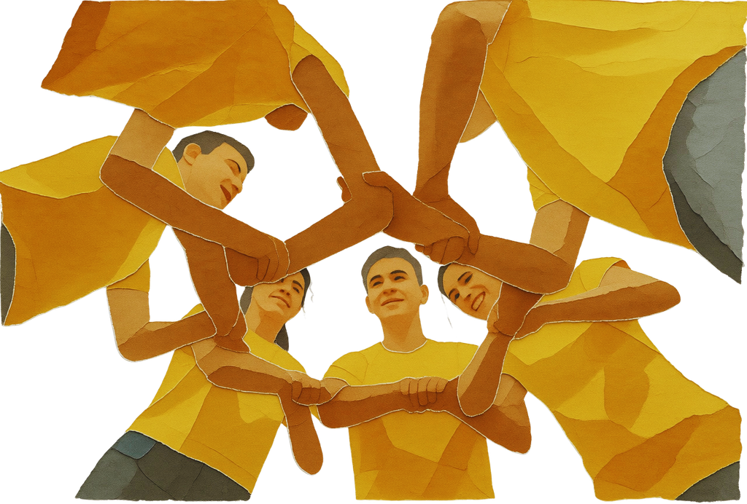

The impact of empowerment
ORGANISATIONS & PRODUCTIVITY
  Performance and initiative
  Team effectiveness
  Time and business management
  Healthy and sustainable organisations
  Innovation and competitiveness
ATTITUDE & PEOPLE
  Self-confidence
  Relationships
  Communication skills
  Motivation and commitment
  Learning and development
  Work/life balance

Slide 15

Mini practice: coach, don't advise
  Think of a real professional dilemma you are currently facing
  In pairs, one person speaks for 2 minutes.
  The other person may only:
    listen actively
    ask open questions
    avoid giving advice
  Switch roles if time allows
Debrief: What changed when you resisted the temptation to solve the other person's problem?

Slide 16
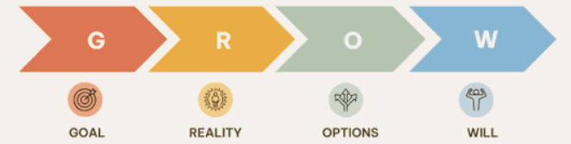
The GROW model
GOAL: What do you want to achieve?
REALITY: Where are you now?
OPTIONS: What alternatives do you have?
WILL: What actions will you take? What is your first step? When?

Slide 17

A practical coaching conversation
  Dilemma → What would you like to talk about?
  Goal → What would you like to achieve?
  Current state → What is the current situation?
  Dream → What would be an ideal situation?
  Alternatives → What options do you have?
  Risks & opportunities → What do you see?
  Best alternative → What feels most useful?
  First step → What will you do first?
  Timing → When will you start?
Coaching is about unlocking potential, not providing solutions.

Slide 18
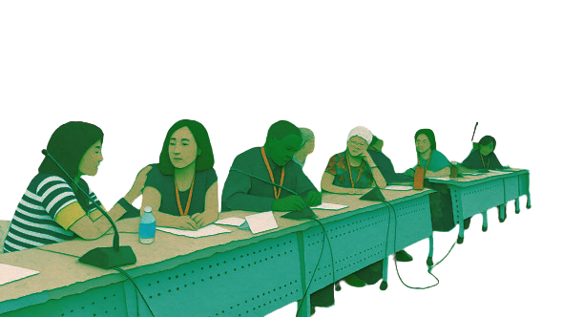
Coaching practice
  Give it a try!
  In pairs, using the CPDWL worksheet
  Interaction of approx. 15 minutes each
  Rotate to switch partner and role (from coach to coachee and viceversa)
Debrief: How did you feel? Would you be eager to become a professional coach within your institution? Would you be interested in contributing to create a SLA Coaching Initiative based on the IFLA CPDWL and M&M Sections model?

Slide 19
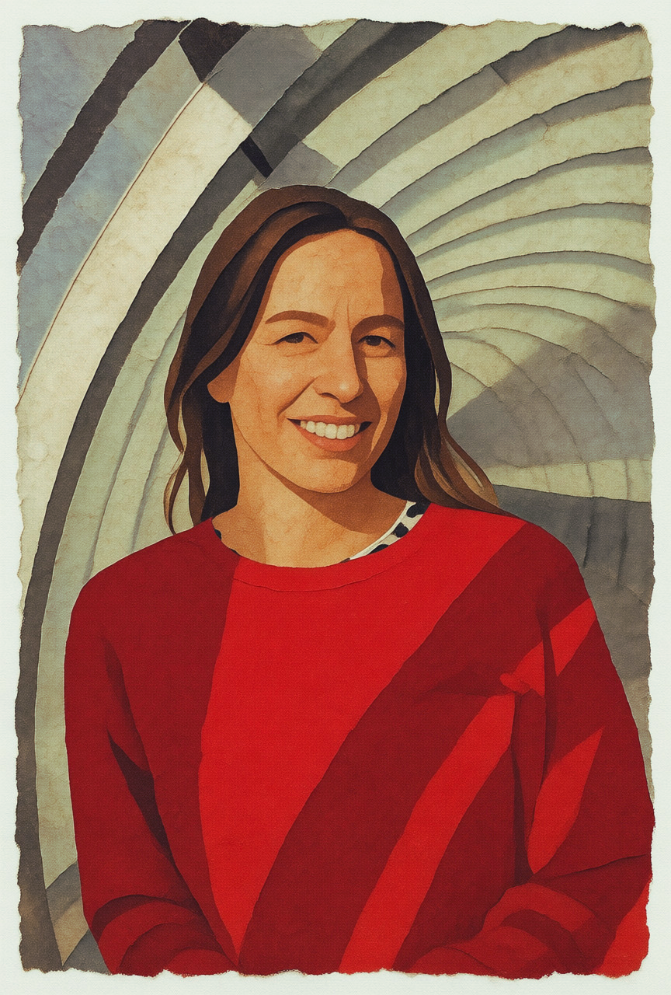

Thank you
To contact me as Head of Training at Quality at the Milan Library System: camilla.notarbartolo@comune.milano.it
To contact me as Chair of the IFLA CPDWL Section and as a member of the Italian Library Association:
camilla.notarbartolo@aib.it

