Slide 1
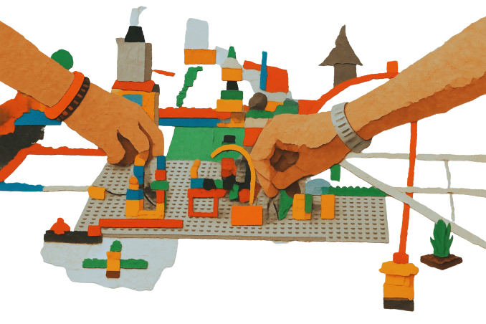

CAMILLA NOTARBARTOLO
MILAN PUBLIC LIBRARY SYSTEM
IFLA CPDWL SECTION 2023-2027
KONGRES ZBDS
17 SEPTEMBER 2026
The importance of being proactive
Some suggestions for institutions, organisations and individuals on how to improve through a professional development and workplace learning strategy.
Professional development is not something that happens to us. It is something we actively build, individually and collectively.

Slide 2

A Simple Question
Can library professionals afford to wait for the next training course?
  AI tools evolve monthly
  Information ecosystems change continuously
  User expectations evolve rapidly
  New professional roles are emerging
The future belongs to professionals who learn continuously.

Slide 3

Why This Topic Matters Now
We are experiencing
  AI-driven transformation
  New knowledge practices
  Increasing complexity of skills
  Changes in trust and information behaviour
  Growing need for partner and community engagement
These trends are highlighted in the IFLA Trend Report 2024 (updated 2025)

Slide 4

The Core Message
Librarians must take an active and continuous role in their own professional development.
We can no longer rely solely on:
  occasional workshops
  annual conferences
  formal courses
Learning must become part of everyday professional life.

Slide 5
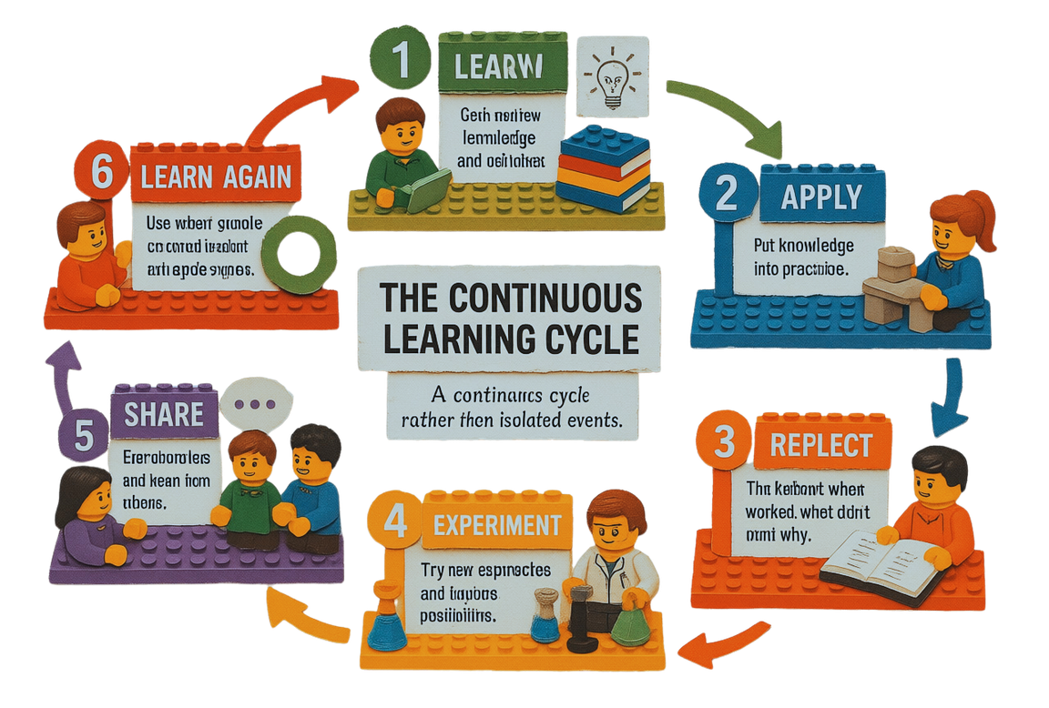
Professional Development Has Changed
Traditional model
Learn → Apply
Emerging model
Learn → Apply → Reflect → Experiment → Share → Learn Again
A continuous cycle rather than isolated events.

Slide 6
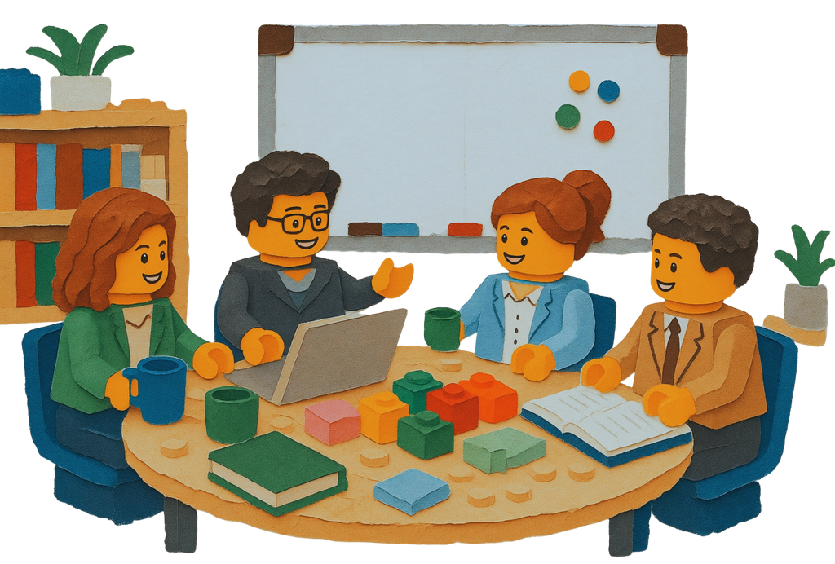
Continuous Learning is Daily Work
Professional development today includes
  following professional news
  reading reports and research
  exploring new technologies
  testing tools
  discussing with colleagues
  learning from successes and failures
The Mindset We Need
Three essential attitudes
  Curiosity: "What is changing?"
  Initiative: "What should I learn next?"
  Courage: "What happens if I try something new?"

Slide 7

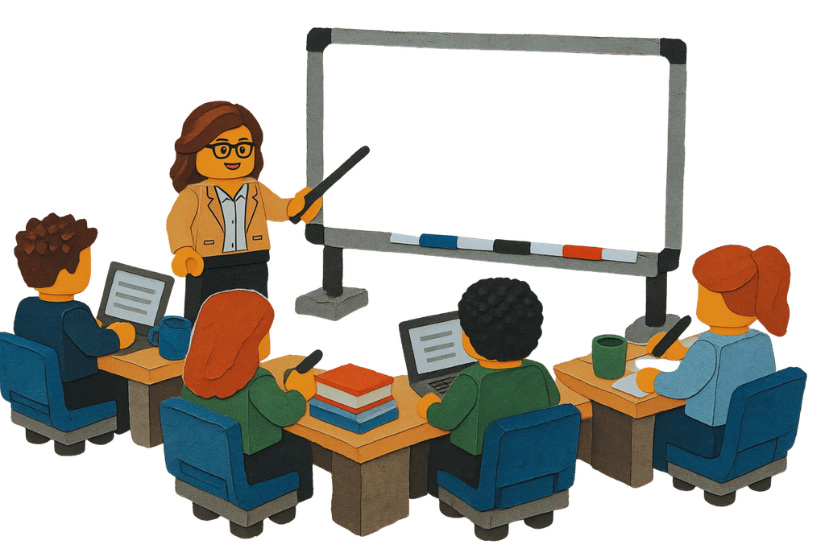
What to do
Formal Learning Still Matters
Taining programmes remain essential.
They provide:
  structure
  expert guidance
  certification
  common standards
But they must be complemented by self-directed learning.
Continuous Learning as a Day-To-Day Attitude
Professional development is
  not an extra activity
  part of professional practice
Learning should be embedded in daily work

Slide 8
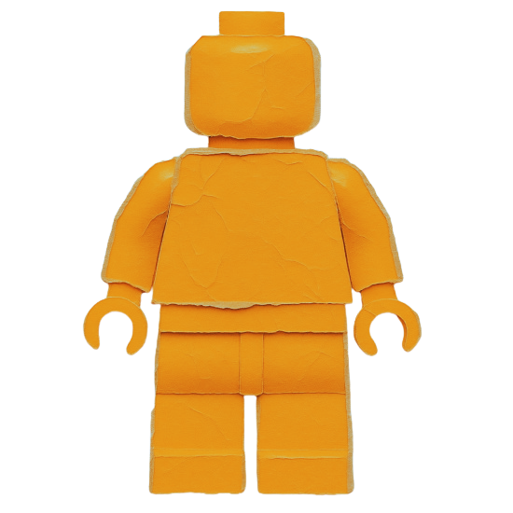

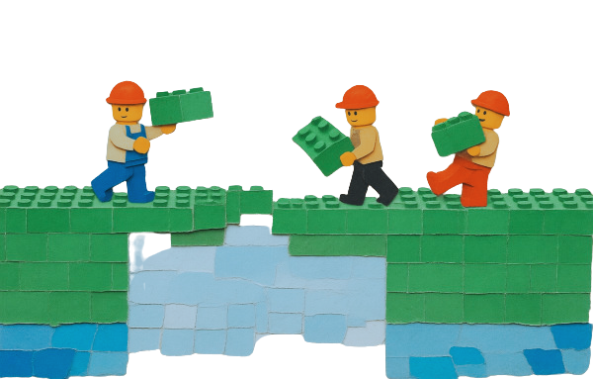
Who’s Responsible for it?
Individual Professionals
Employers and Library Managers
Professional Associations
Own their learning
Professional growth begins with personal responsibility.
Create the conditions for learning
People cannot continuously learn if organisations do not provide support.
Enable and connect
Associations transform individual learning into collective professional growth.

Slide 9

What is IFLA
IFLA – International Federation of Library Associations and Institutions
  promoting
    high standards of delivery of library and information services and professional practice
    accessibility, protection, and preservation of documentary cultural heritage
    professional education, the development of professional standards, the dissemination of best practice and the advancement of relevant scientific and professional knowledge;
  encouraging widespread understanding of the value and importance of high quality library and information services in the public, private and voluntary sectors;
  representing the interests of its Members and library and information organizations and the communities they serve throughout the world.

Slide 10

About the CPDWL Section
The CPDWL Section embraces all aspects of professional development and learning in the workplace from the period post-qualification to the end of a career.
The imperative for library associations and institutions to be ‘learning organisations’ requires them to provide opportunities for ongoing staff development or workplace training, and individuals to be responsible for their own career planning and development. The Section brings together those who are interested in and responsible for the quality improvement of processes for delivering continuing professional development and workplace learning programs: Learners; Employers; Professional Associations, consortia, government agencies, and other bodies with library development responsibilities; Library/Information Science (LIS) degree-granting programmes; All providers.

Slide 11
About the CPDWL Section
IFLA Guidelines for Continuing Professional Development
Major Activities
Podcast Project: library leaders share their perspectives on our profession (Spotify)
CPDWL Webinars: webinars on issues of interest to library and information professionals (Youtube)
Coaching Initiative: Face-to-face and online coaching sessions
Section Newsletter: showcases the work of the section and good CPD practices
Blog: inspiring librarians write articles about cpdwl
Social Media: FB (active) and LinkedIn , IG (to be reactivated)
Recommendations for all stakeholders involved in CPDWL of library and information professionals

Slide 12
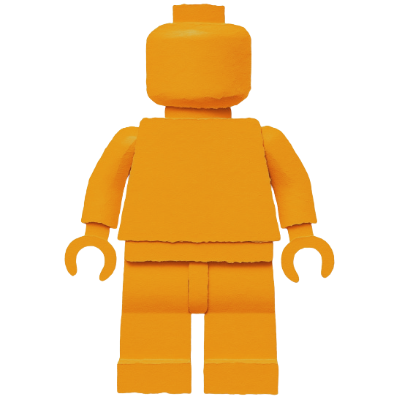
IFLA Guidelines for Continuing Professional Development
The Learner
Principle: The individual library and information professional is primarily responsible for pursuing ongoing learning that constantly improves knowledge and skills.
Rationale: Ethics codes generally include statements such as “Librarians and other information workers strive for excellence in the profession by maintaining and enhancing their knowledge and skills” (IFLA, 2012). Individuals are responsible to themselves, their profession and society.
The
Learner

Slide 13
IFLA Guidelines for Continuing Professional Development
Best practice: The Learner
  conducts regular self-assessment congruent with job responsibilities and aspirations;
  participates in performance appraisals;
  monitors developments that impact the profession and seeks out and uses opportunities to close competency gaps and to advance knowledge and skills;
  develops a personal learning plan that will lead to both improvement in current performance and future career advancement;
  makes judicious choices of formal and informal learning resources based on the best available information;
  seeks learning needed for present responsibilities before preparing for a new position.
The
Learner

Slide 14

IFLA Guidelines for Continuing Professional Development
The Employer
Principle: Employers/Managers of library/information personnel are responsible for providing staff development programmes and support for continuing education.
Rationale: “The librarian is an active intermediary between users and resources, both digital and traditional. Sufficient human and material resources, as well as professional and continuing education of the librarian, to meet the challenges for now and in the future, are indispensable to ensure adequate services.” (IFLA/UNESCO, 2022). It follows that the organization responsible for providing service to its users is also responsible for enabling staff to maintain competencies and to continue to learn.
The Employer

Slide 15
IFLA Guidelines for Continuing Professional Development
Best practice: The Employer
  designates one individual to oversee staff development; provides a system of regular needs assessment, resulting in learning plans for both individuals and staff as a whole; ensures access to a broad range of learning opportunities, both formal and informal, from basic to advanced training; periodic evaluation of the staff development program
  conserves consistent documentation of an individuals’ participation in learning; recognises the learning through new assignments, and in compensation and promotion decisions;
  a minimum of 0.5% to 1.0% of institutional budget for staff development; approx. 10% of work hours to professionals for attendance at workshops, conferences, in-service training, and other educational activities, as well as for informal learning projects, including professional association and publishing work
The Employer

Slide 16
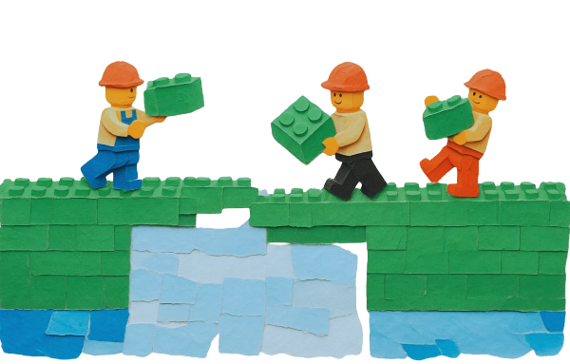
IFLA Guidelines for Continuing Professional Development
Professional Associations
Principle: In the interest of advancing the profession, associations and other organizations are active providers, advocates, and arbiters of continuing professional development quality.
Rationale: Professional associations can build consensus for quality by enabling the adoption of guidelines and systems such as provider approval programmes and recognition of member’s professional development achievements; government bodies may be responsible for administering certification/licensure programmes.
Professional Associations

Slide 17
IFLA Guidelines for Continuing Professional Development
Best practice: Professional Associations
  promote quality continuing education for the LIS profession
  in their role as providers of learning activities and events they also:
    develop guidelines, recognition systems, certification/licensure processes;
    identify topics and learning needs that should be addressed by the organization;
    coordinate efforts in their area of expertise and/or geographical region and promote collaboration in continuing education provision, including train-the-trainer projects;
    disseminate timely and accurate information about continuing education opportunities to their constituencies;
    sponsor resources such as publications, electronic communication, and learning objects that inform education
Professional Associations

Slide 18
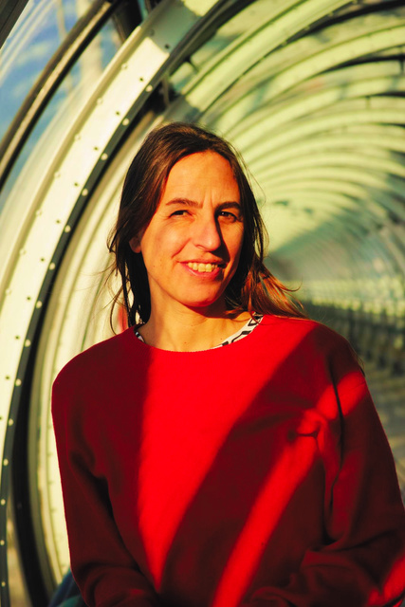


OWN YOUR LEARNING
What each stakeholder should do
  Stay curious and informed
  Identify personal skills gaps
  Explore new tools and practices
  Build a personal learning routine
  Take initiative rather than waiting for opportunities
Individual Professionals
Camilla Notarbartolo
  Allocate time for professional development
  Invest in training and learning resources
  Encourage experimentation and innovation
  Support mentoring, coaching and peer learning
  Embed learning into workplace culture
  Recognise achievements
Employers and Library Managers
The Milan Library System
  Provide standards and guidelines
  Offer training opportunities
  Facilitate networking and communities of practice
  Disseminate new knowledge and trends
  Advocate for investment in the profession
Professional Associations
IFLA

Slide 19
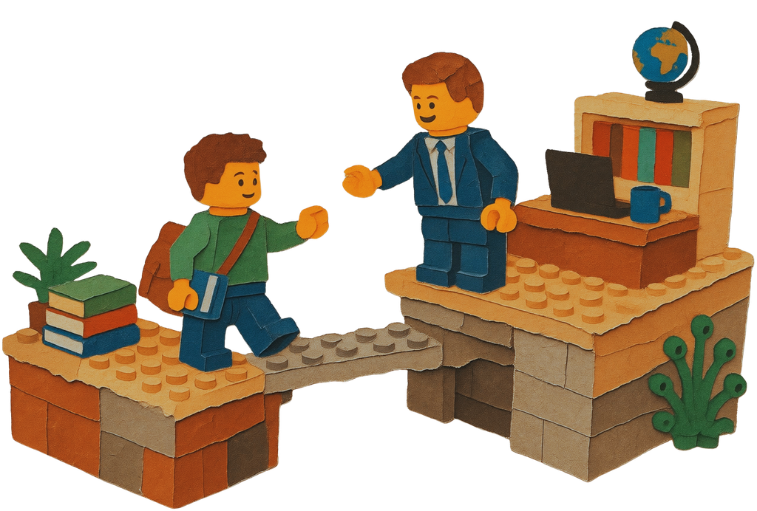
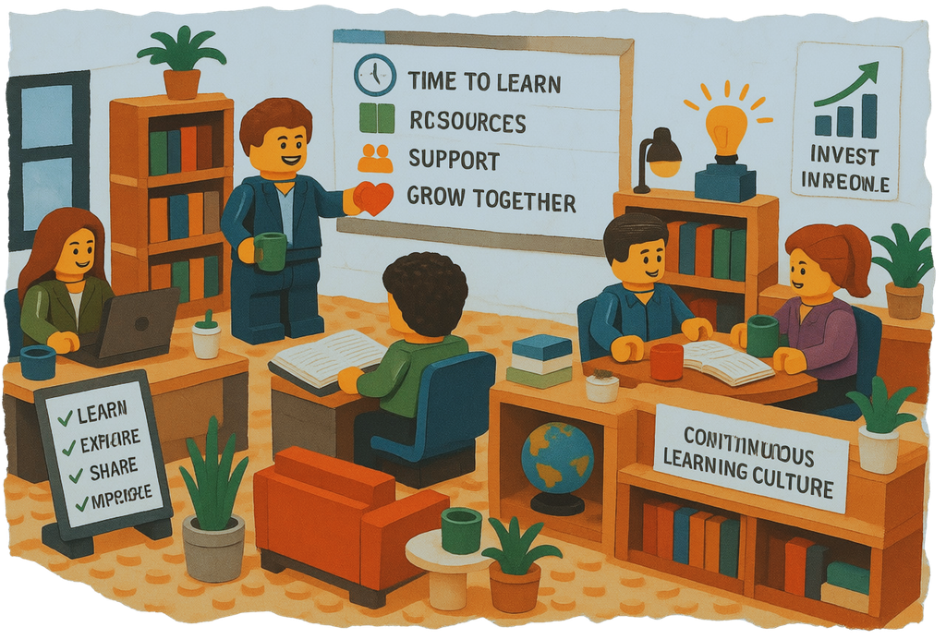

The Role of Employers
Individuals cannot do everything alone.
  Organisations must create conditions that support learning.
  Professional development is also a management responsibility.
In the next part of my presentation, we will see how the Milan Library System supports its employees in their continuing professional development.

Slide 20
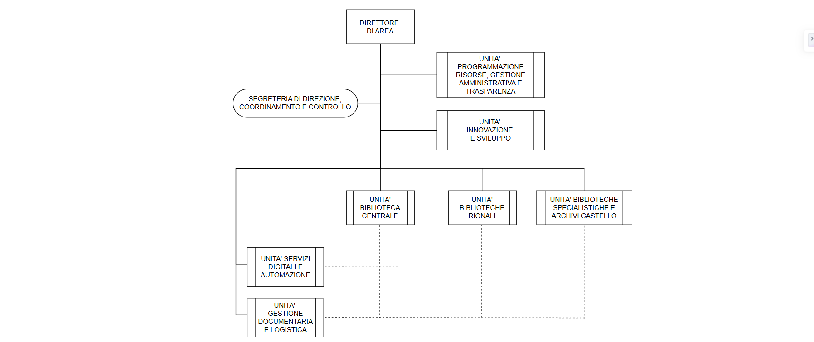
The Milan Library System

Slide 21
The Milan Library System
The Innovation and Development Unit includes:
  Innovation and Development Office ( 5 staff members)
    Reading Promotion
    Special Projects
    Proximity Libraries and Prison Libraries
    Social Report
  Libraries Promotion Office (5 staff members)
    Website
    Social Media
    Corporate Identity
    Posters and flyers
  Training and Quality Office ( created in 2015, 2 staff members)
    Trainings
    European Mobility
    EU projects
    Coordination of the MIL Working Group
    Library Visits, Internships, Traineeships

Slide 22
The Milan Library System
TRAINING OFFICE PLATFORM where you can find teaching materials, links
to professional development opportunities, news on training opportunities, and details of conferences and trade fairs
TRAINING BULLETIN to share internal
and external training opportunities
LEARNING RECOGNITION SYSTEM to register participation and extract data for the annual report
ANNUAL TRAINING NEWS to highlight the topics and activities for the academic year to come
PEER-TO-PEER TRAININGS to encourage the sharing of innovation and best practices amongst colleagues
ANNUAL FOCUS AS A SUPPORT TO QUALITY STANDARS through intensive
training periods on specific issues
ANNUAL REPORT to share the learnings and highlight participation

Slide 23
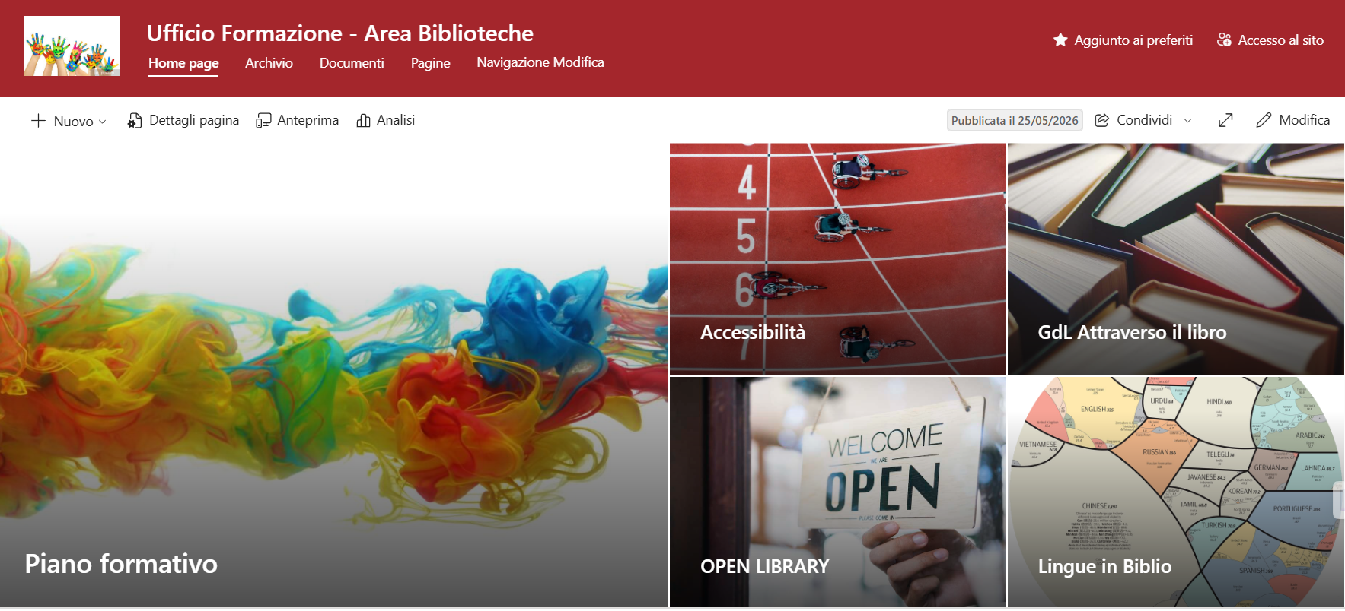
The Milan Library System
Platform

Slide 24
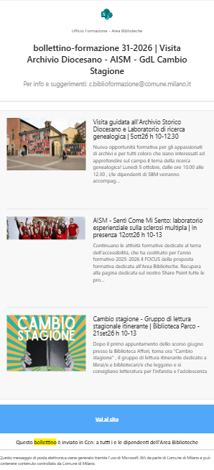
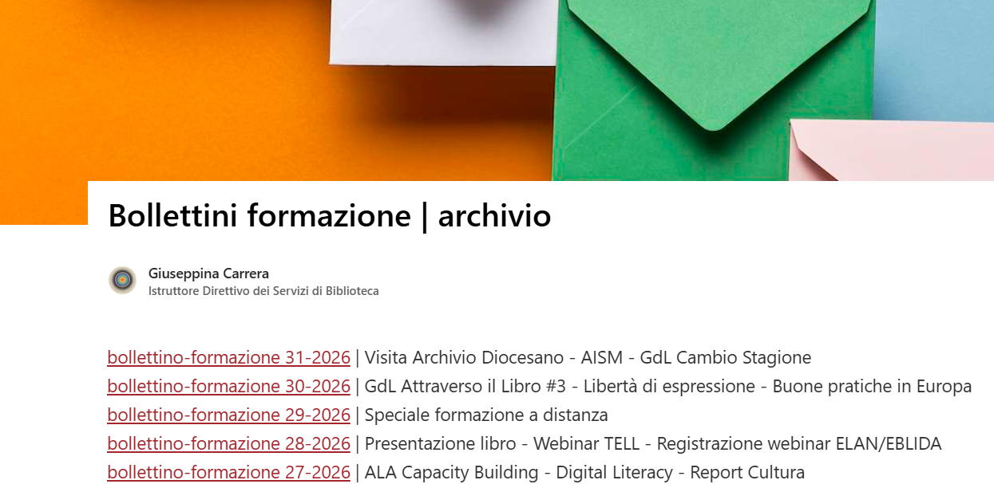
The Milan Library System
Bulletins

Slide 25
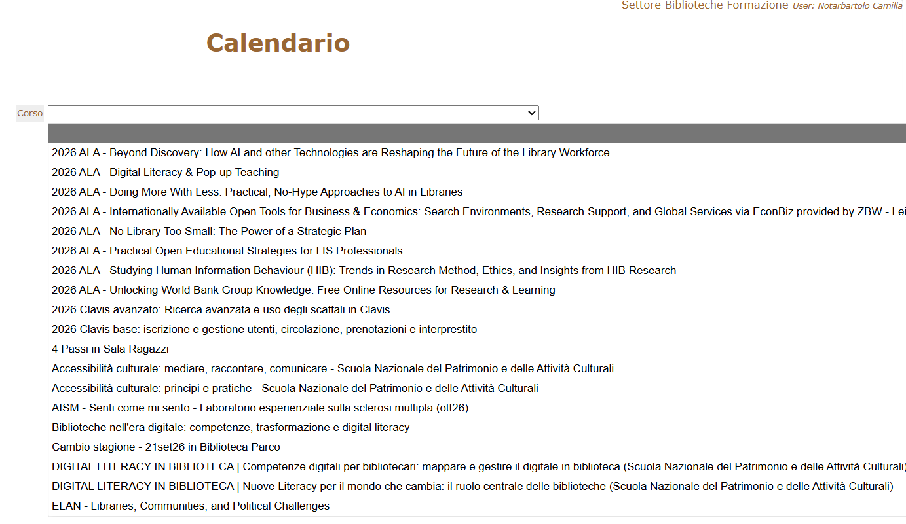
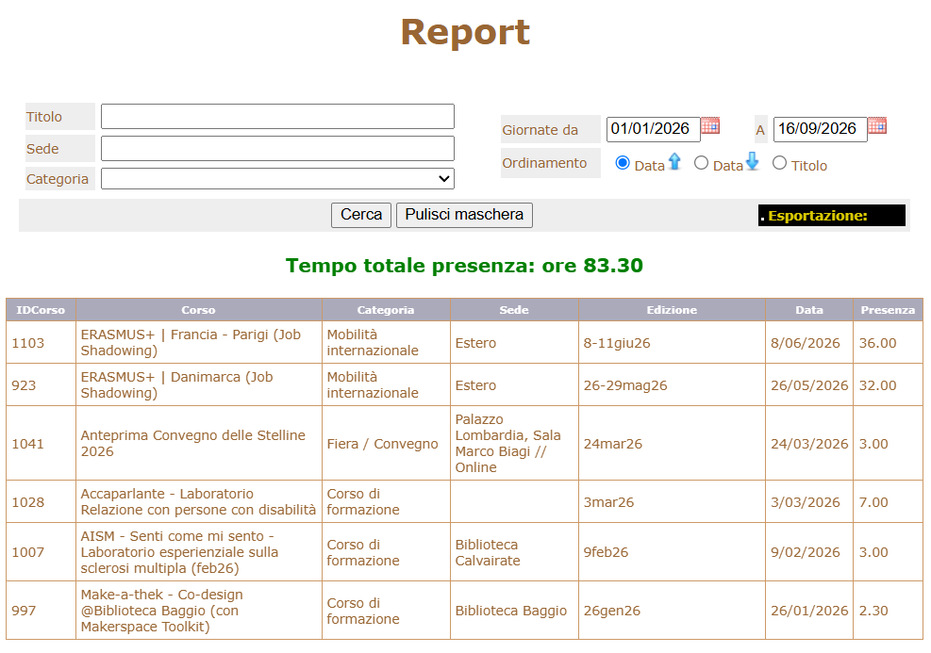
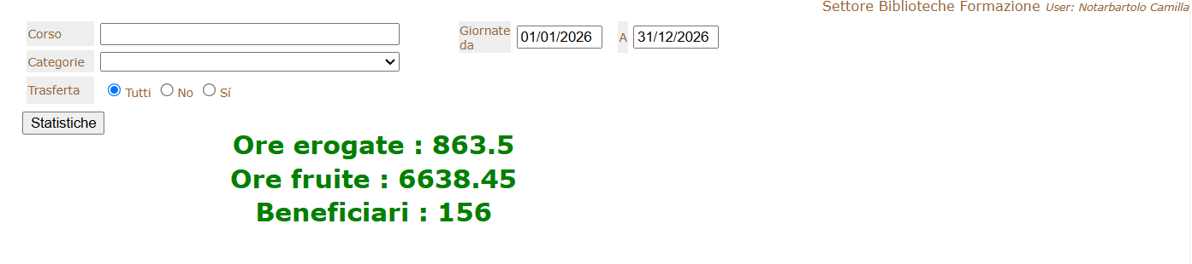
The Milan Library System
Learning Recognition System

Slide 26
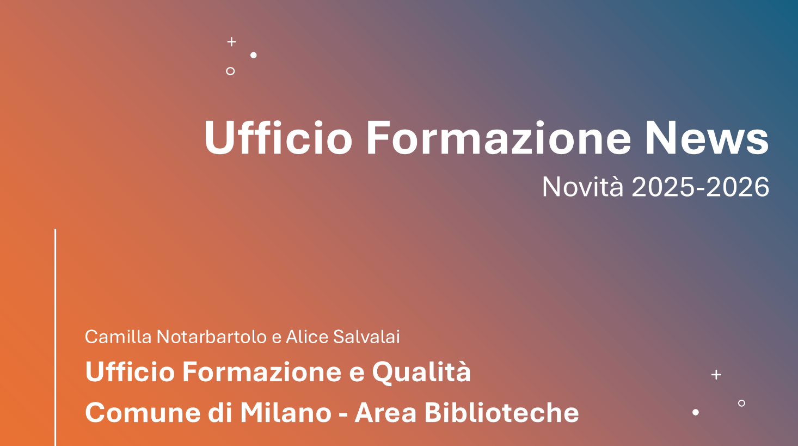
The Milan Library System
Annual Training News

Slide 27
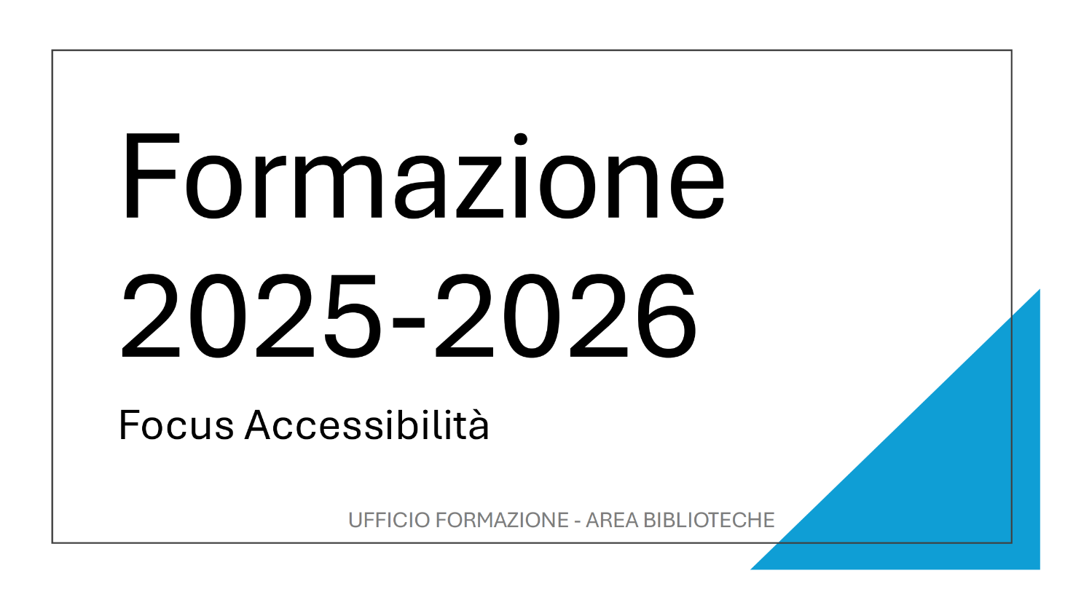
The Milan Library System
Annual Focus as a Support For Quality Standards

Slide 28
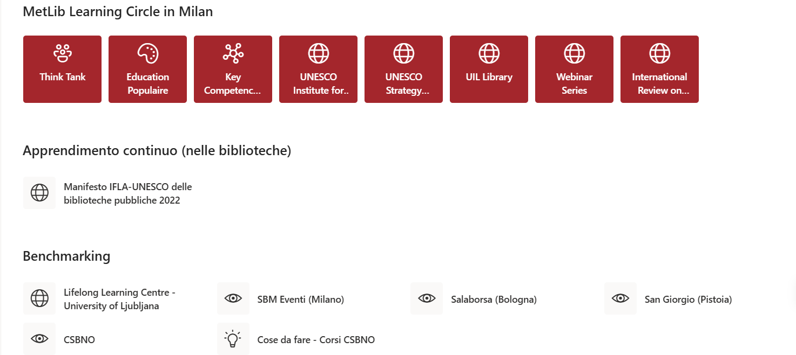
The Milan Library System
Peer-to peer trainings

Slide 29
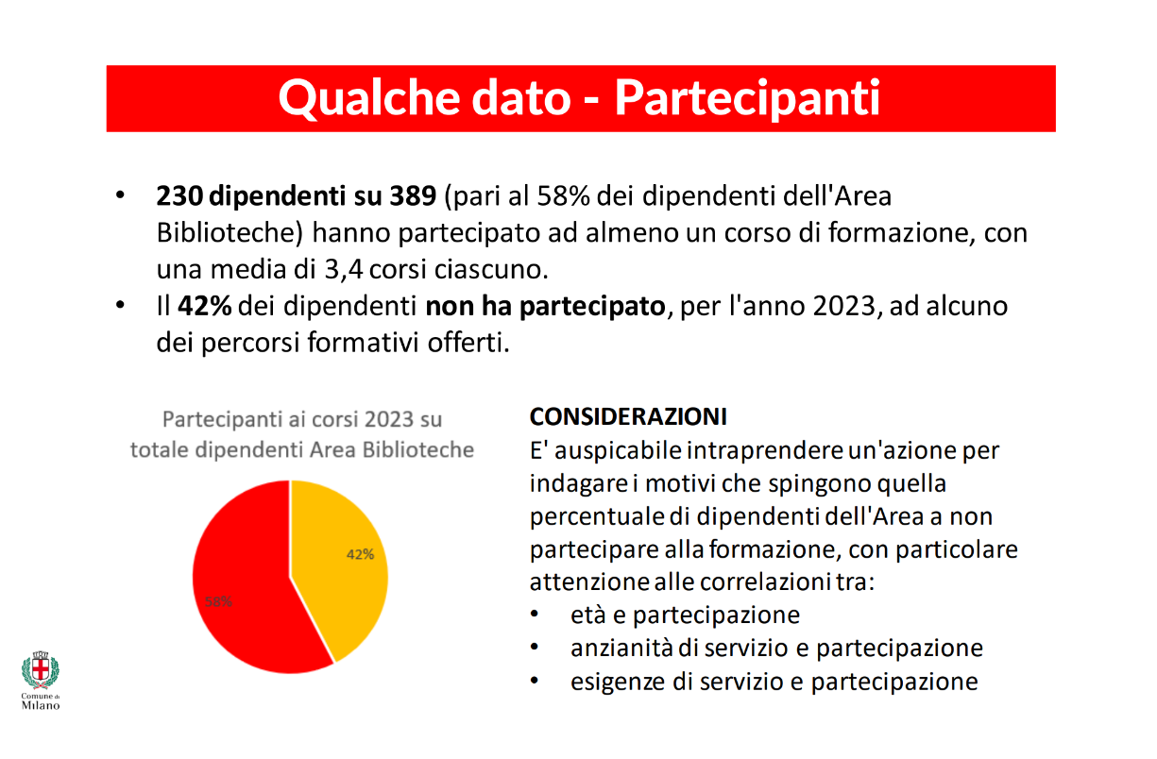
The Milan Library System
Annual Report

Slide 30
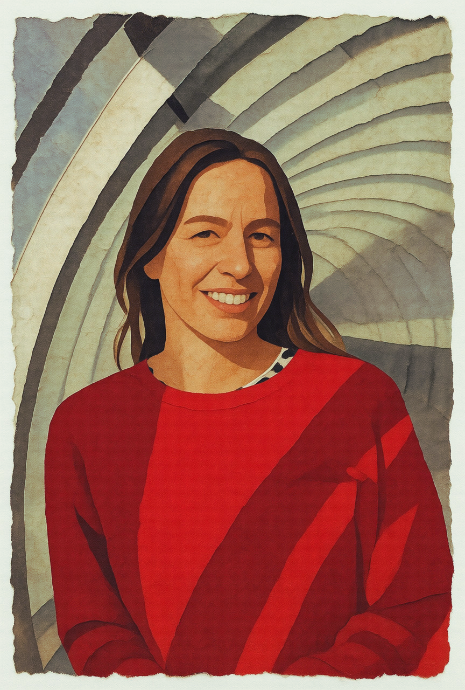

Thank you
To contact me as Head of Training at Quality at the Milan Library System: camilla.notarbartolo@comune.milano.it
To contact me as Chair of the IFLA CPDWL Section and as a member of the Italian Library Association:
camilla.notarbartolo@aib.it

