Slide 1
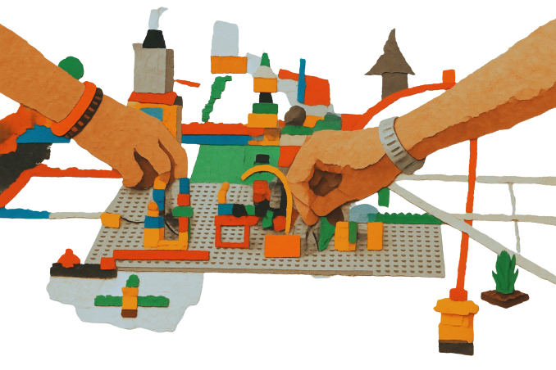

CAMILLA NOTARBARTOLO
MILAN PUBLIC LIBRARY SYSTEM
IFLA CPDWL SECTION 2023-2027
KONGRES ZBDS
17 SEPTEMBER 2026
Design your own professional development strategy
Suggestions from the Milan Library System
Professional development is not something that happens to us. It is something we actively build, individually and collectively.

Slide 2
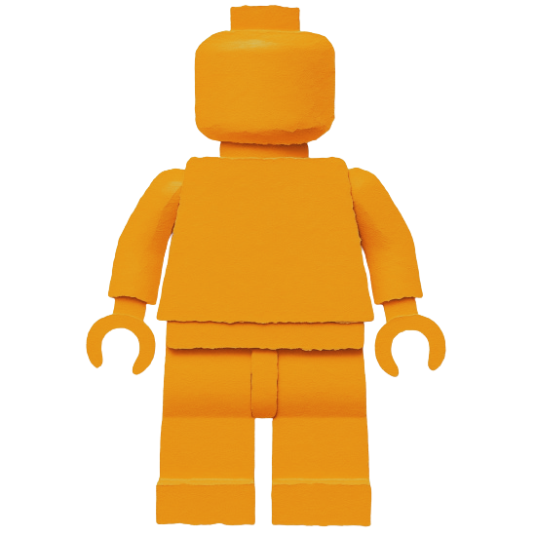
IFLA Guidelines for Continuing Professional Development
The Learner
Principle: The individual library and information professional is primarily responsible for pursuing ongoing learning that constantly improves knowledge and skills.
Rationale: Ethics codes generally include statements such as “Librarians and other information workers strive for excellence in the profession by maintaining and enhancing their knowledge and skills” (IFLA, 2012). Individuals are responsible to themselves, their profession and society.
The
Learner

Slide 3
IFLA Guidelines for Continuing Professional Development
Best practice: The Learner
  conducts regular self-assessment congruent with job responsibilities and aspirations;
  participates in performance appraisals;
  monitors developments that impact the profession and seeks out and uses opportunities to close competency gaps and to advance knowledge and skills;
  develops a personal learning plan that will lead to both improvement in current performance and future career advancement;
  makes judicious choices of formal and informal learning resources based on the best available information;
  seeks learning needed for present responsibilities before preparing for a new position.
The
Learner

Slide 4
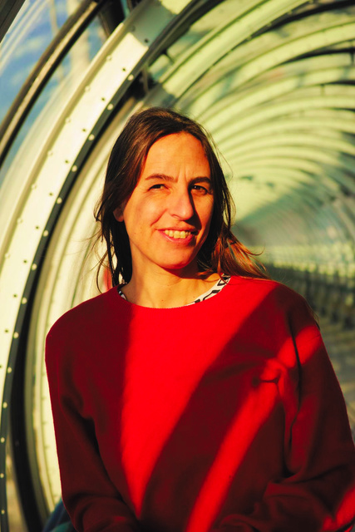


OWN YOUR LEARNING
What each stakeholder should do
  Stay curious and informed
  Identify personal skills gaps
  Explore new tools and practices
  Build a personal learning routine
  Take initiative rather than waiting for opportunities
Individual Professionals
Camilla Notarbartolo
  Allocate time for professional development
  Invest in training and learning resources
  Encourage experimentation and innovation
  Support mentoring, coaching and peer learning
  Embed learning into workplace culture
  Recognise achievements
Employers and Library Managers
The Milan Library System
  Provide standards and guidelines
  Offer training opportunities
  Facilitate networking and communities of practice
  Disseminate new knowledge and trends
  Advocate for investment in the profession
Professional Associations
IFLA

Slide 5
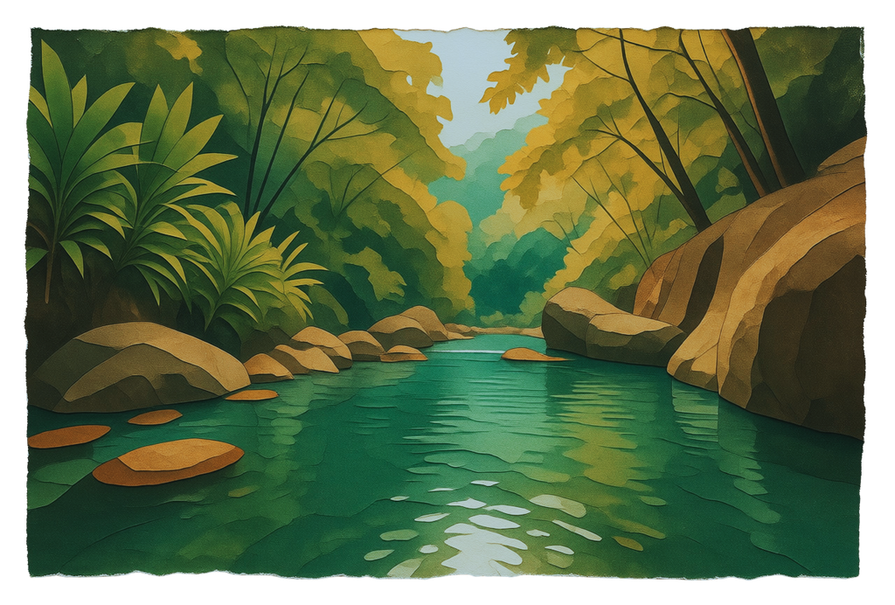
Being Proactive: Individual Strategies
Create a personal learning environment
  favourite websites
  blogs
  journals
  podcasts
  repositories
  AI resources
Organise your learning ecosystem

Slide 6
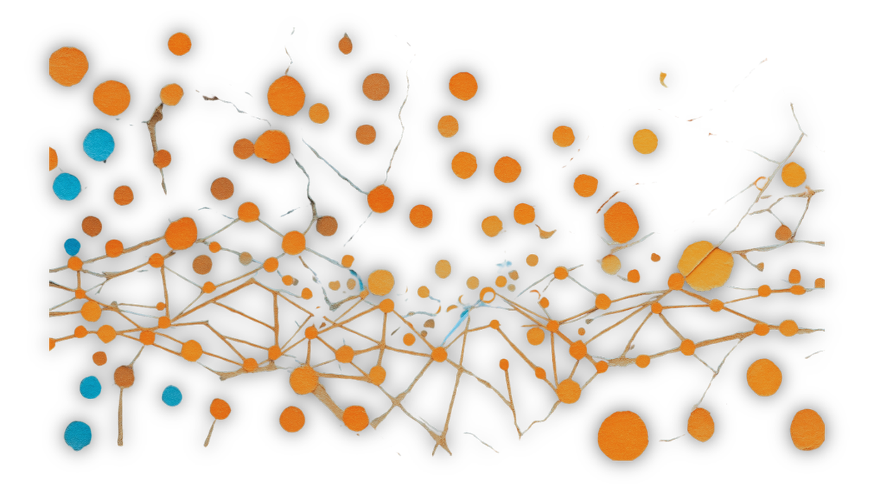
Being Proactive: Individual Strategies
Subscribe Newsletters, follow Social Networks
International
IFLA Newsletter
CPDWL Newsletter
EBLIDA Newsletter
PL2030 mailing list
National
Library associations
Sector newsletters
Ministry updates
Stay Connected
Social Networks
LinkedIn, Facebook

Slide 7
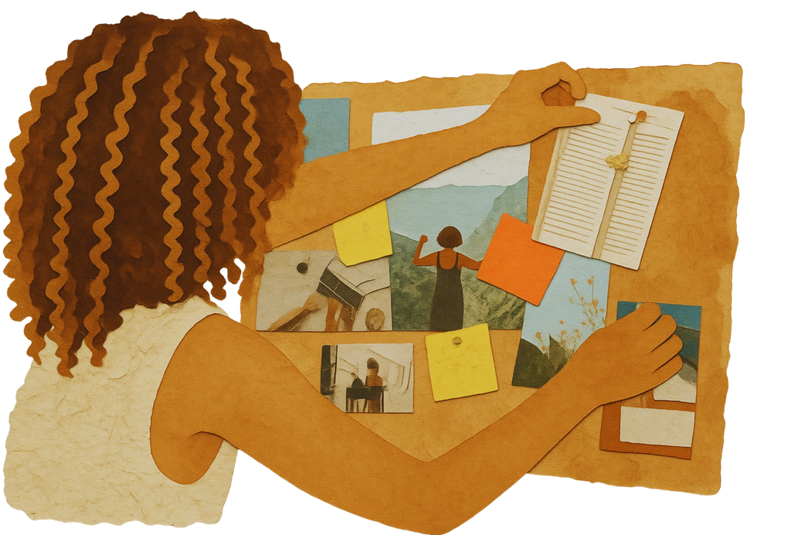
Being Proactive: Individual Strategies
Build Your Personal Learning Routine
15-20 minutes per day can be enough.
Example:
Monday: professional news
Wednesday: tool exploration
Friday: reflection and notes
Small habits create long-term growth

Slide 8

Design a learning strategy (30')
  In 3 or more groups (national, ministry, public, school, academic libraries)
  Identify and share: websites, blogs, journals, podcasts, repositories AI resources ⟶ Create your learning environment by saving links in your Favourites
  Identify and share interesting Newsletters and Social Network Channels it is owrth folowing ⟶ Subscribe to connect
  Identify your IFLA Section/s of interest
  Try to figure out your learning routine
Debrief: How did you feel about these tasks? Do you feel confident of your abilities in searching and choosing the right resources?

Slide 9
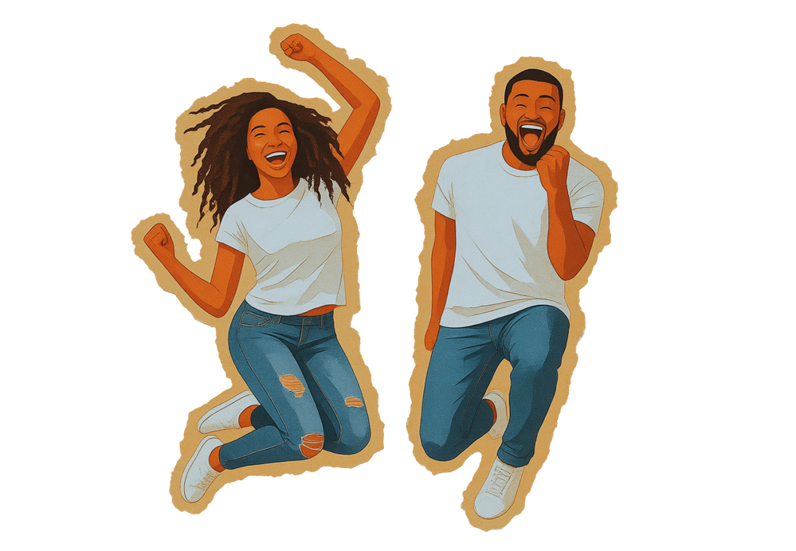
Being Proactive: Individual Strategies
Know Your Competencies
Questions:
  What am I good at?
  What is becoming important?
  Where are my gaps?
You cannot improve what you do not measure.

Slide 10
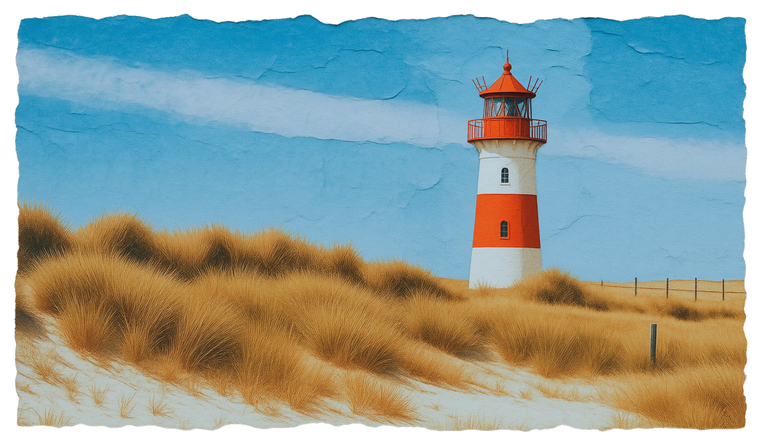
Competency Frameworks
Use frameworks to:
  self-assess
  identify gaps
  set learning priorities
  monitor progress
A lighthouse to guide your professional development

Slide 11

The Skills Agenda for the Trend Report
  Practical skills refer to technical abilities that can help us make better – and safer – use of technology and other opportunities to achieve greater impact: Basic Programming; AI Literacy; Privacy Literacy; Scholarly Communications Literacy; Project Management; Media and Information Literacy; Information Stewardship
  Partnership skills allow us to collaborate more effectively, as well as to engage with our colleagues, communities and partners: Advocacy, outreach, marketing and communication; Negotiation and interpersonal skills; Community building, collaboration and networking; Change management; Pedagogy and teaching; Cultural awareness; Storytelling skills
  Personal development skills help us to think further and more broadly, helping us to become leaders ourselves, and to bring out the best in other: Imagination, intuition and creativity; Lifelong learning; Futures thinking; Data-driven decision-making; Risk literacy; Professional awareness; Growth mindset
A framework to assess emerging skills

Slide 12

Assess your learning needs (30')
  In 3 groups (switch domain every 10 minutes)
    Practical Skills
    Partnership Skills
    Personal Development Skills
  Using the Skills Agenda for the Trend Report
  Identify which are the skills that you would mostly need, prioritising them (set yours first and then agree within the group on common priorities)
Debrief: What emerged through your self-assessment? What through the group assessment?

Slide 13
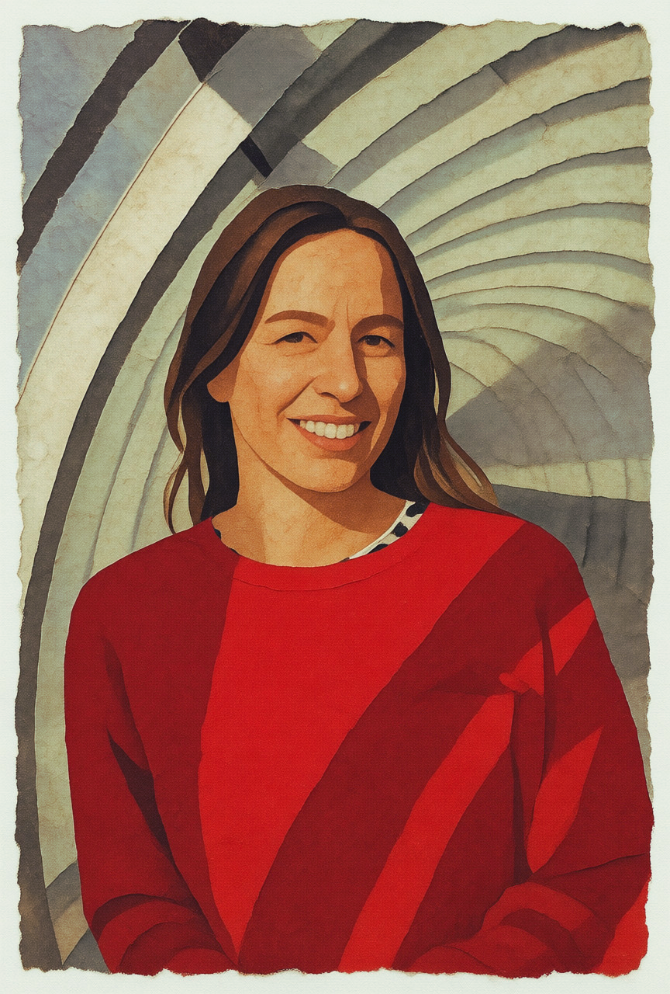

Thank you
To contact me as Head of Training at Quality at the Milan Library System: camilla.notarbartolo@comune.milano.it
To contact me as Chair of the IFLA CPDWL Section and as a member of the Italian Library Association:
camilla.notarbartolo@aib.it

