Slide 1


Text Recognition, Information Extraction, and Beyond:
How Transkribus Serves Cultural Institutions
Sara Mansutti, READ-COOP SCE
s.mansutti@readcoop.eu
10th November 2025

Slide 2

Introduction

Slide 3
With Transkribus we want to provide the best tools for making historical data accessible, as a co-operative putting purpose before profit.

Slide 4

Who’s behind Transkribus?
READ-COOP SCE
Purpose before profit: A European Cooperative Society in charge of the maintenance and development of the Transkribus platform.
2013
tranScriptorium
2016
READ
2019
Foundation of READ COOP SCE
Today 250+ members
30+ countries

Slide 5
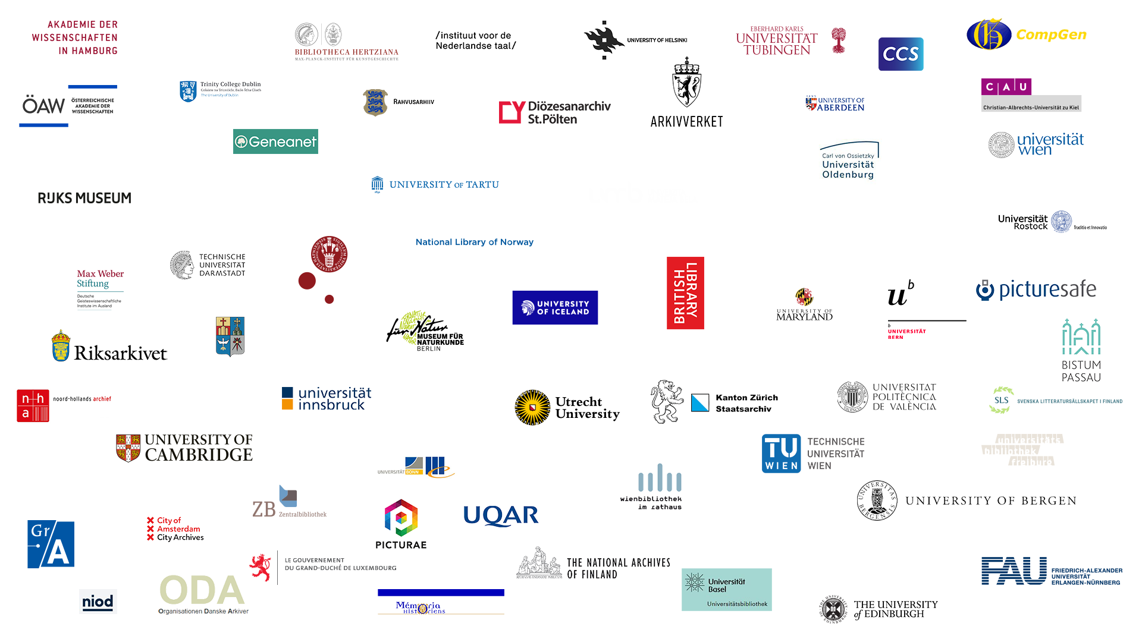
Who’s behind Transkribus?
250+ Members
Institutional: 52%
Private: 48%

Slide 6
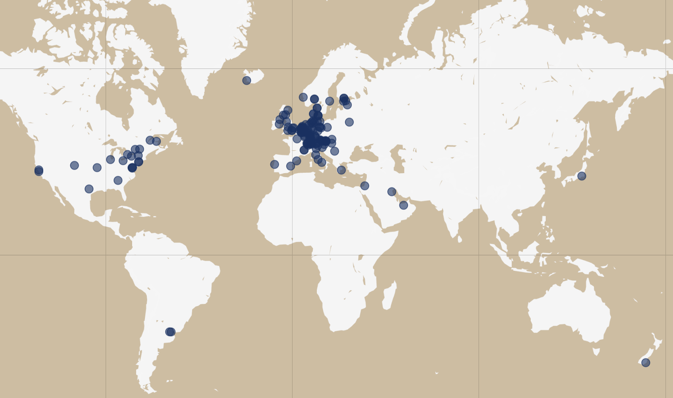

Where are our Members
34 Countries
Argentina | Japan
Australia | Kuwait
Austria | Luxembourg
Belarus | Netherlands
Belgium | New Zealand
Canada | Norway
Denmark | Poland
Estonia | Portugal
Finland | Serbia
France | Slovakia
Germany | Slovenia
Greece | Spain
Hungary | Sweden
Iceland | Switzerland
Ireland | UK
Israel | United Arab Emirates
Italy | USA

Slide 7
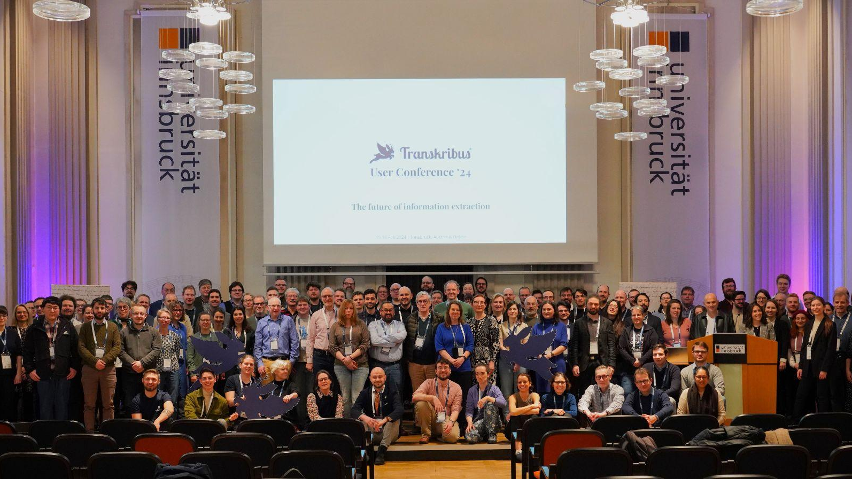
Who’s behind Transkribus?
The User Community

Slide 8



The Transkribus Ecosystem
Enabling digital availability
Imaging
Editing, Data Collection + Annotation
AI Recognition +
AI Training
Publishing

Slide 9

The ScanTent

Slide 10
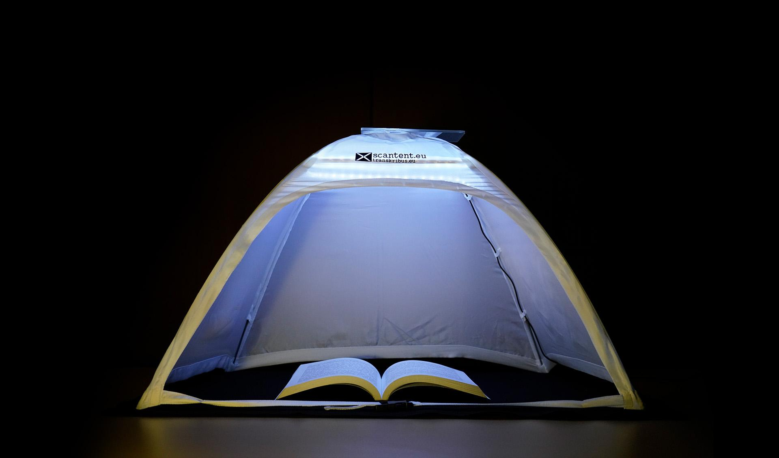
The ScanTent
https://www.transkribus.org/scantent

Slide 11
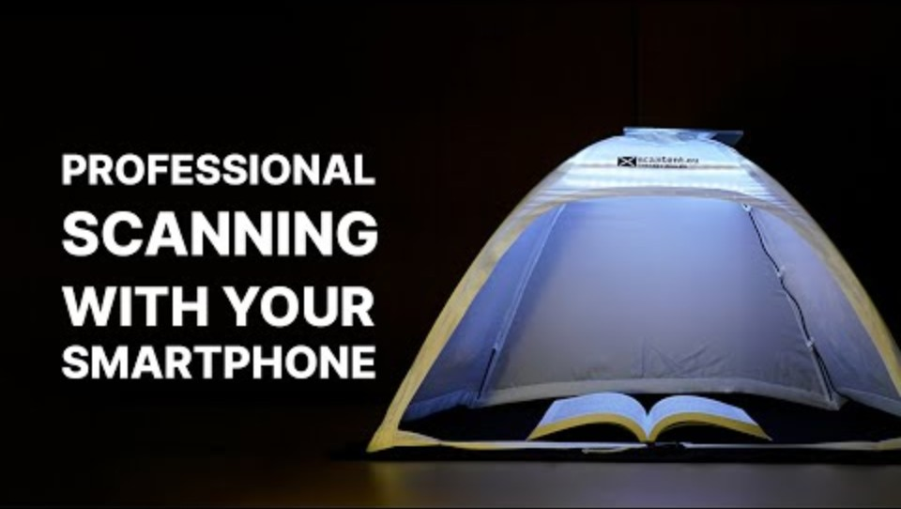
The ScanTent
https://www.transkribus.org/scantent

Slide 12
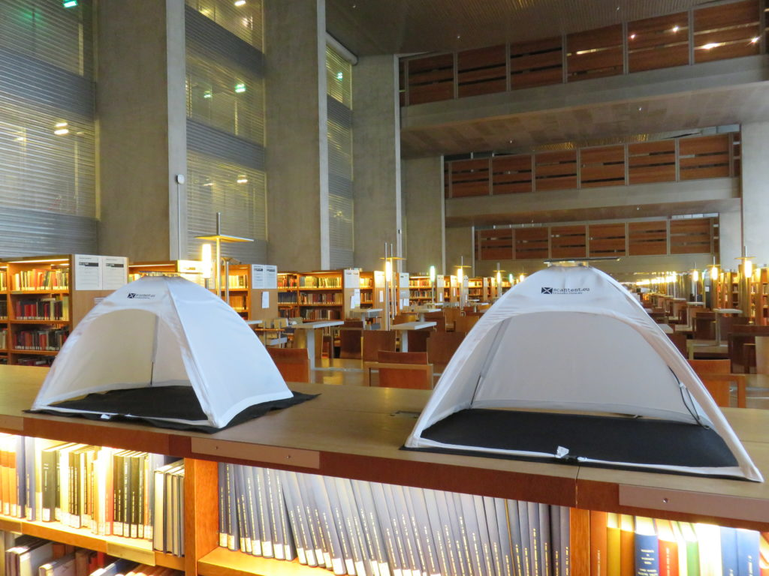
Bibliothèque nationale de France (BnF)
Portable Scanning with ScanTent
~40 ScanTents installed across BnF sites
Empowers users to scan independently with their smartphones
Portable, bright, easy to use
“Members like that it is easy to use, and that it is free.”

Slide 13
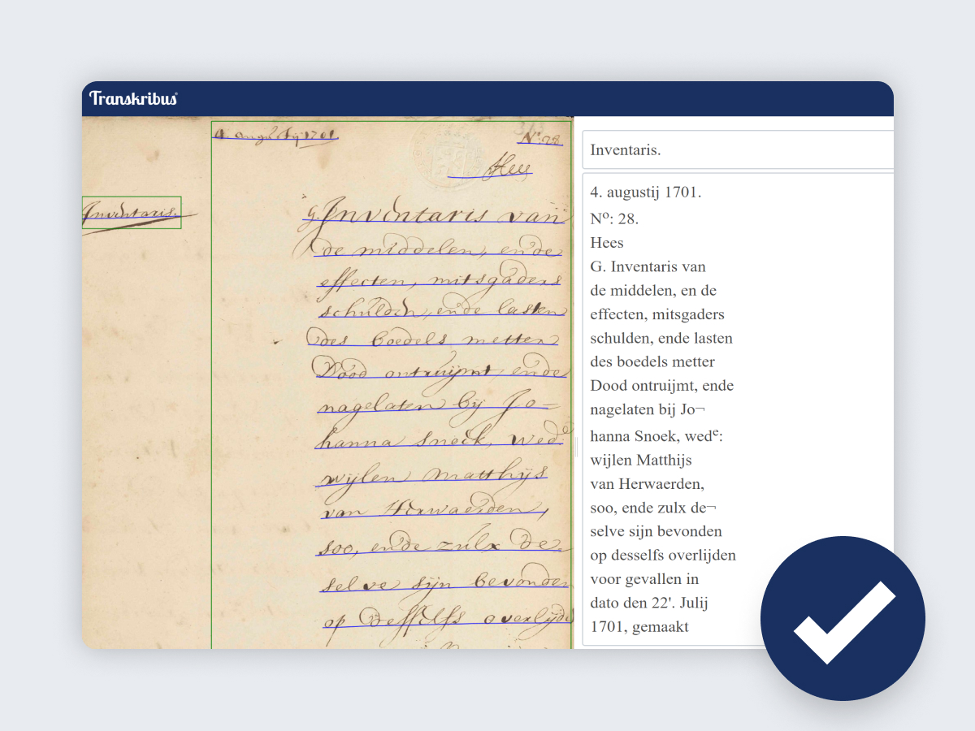
Transkribus Platform

Slide 14
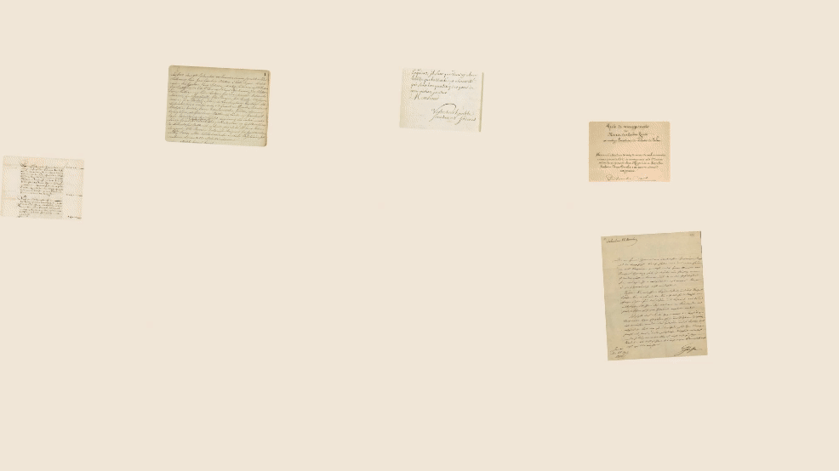
The Transkribus Platform
Transkribus is your AI-powered ally designed to simplify your time-consuming and laborious work with historical documents.

Slide 15
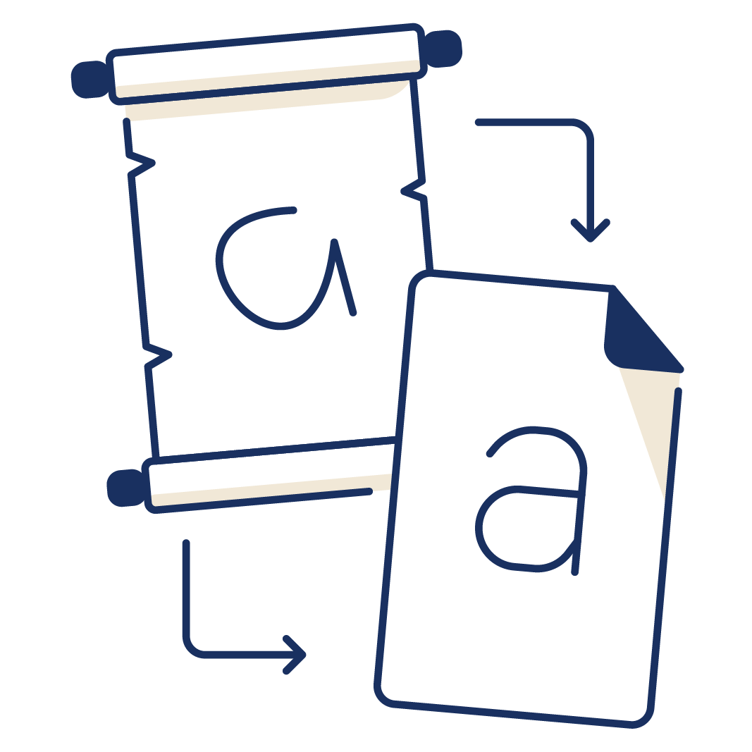





What does Transkribus make possible?
Manual & automatic transcription of handwritten and printed documents
Training of AI models
Collaboration
Searching in documents with powerful tools
Tagging of the documents’ structure and content
Export of documents in different formats

Slide 16
Text Recognition

Slide 17
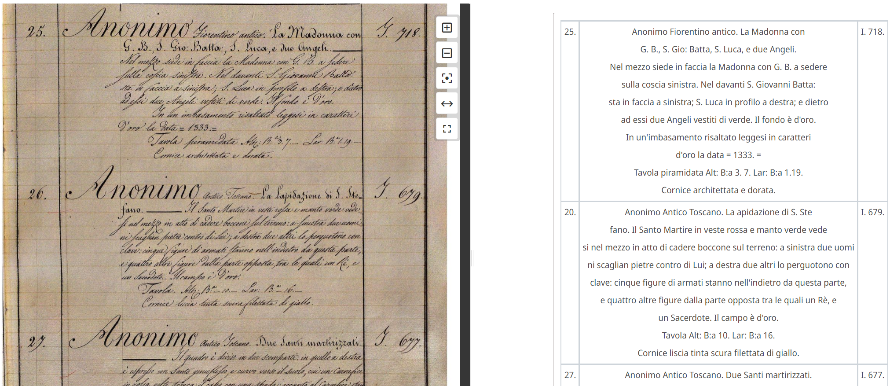
Recognising handwritten or printed text
1,30% CER

Slide 18
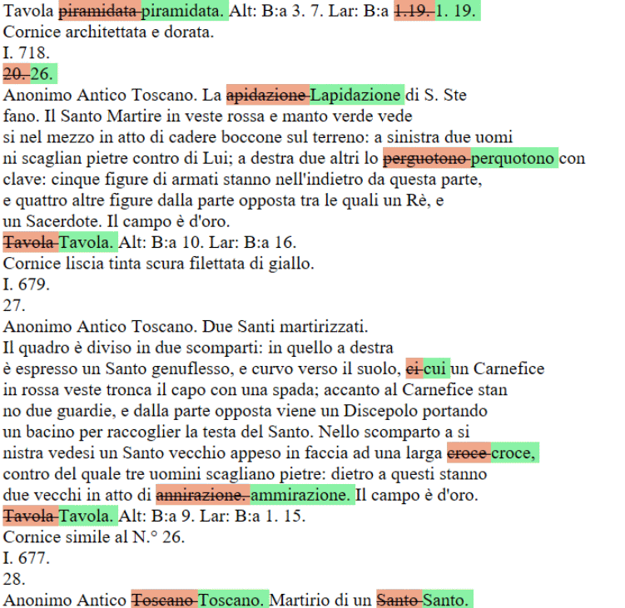

Slide 19

Text recognition converts printed or handwritten text into digital text using existing or custom AI models.

Slide 20
Models are like manuals, telling Transkribus how to transcribe a certain type of writing.

Slide 21


Text Recognition
Public models
Pre-trained - can be used right away
Large & Robust
Easy to use
Handwritten & printed
Custom Models
Tailored & higher accuracy
Adaptable to your material
Control what data goes into the model
Can be fine tuned to your project

Slide 22
Public Models
Models
300+ public models available
Material
Handwritten & Print
Languages
30+ languages available
Notes:
Models Gallery: view them, filter them and test them out

Slide 23
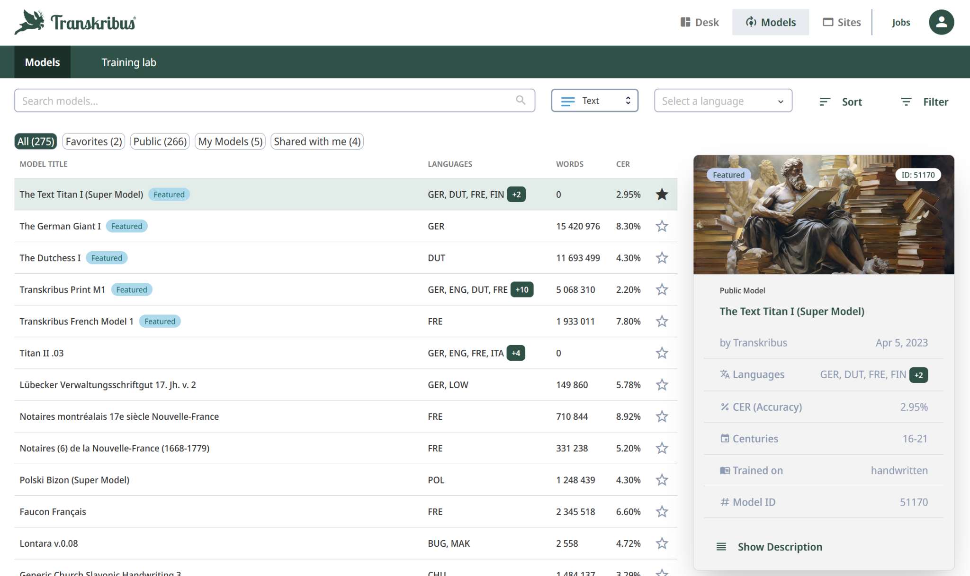
Public Models
Filter by name, language, handwritten/printed, century

Slide 24
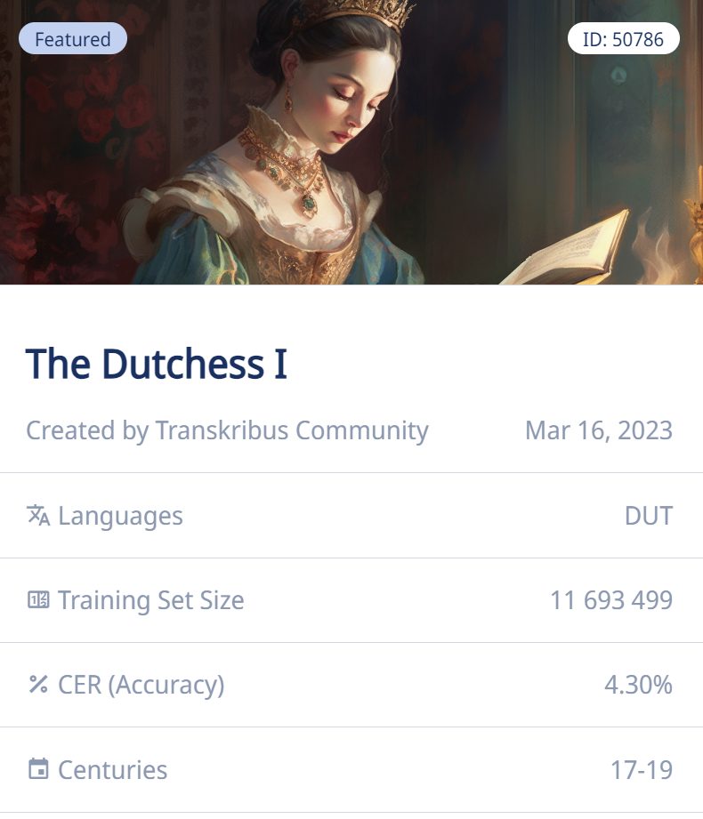
Public Models
Look at the Training Set Size and Character Error Rate (CER)
Trained on
11 million words
Accuracy during training: 95,7%
Notes:
What to consider when choosing a public model:
accuracy
nr of words
period
type of writing
description: general models could have a lower accuracy than specialised models trained on just a few hands, but they are better at generalising and reading also new hands not seen at all during the training

Slide 25

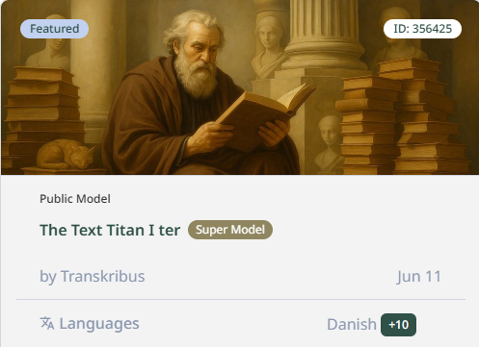
Public Super models
Super models
Large & robust
Handwritten & printed
Multiple languages
Often best out-of-the box model

Slide 26
Choosing the right approach
Public models
Pre-trained - can be used right away
Large & Robust
Easy to use
Handwritten & printed
Custom Models
Tailored & higher accuracy
Adaptable to your material
Control what data goes into the model
Can be fine tuned to your project

Slide 27
Custom AI model training uses specific examples to help the AI accurately recognise and understand the writing in your training data.

Slide 28
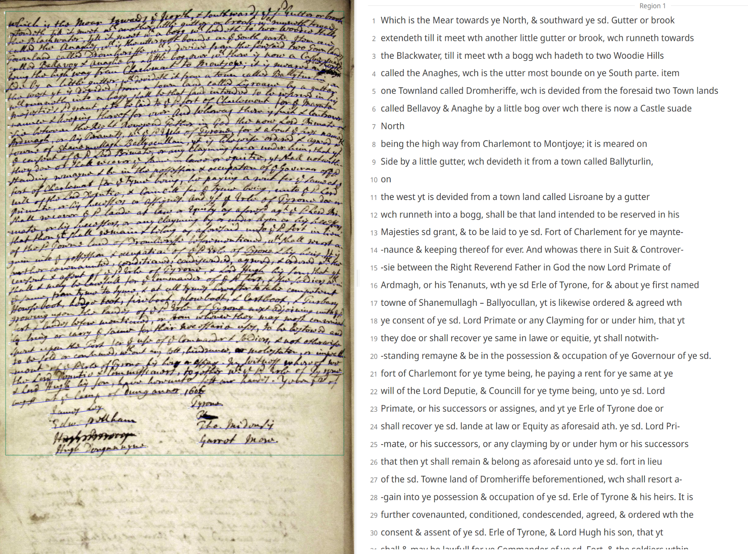
Training data (=Ground Truth) is accurately transcribed text paired with its image.

Slide 29
Training Data Estimates
 | Character Error Rate | Training Data
Printed text | 0,5-2% | ~ 5.000 words / 25 pages
Single hand - simple writing | 2-4% | 10.000+ words / 50+ pages
Several hands – all seen during training | 4-6% | 10.000+ words per hand / 150+ pages
Many hands from same period and region – not all seen during training | 6-8% | 100.000+ words / 500+ pages

Slide 30
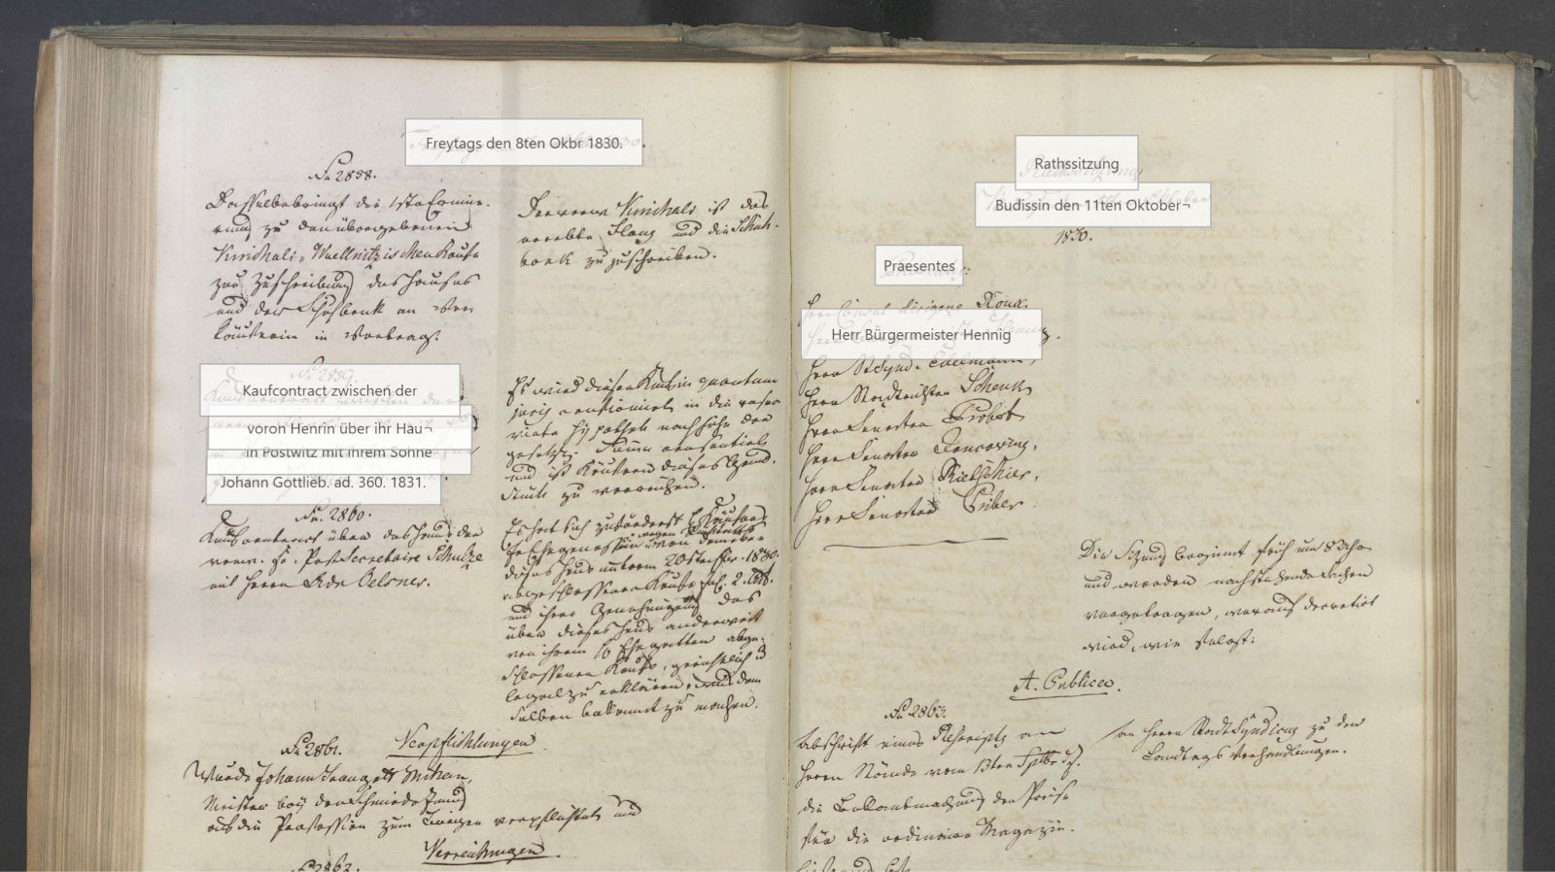
Archivverbund Bautzen
Making 200 years of Bautzen’s city history accessible
257 council minute books (1623–1832), ~55,000 pages
Collection digitised but little used
Custom AI model to improve accuracy
“The archive holdings can now be used by all, even with limited knowledge of historical writing.”

Slide 31
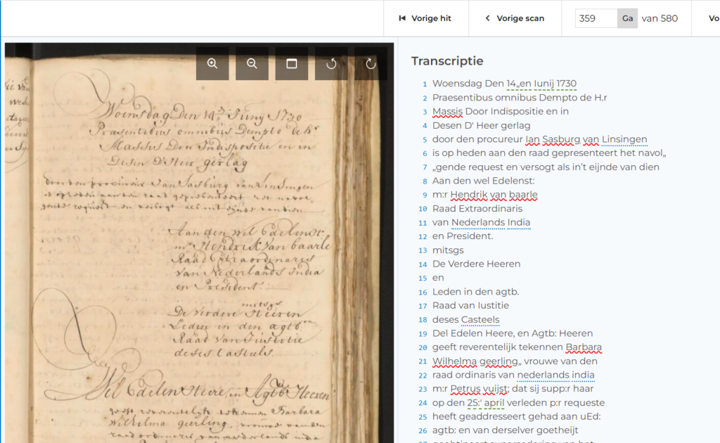
National Archives of the Netherlands: Mass HTR
Mass HTR pilot project
~3 million pages
Notarial and maritime trade documents
Custom model trained and made public in Transkribus
“At the start, we were aiming for a CER of 20%, we would have been happy with that. But after creating 6000 pages of training data, we got down to a CER of 7%, which was even better for us.”

Slide 32
Information Extraction

Slide 33
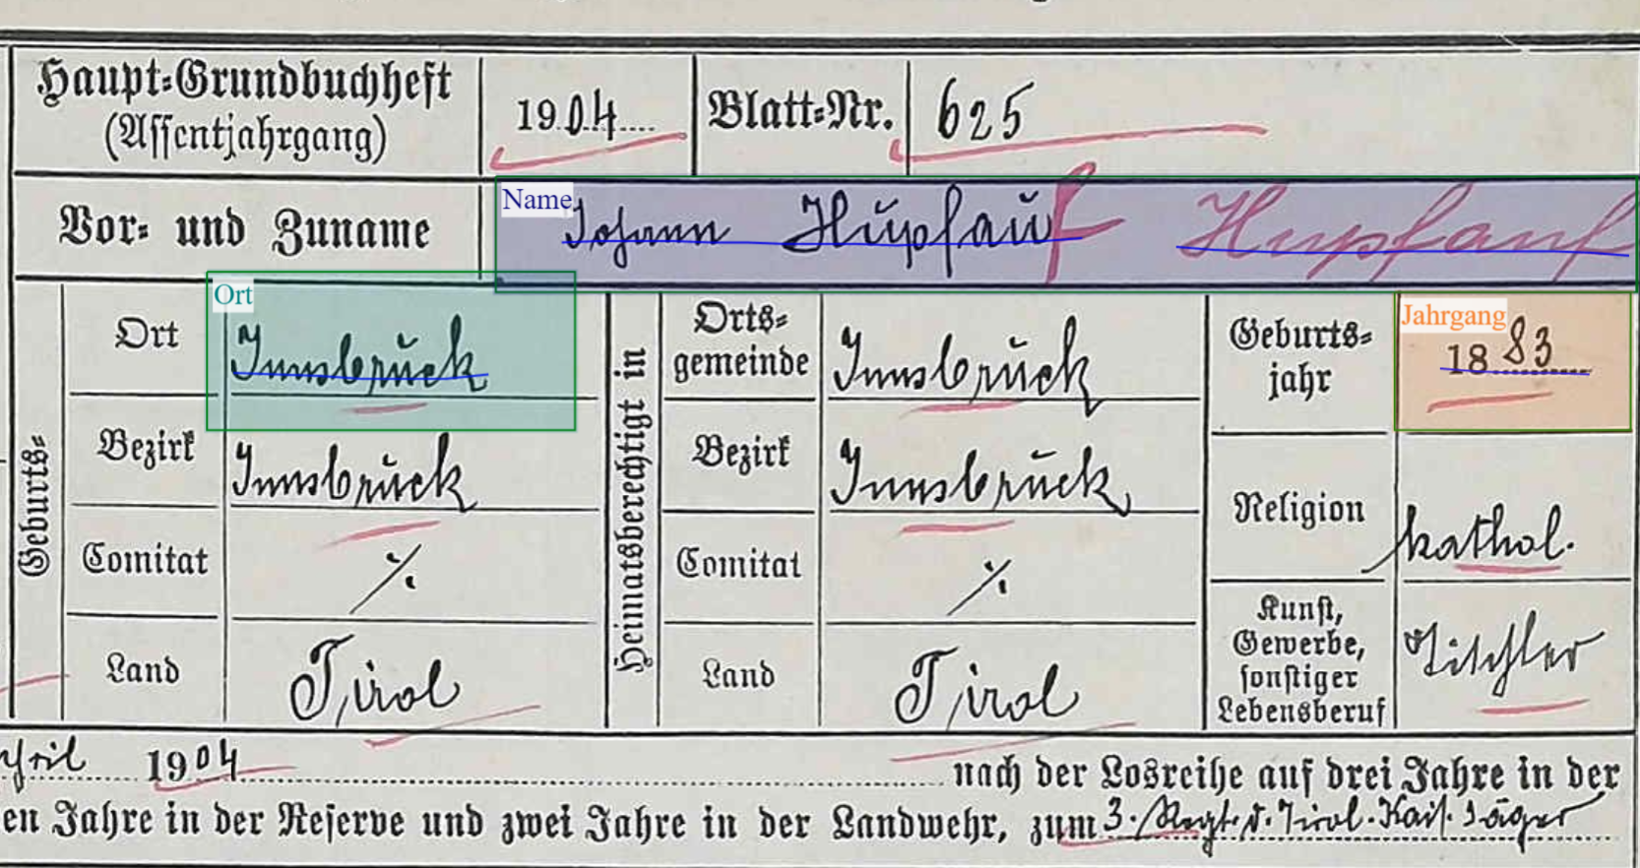
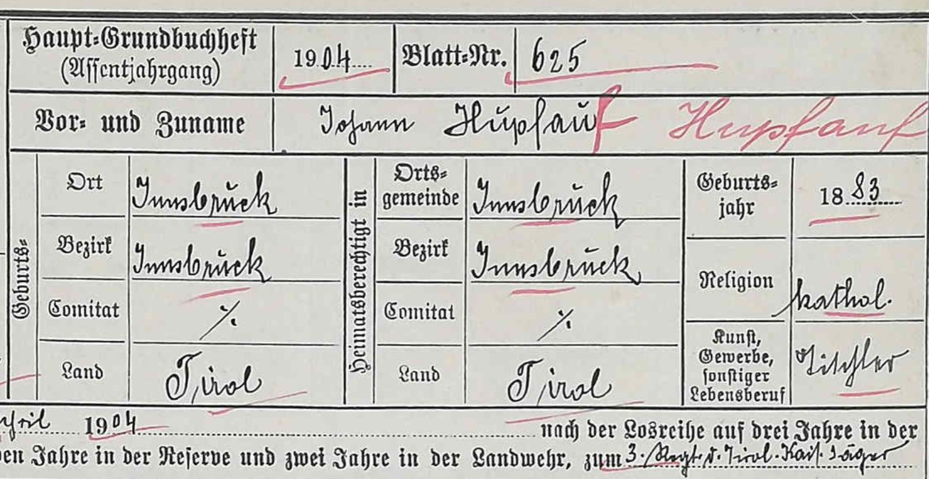
Field Models

Slide 34
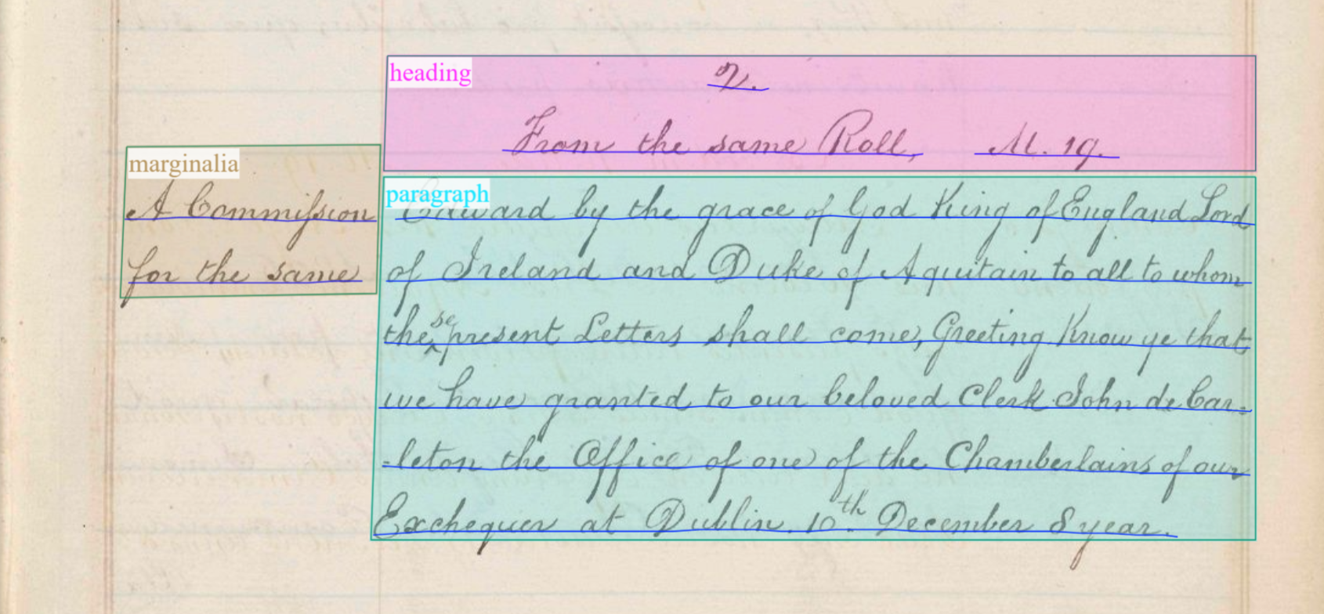
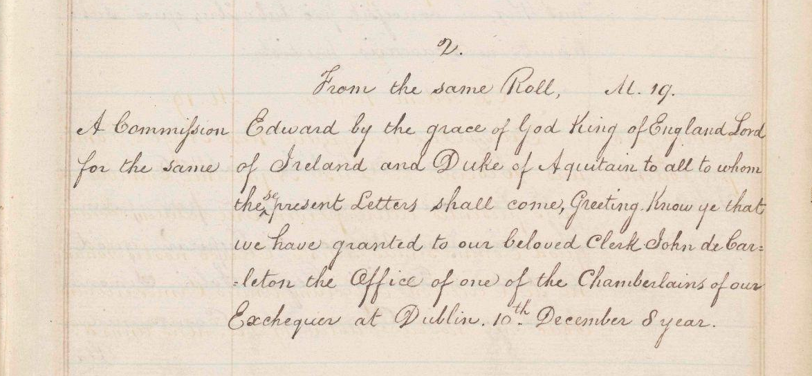
Field Models
Field models can be trained to automatically detect layout components of the document and label the detected fields with regions & tags.

Slide 35
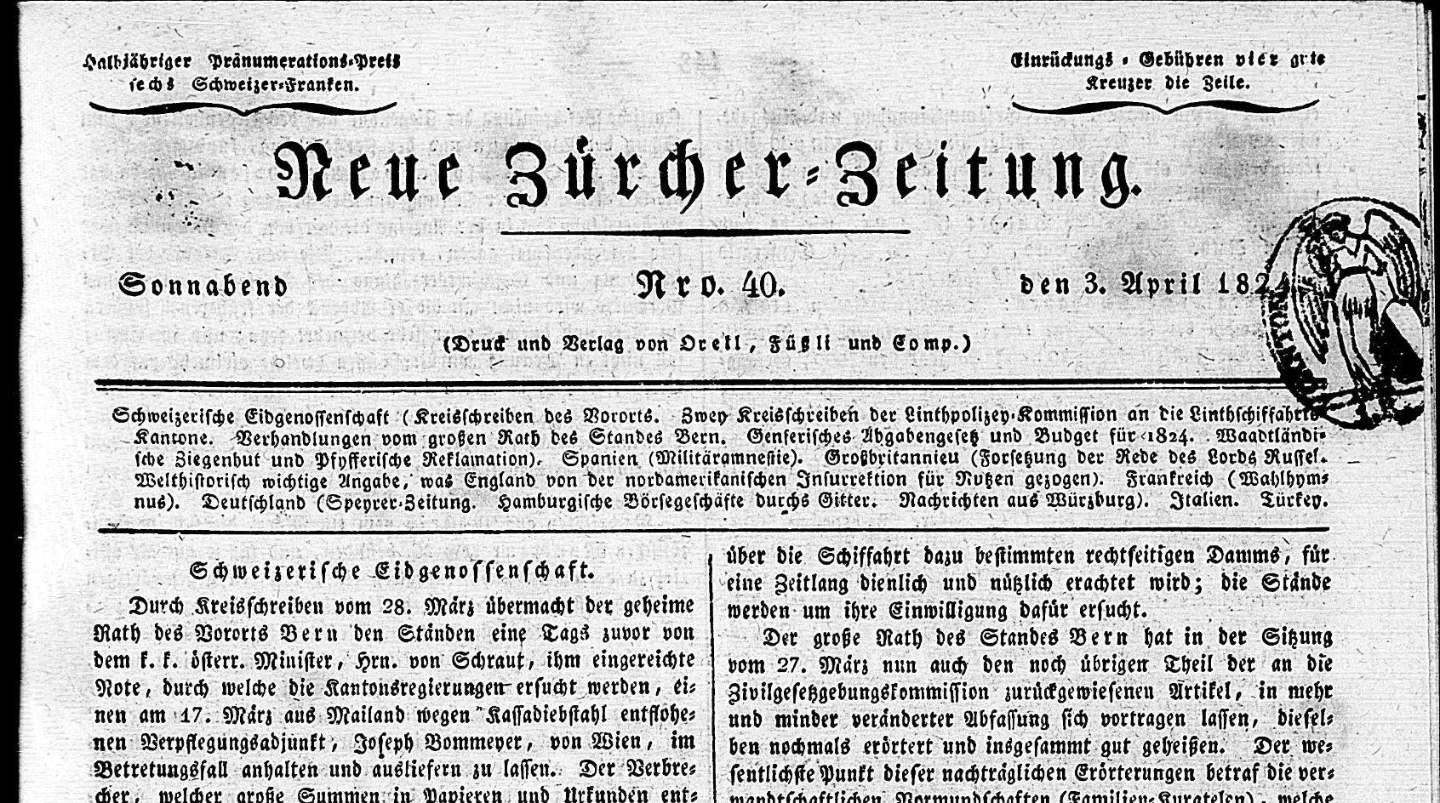
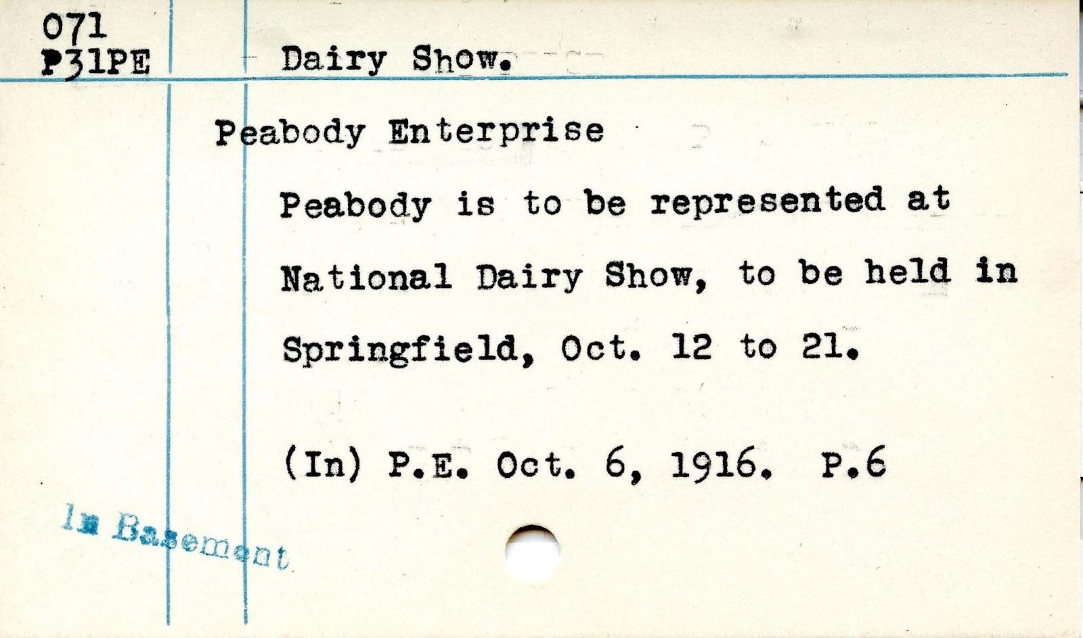
What type of documents are they for?
Newspapers
Legal Forms
Index Cards
Court Records
Scrap Books
Sheet Music
….

Slide 36
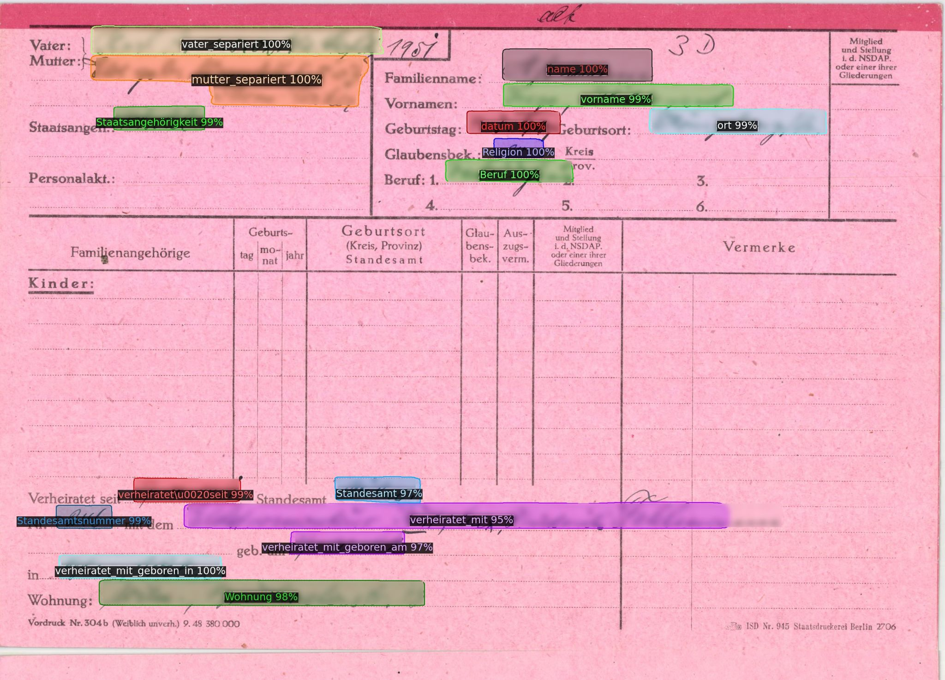
Forms Segmentation

Slide 37
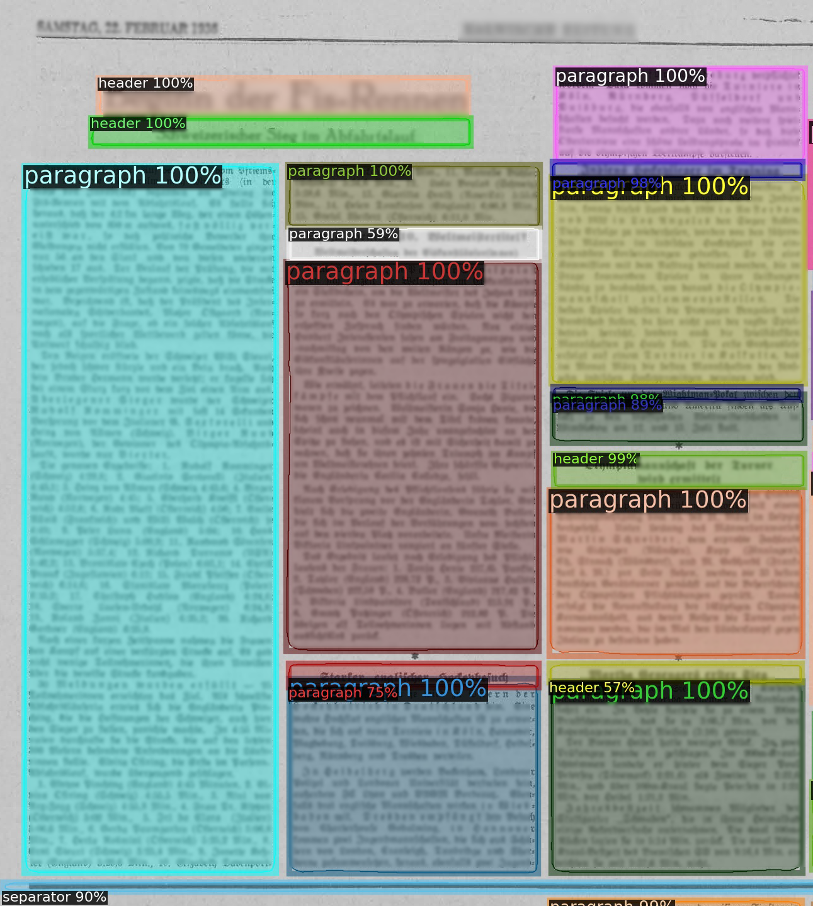
Newspapers: Layout Segmentation

Slide 38
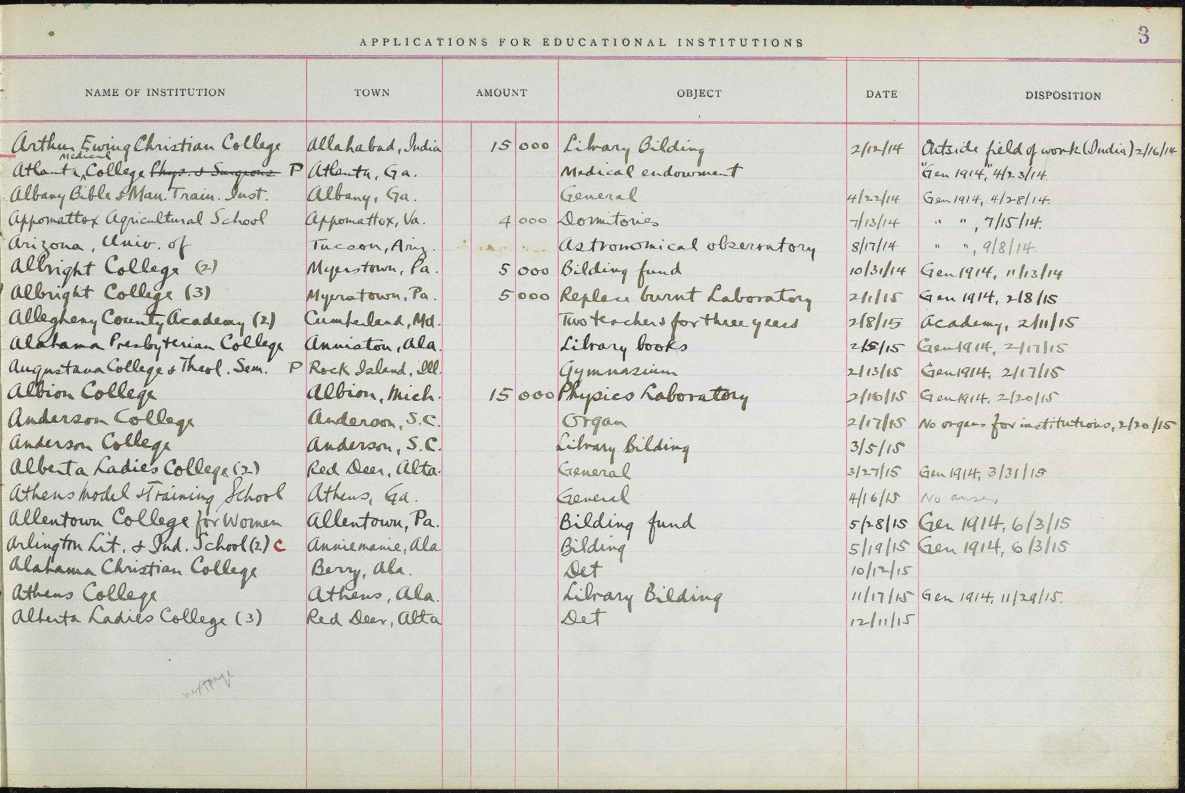
Table Models

Slide 39
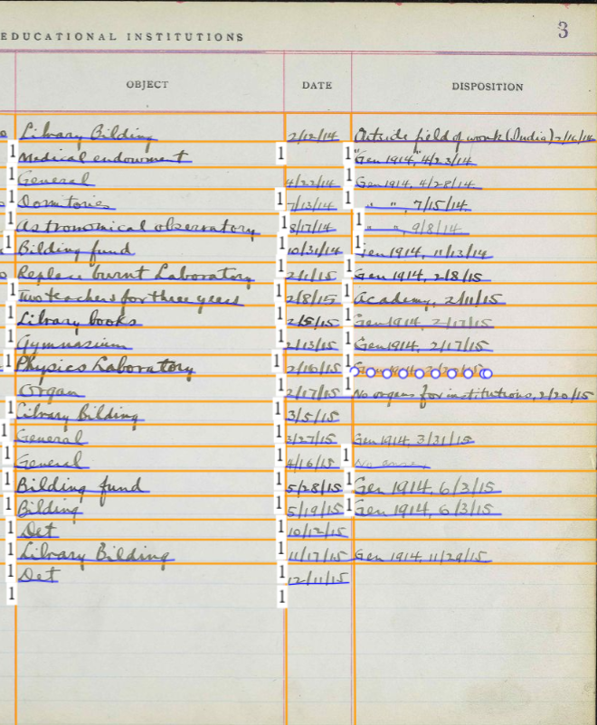
Table Models
IMAGE

Slide 40
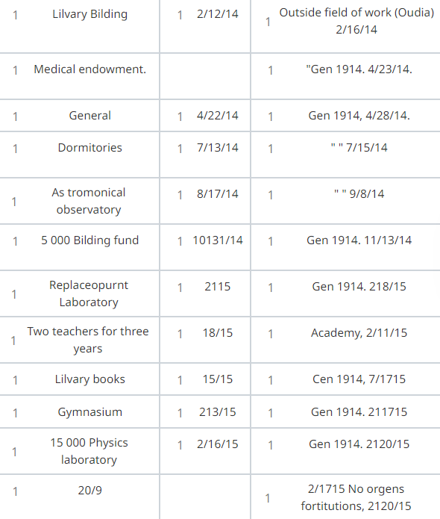
Table Models
IMAGE

Slide 41
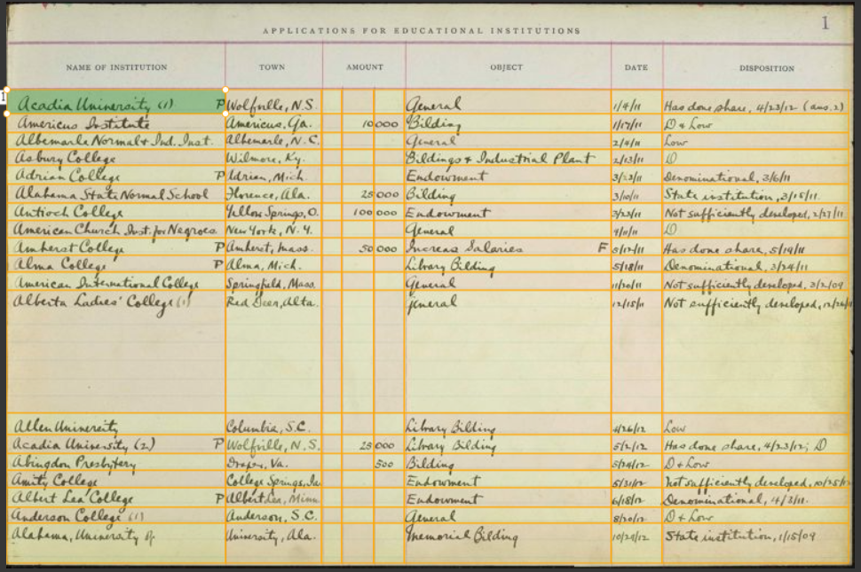
Table Models
Table Models can be trained to automatically detect the table layout of the document and extract structured data.

Slide 42
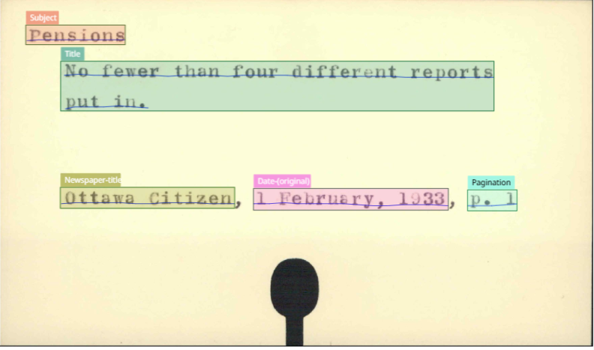
Library and Archives Canada
Finding aids
Information extraction pilot project
Indexes and registers
Extraction of information contained in documents with mixed handwritten and printed text and multiple layouts

Slide 43
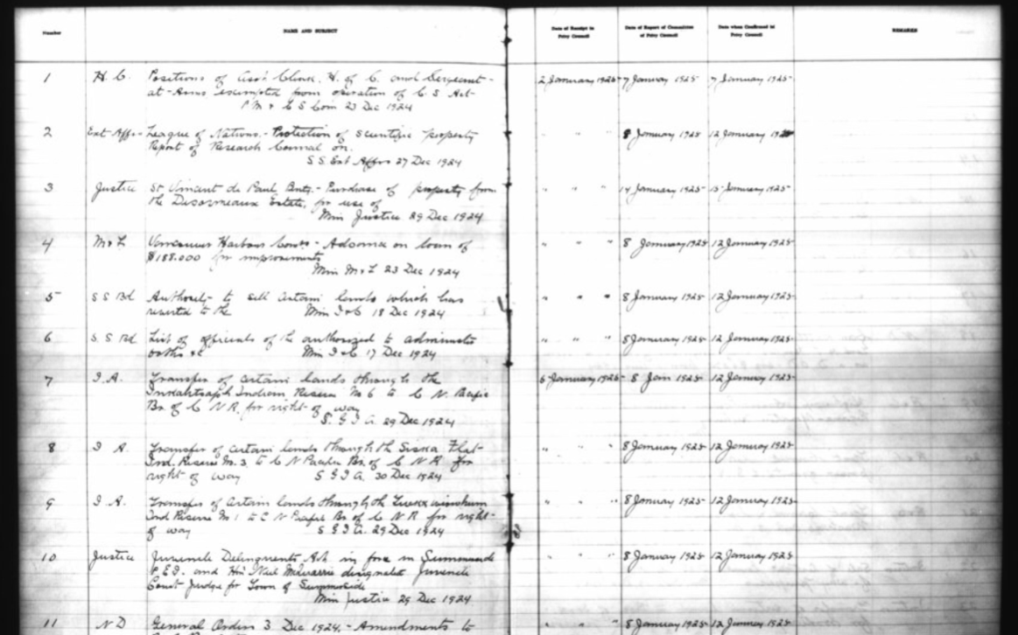
Library and Archives Canada
Finding aids
Information extraction pilot project
Indexes and registers
Extraction of information contained in documents with mixed handwritten and printed text and multiple layouts

Slide 44
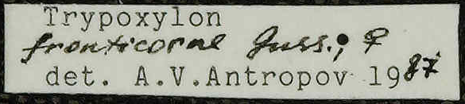
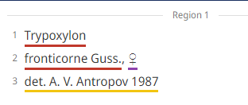
Museum für Naturkunde Berlin
© MfN
Automated label transcription & entity extraction
~250,000 specimen labels
SME model
Name Entity Recognition and linking to GeoNames database
Specimen | Sex | Determination
Trypoxylon fronticorne Guss. | ♀ | det. A.V. Antropov 1987

Slide 45

Collaboration

Slide 46
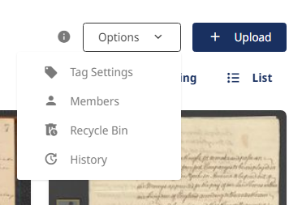
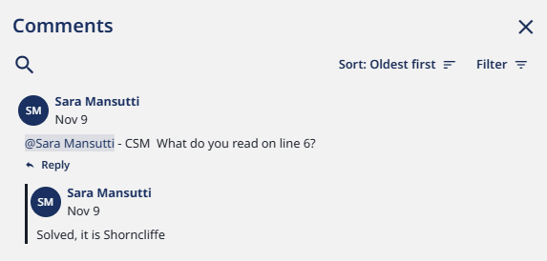
User collaboration tools
Inviting the team to a collection and assign them user roles (Viewer, Manual Transcriber, Transcriber, Editor, Owner)
Comments
Sharing models / Making Models Public
Sharing credits
Notes:
Sara

Slide 47
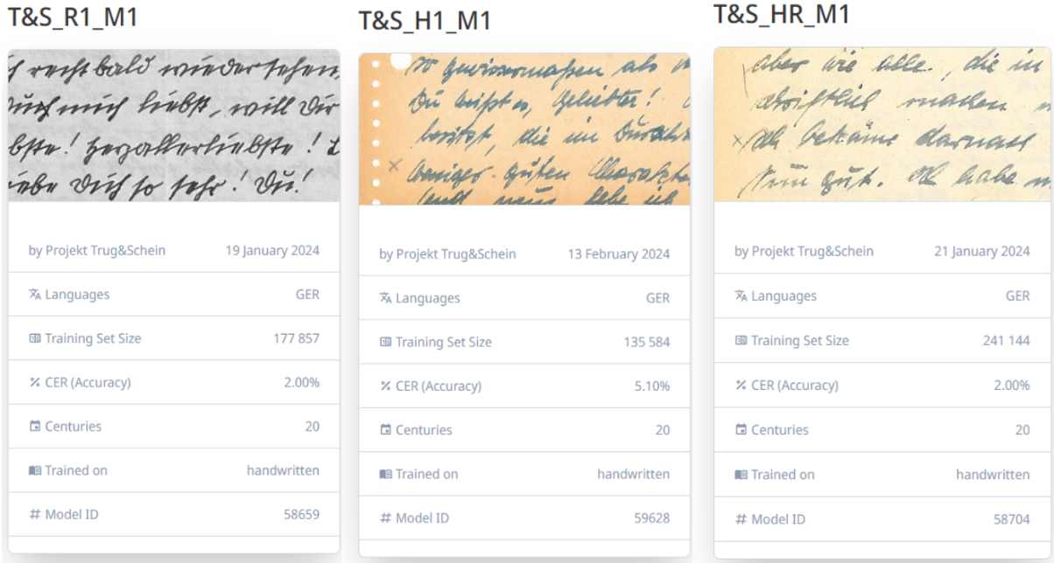
Project “Trug und Schein – Alltag im Krieg”
Crowdsourced transcription of 2,600 wartime letters
2,600 letters of a German couple
Senior citizens and students learning German
Volunteers trained on Transkribus; project scaled from manual to semi-automated
“History is a matter for everyone and not just professional historians”

Slide 48
Publishing: Transkribus Sites

Slide 49
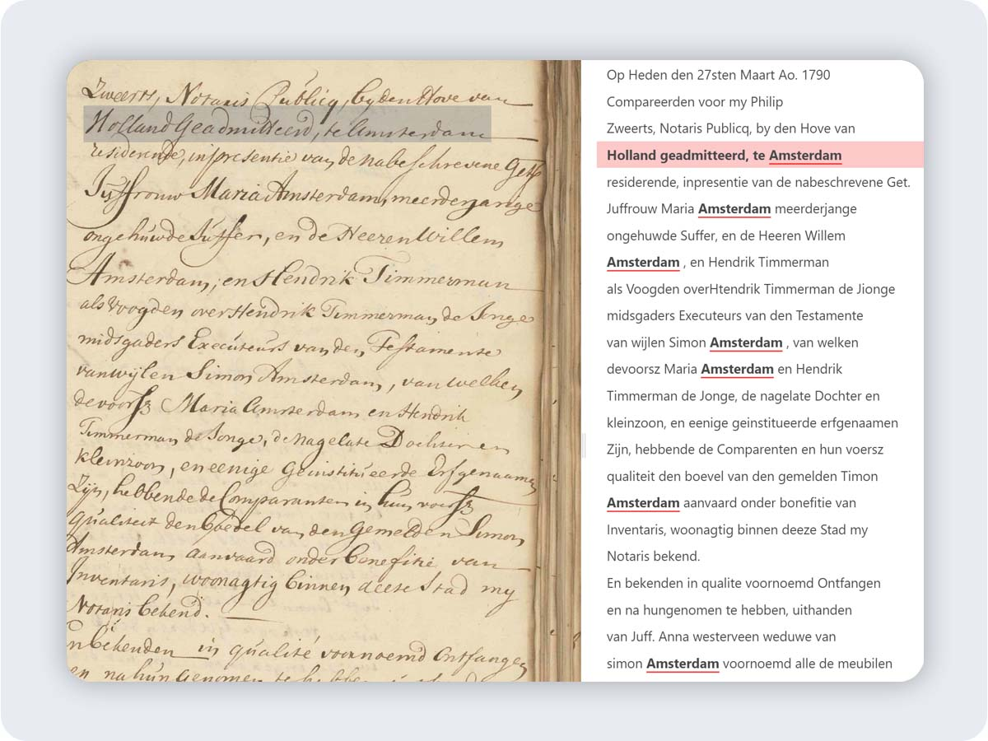



Transkribus Sites - Features
Easily share your material
Side-by-side view
Enhanced search capabilities

Slide 50
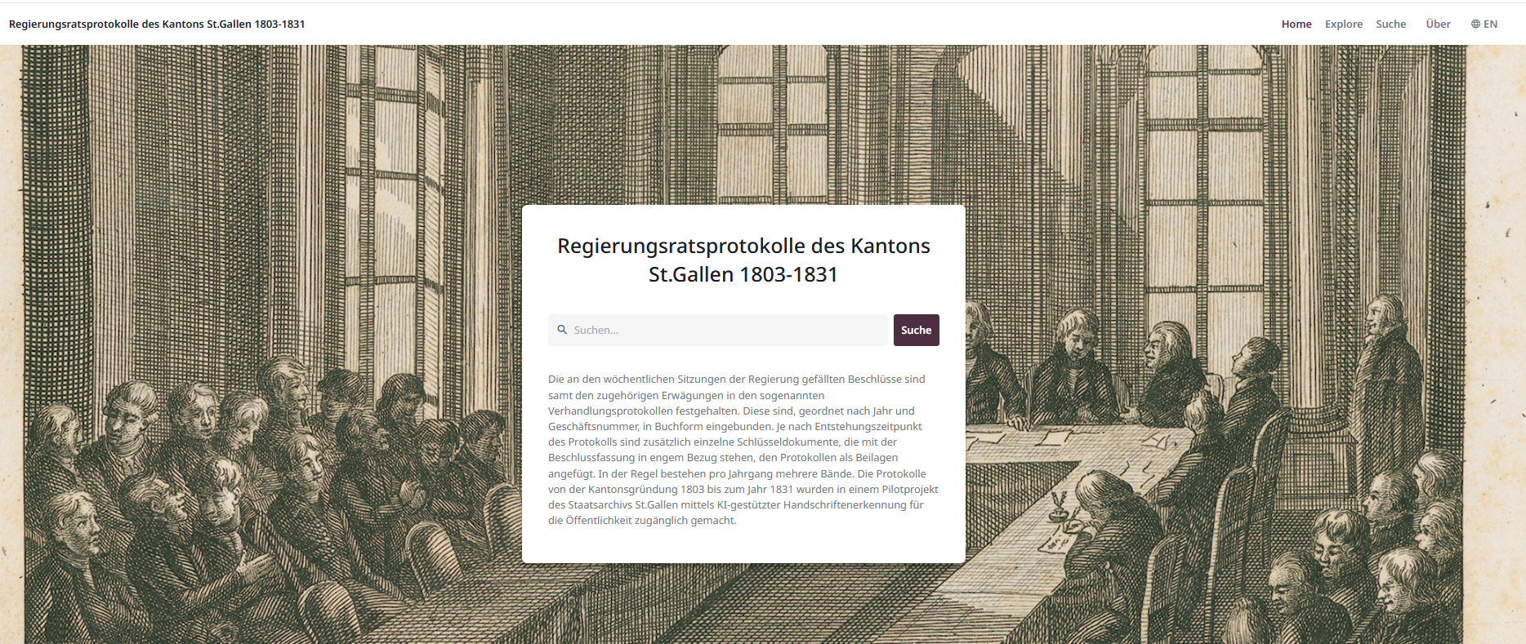
St. Gallen Archives
Publishing Council Minutes with Transkribus Sites
~200,000 pages of council minutes
Mixed handwritten and typewritten material
Used Transkribus Sites to publish an organised, searchable collection online.

Slide 51
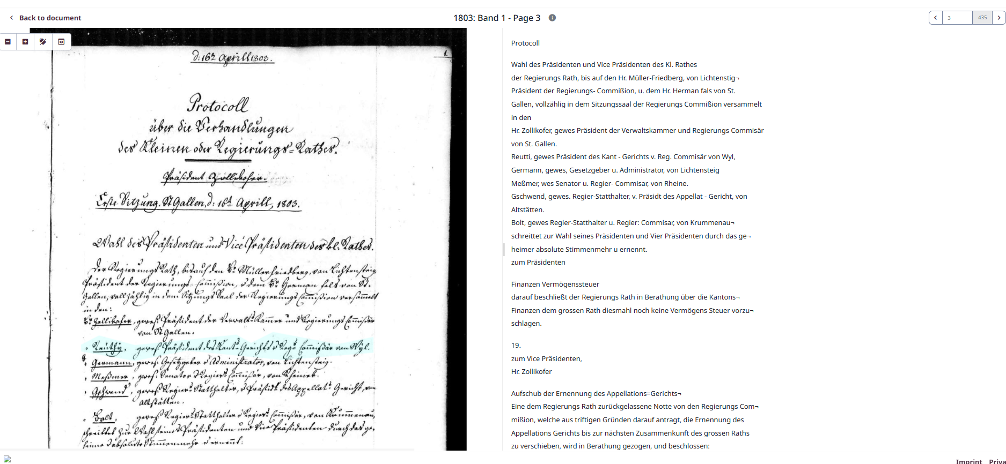
St. Gallen Archives

Slide 52
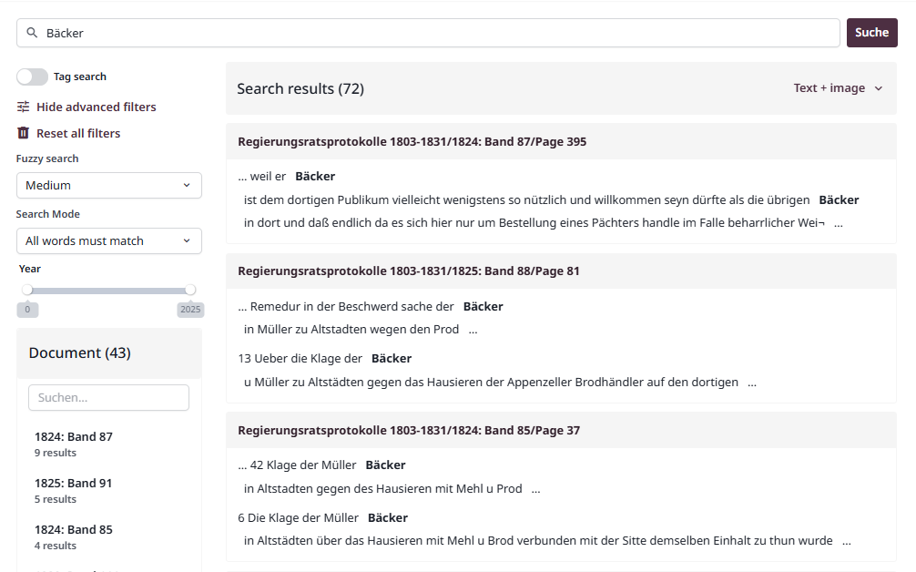
St. Gallen Archives

Slide 53
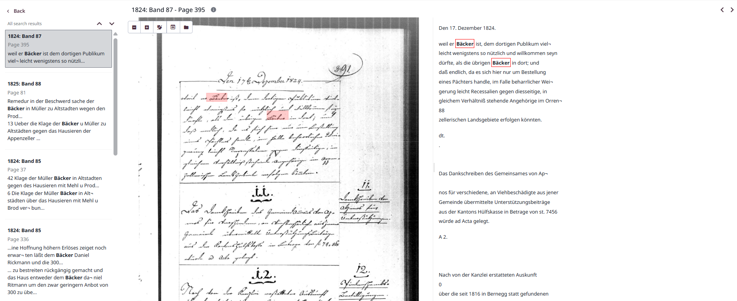
St. Gallen Archives

Slide 54

Unlocking the past, together

