Slide 1


Slide 2
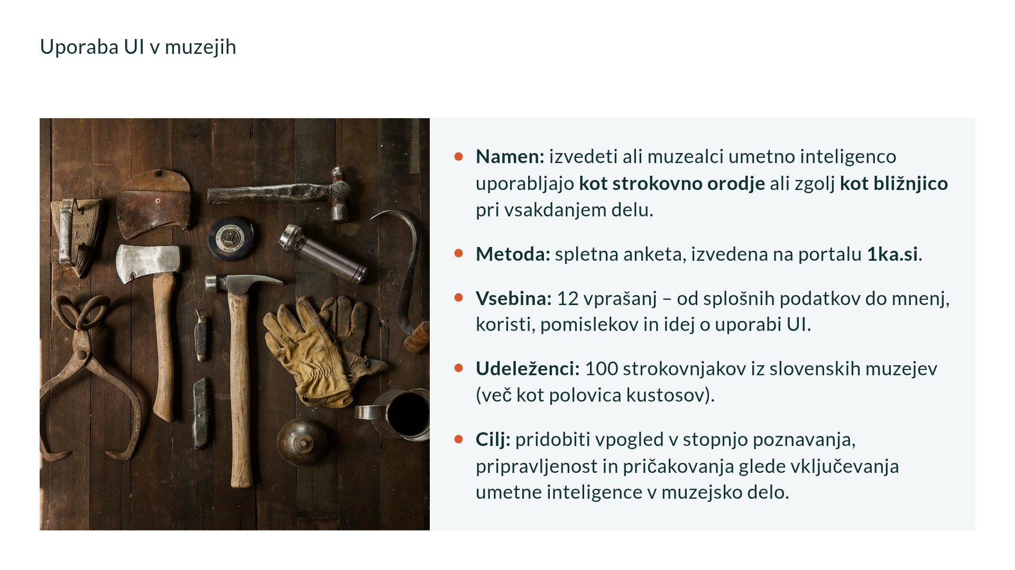

Slide 3
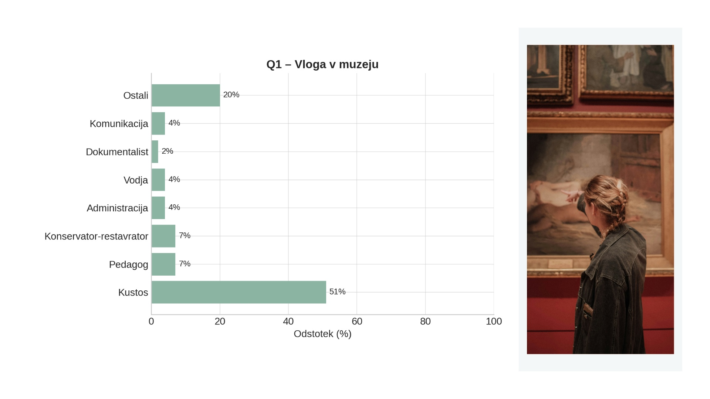

Slide 4
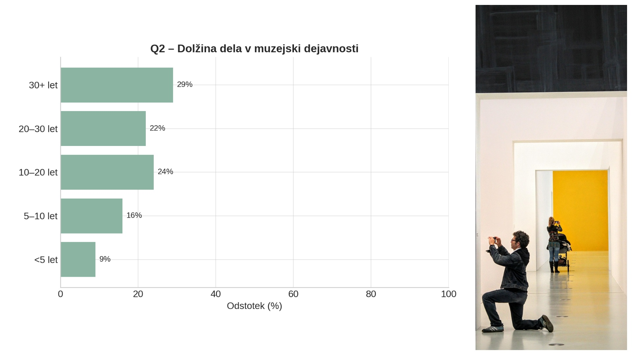

Slide 5
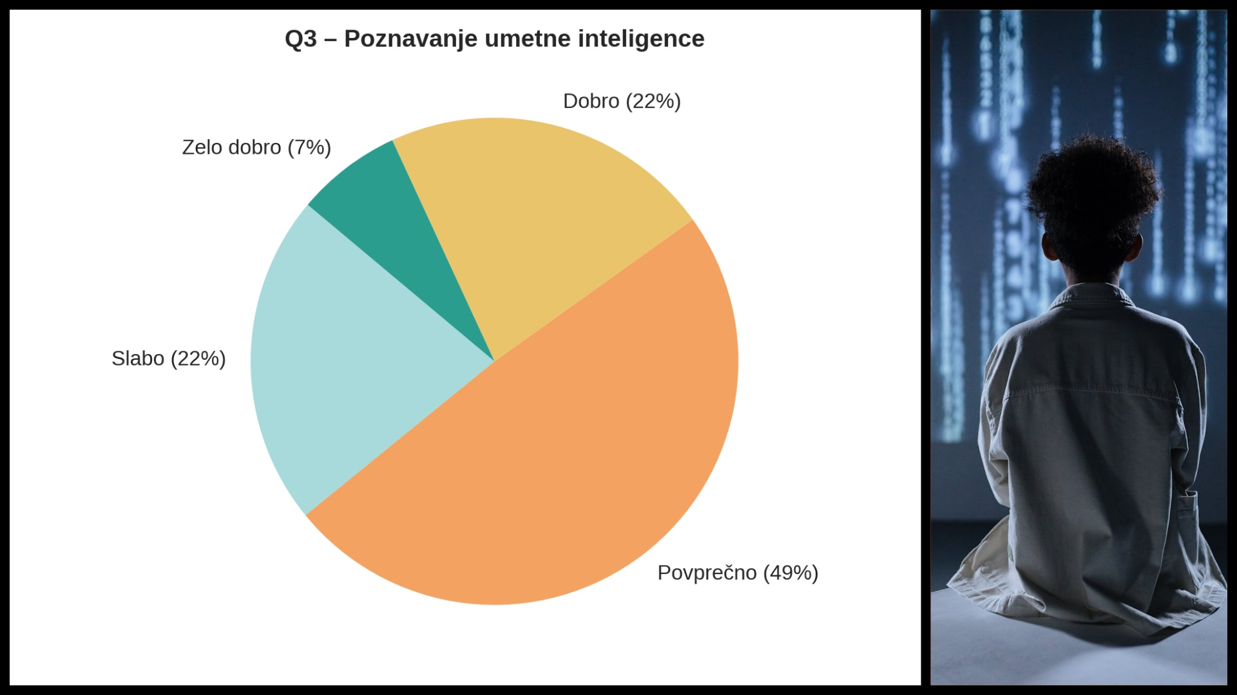

Slide 6
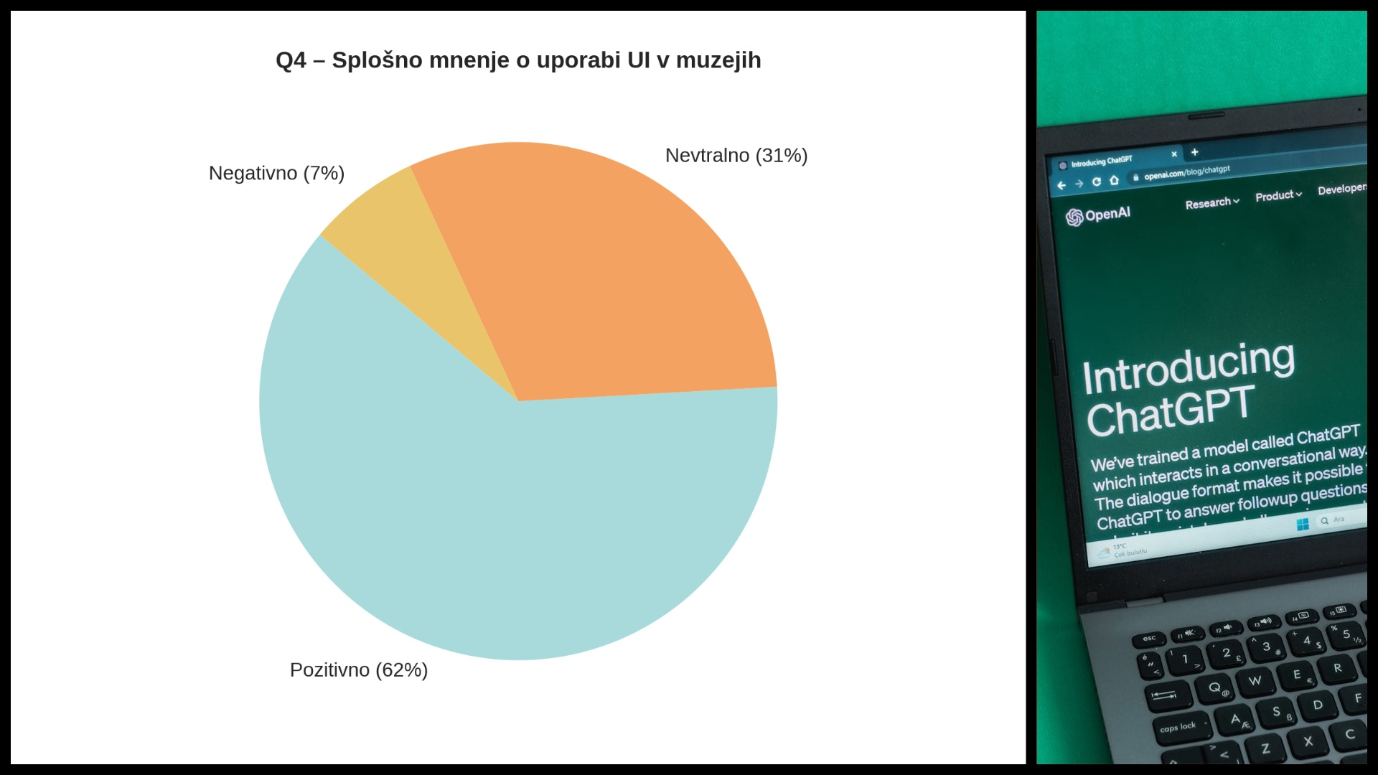

Slide 7


Slide 8
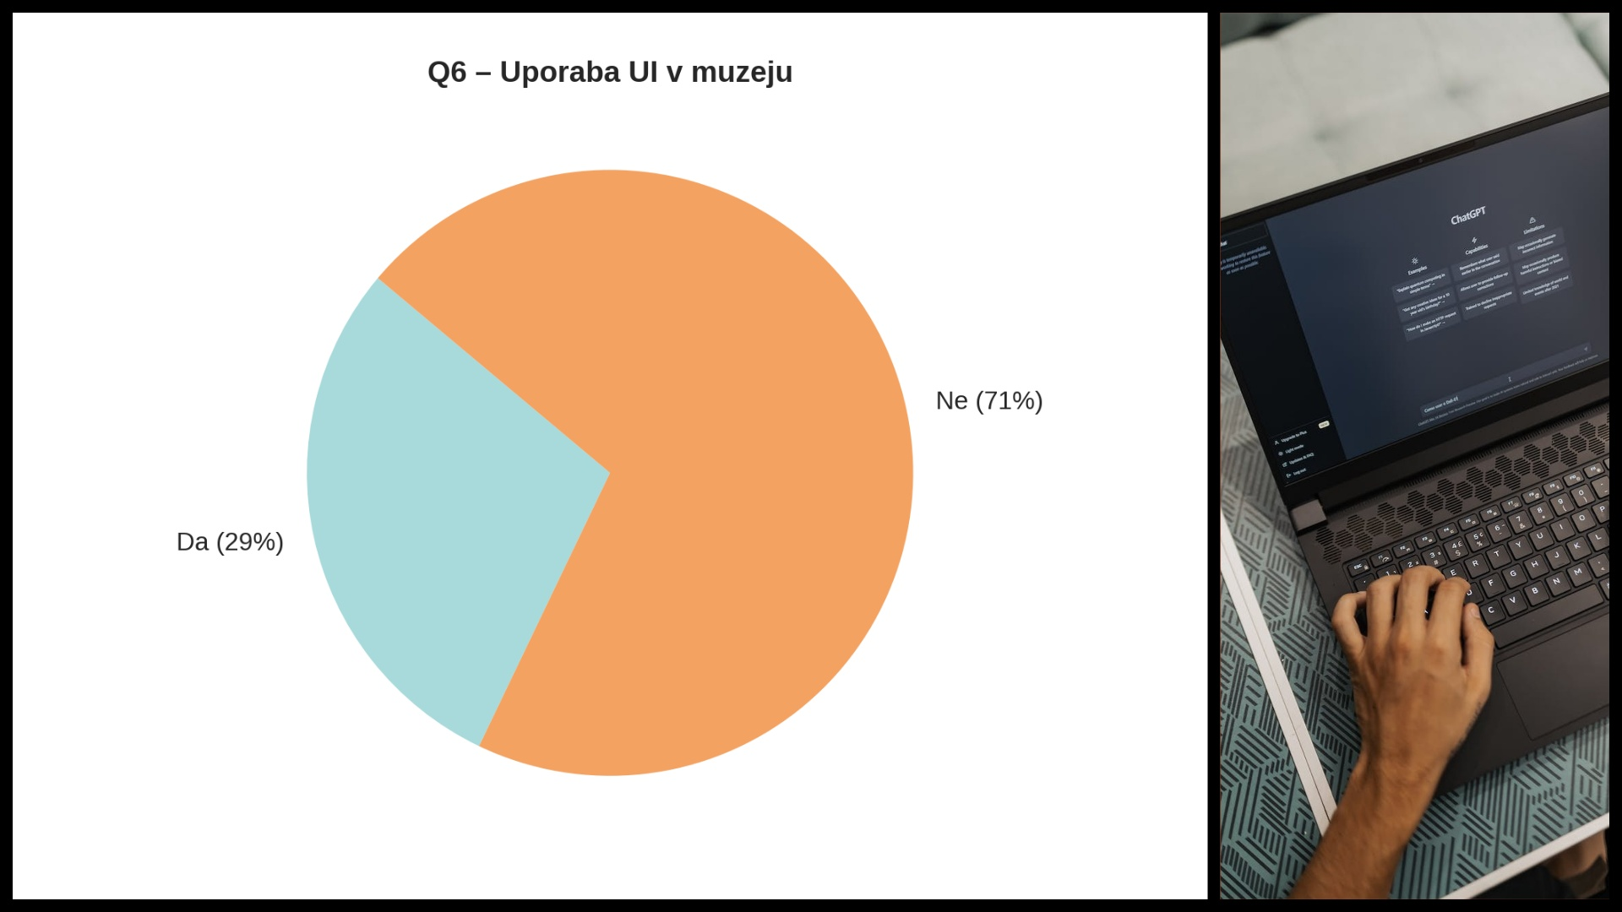

Slide 9
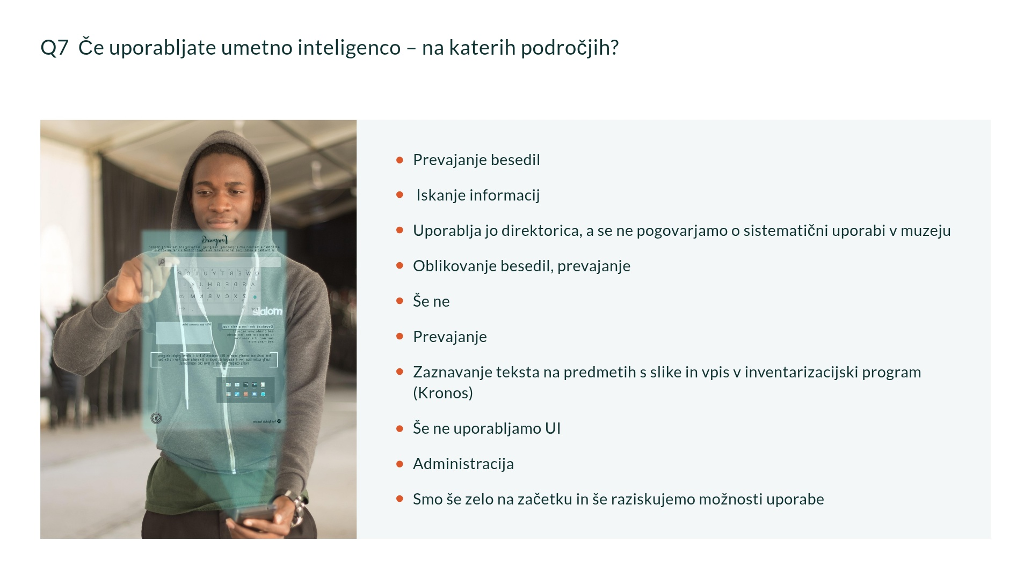

Slide 10
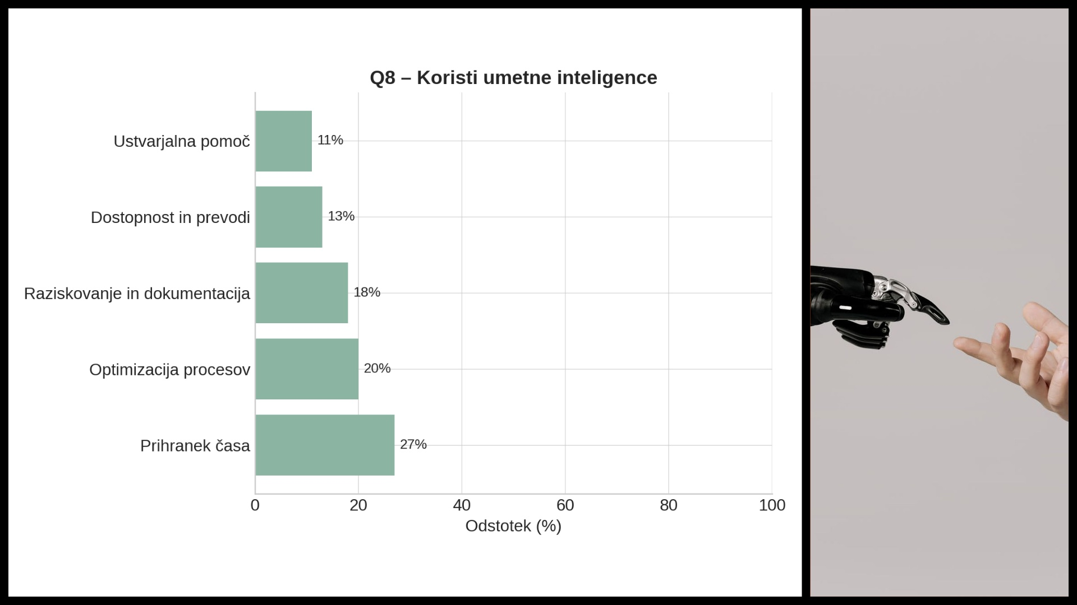

Slide 11
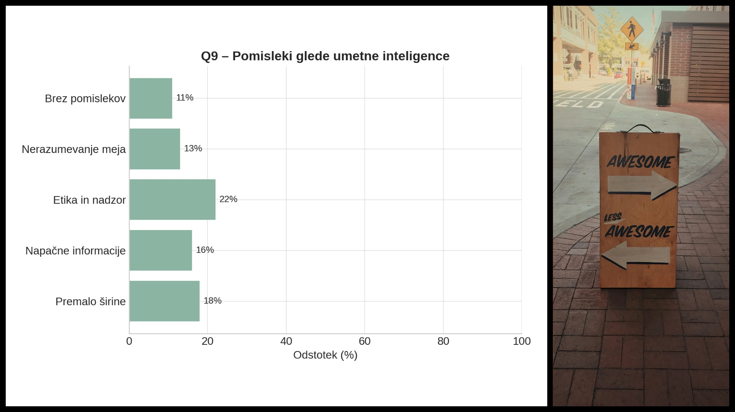

Slide 12
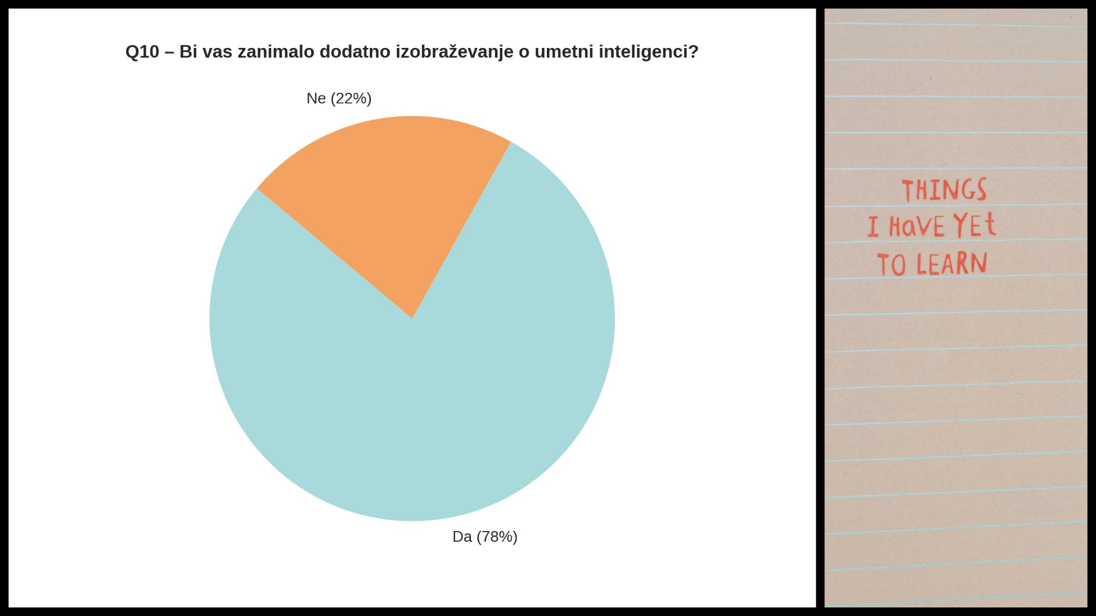

Slide 13
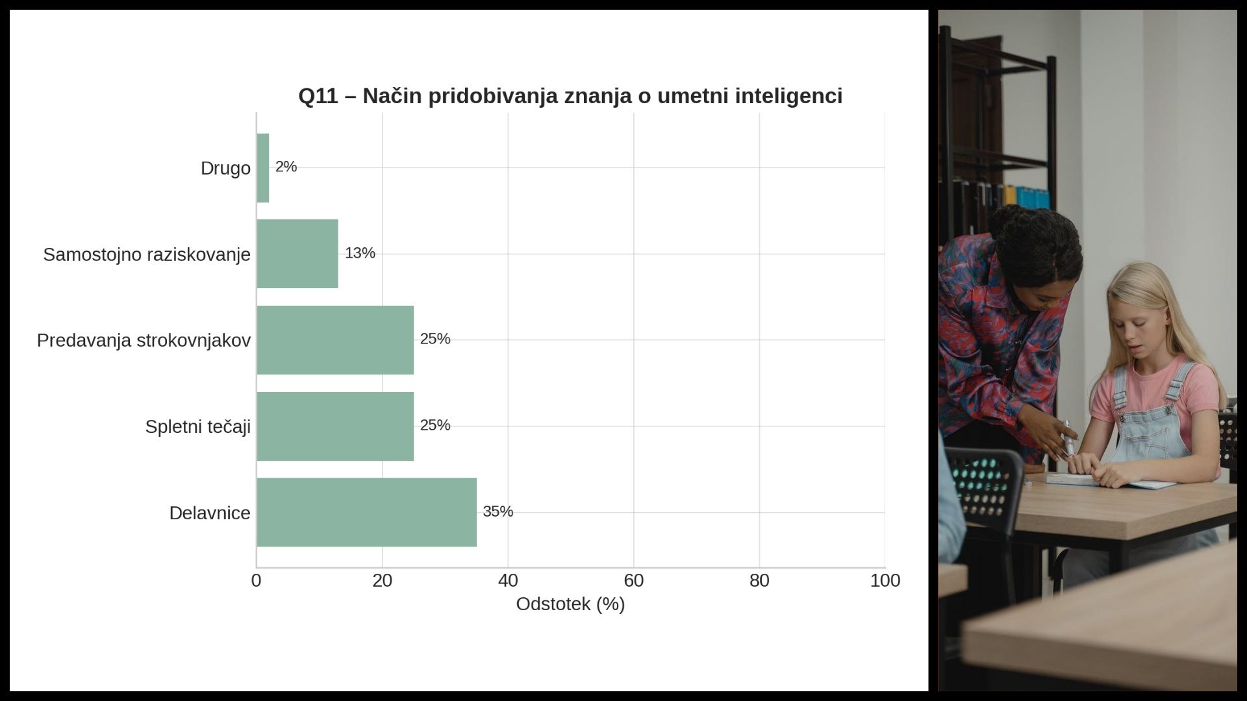

Slide 14
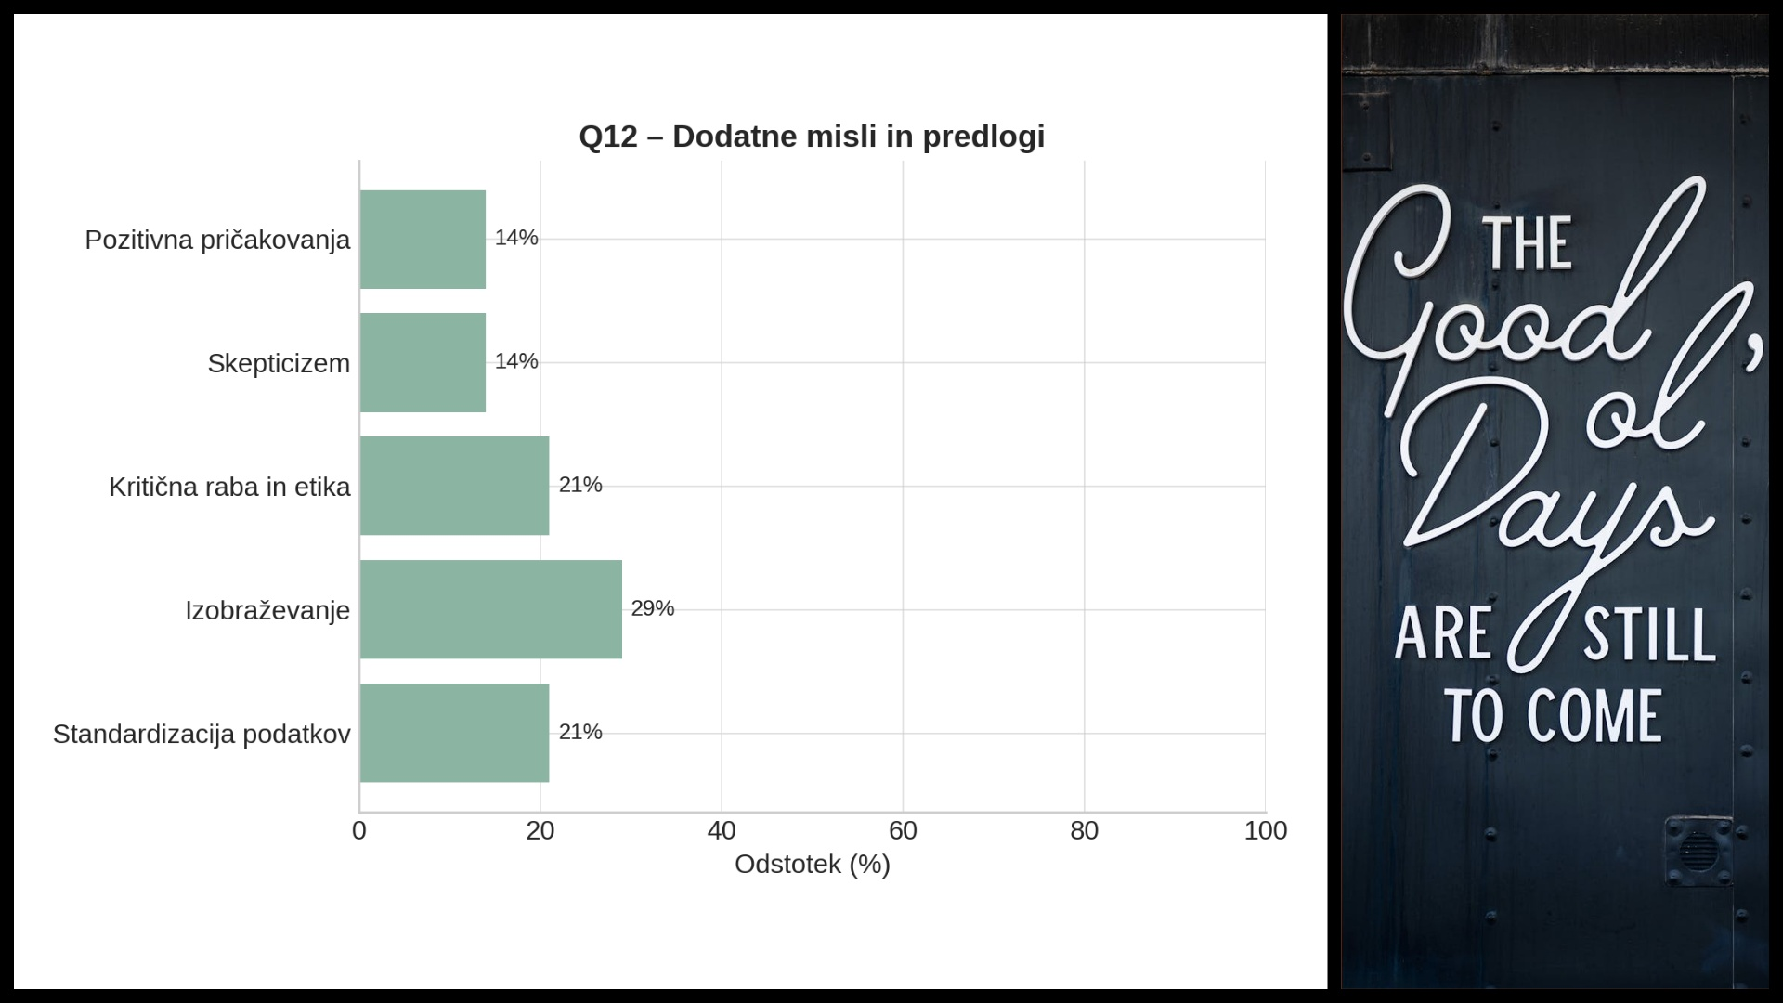

Slide 15


Slide 16


Slide 17


Slide 18

Notes:
Video URL: https://www.youtube.com/watch?v=BIDaxl4xqJ4&t=38s

Slide 19

Notes:
Video URL: https://www.youtube.com/watch?v=F5lfIHjI2Vs

Slide 20


